Slide 1
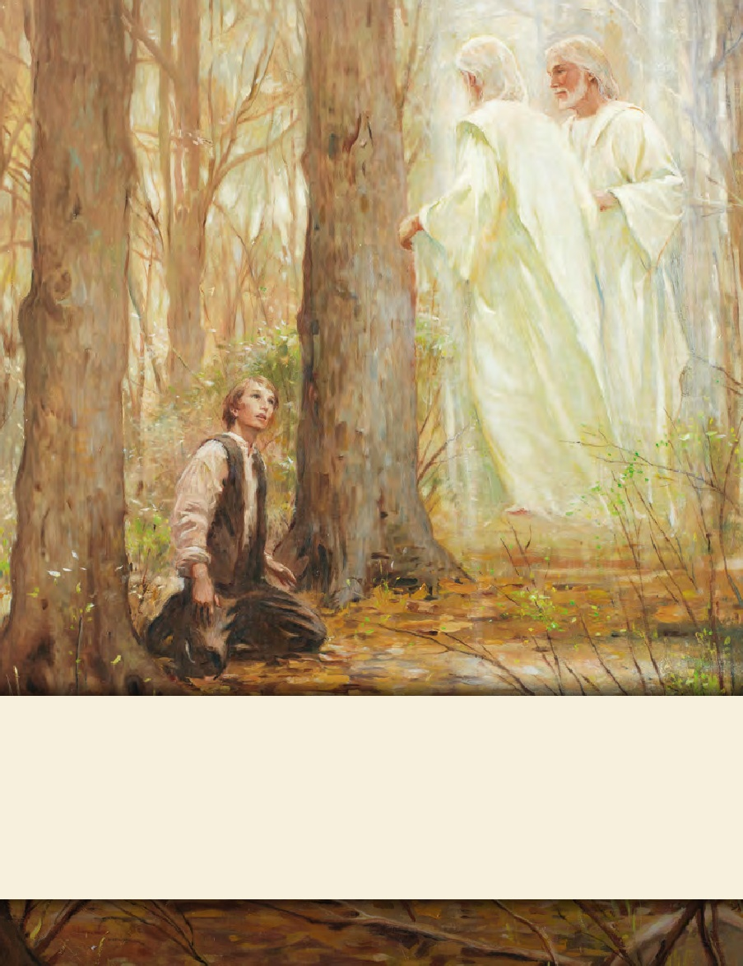
LESSON 15
SEMINARY
Doctrine and Covenants
and Church History

Slide 2
LESSON 103
Doctrine and Covenants 99-100.

Slide 3
LESSON 103
Doctrine and Covenants 99.
“The Lord calls John Murdock to
proclaim the gospel”

Slide 4
LESSON 103
How would you answer this question?
John Murdock investigated many churches and concluded that all religions had lost their way. However, in late 1830, he read the Book of Mormon and felt the Holy Ghost bear witness of its truth. He was baptized on November5, 1830. Shortly thereafter, he served a mission, baptizing about 70 people in four months in Orange, Ohio, and Warrensville, Ohio. On April30, 1831, shortly after Brother Murdock returned from his mission, his wife, Julia, died after giving birth to twins. In June 1831, the Lord called him to go to Missouri and preach the gospel along the way (seeD&C 52:8–9). Before he could go, he needed to make sure his five children, all under the age of seven, were provided for. He arranged for several individuals to care for his older children, and Joseph and Emma Smith adopted the infant twins. For the rest of 1831 and the first half of 1832, John Murdock preached in Michigan Territory, Indiana, Missouri, and Ohio. When he returned to Hiram, Ohio, in June 1832, he was suffering from the effects of a long illness. He learned that one of his twins had been sick and had died because of exposure to the cold during an attack on Joseph Smith.

Slide 5
LESSON 103
What stands out to you from this account of John Murdock?
Doctrine and Covenants 99:1.
Behold, thus saith the Lord unto my servant John Murdock—thou art called to go into the eastern countries from house to house, from village to village, and from city to city, to proclaim mine everlasting gospel unto the inhabitants thereof, in the midst of persecution and wickedness.
What did the Lord call John Murdock to do?
How might this mission call have tested Brother Murdock’s faith and obedience?

Slide 6
LESSON 103
Doctrine and Covenants 99:2-3.
2 And who receiveth you receiveth me; and you shall have power to declare my word in the demonstration of my Holy Spirit.
3 And who receiveth you as a little child, receiveth my kingdom; and blessed are they, for they shall obtain mercy.
What doctrines and principles can we learn from verses 2–3?
We represent the Lord when we serve missions. When we receive and follow the Lord’s servants, we are receiving and following Him.
How have you been blessed as you have followed the Lord’s servants?
Doctrine and Covenants 99:4-5.
4 And whoso rejecteth you shall be rejected of my Father and his house; and you shall cleanse your feet in the secret places by the way for a testimony against them.
5 And behold, and lo, I come quickly to judgment, to convince all of their ungodly deeds which they have committed against me, as it is written of me in the volume of the book.
What is a consequence of rejecting the gospel message preached by the Lord’s servants?

Slide 7
LESSON 103
Doctrine and Covenants 99:6-8.
6 And now, verily I say unto you, that it is not expedient that you should go until your children are provided for, and sent up kindly unto the bishop of Zion.
7 And after a few years, if thou desirest of me, thou mayest go up also unto the goodly land, to possess thine inheritance;
8 Otherwise thou shalt continue proclaiming my gospel until thou be taken. Amen.
What do the Lord’s words to John Murdock show us?

Slide 8
LESSON 103
Doctrine and Covenants 100:1-12.
“The Lord gives Joseph Smith and Sidney Rigdon words of comfort and instruction”

Slide 9
LESSON 103
What are some concerns that missionaries might have as they begin their missions?
How will I find people to teach?
How will I know what to say?
Will my family be okay while I am gone?
Will I get along with my companions?

Slide 10
LESSON 103
Introduction to Doctrine and Covenants 100
Revelation given to Joseph Smith the Prophet and Sidney Rigdon, at Perrysburg, New York, October 12, 1833. The two brethren, having been absent from their families for several days, felt some concern about them.
Doctrine and Covenants 100:1-2.
1 Verily, thus saith the Lord unto you, my friends Sidney and Joseph, your families are well; they are in mine hands, and I will do with them as seemeth me good; for in me there is all power.
2 Therefore, follow me, and listen to the counsel which I shall give unto you.
What phrases in these verses might have eased Joseph Smith and Sidney Rigdon’s concern?
How might these verses help missionaries today?

Slide 11
LESSON 103
Doctrine and Covenants 100:3-4.
3 Behold, and lo, I have much people in this place, in the regions round about; and an effectual door shall be opened in the regions round about in this eastern land.
4 Therefore, I, the Lord, have suffered you to come unto this place; for thus it was expedient in me for the salvation of souls.
What do you think it means to have “an effectual door” opened for the sharing of the gospel?
What are some ways the Lord “opens doors” for us to do missionary work?

Slide 12
LESSON 103
Doctrine and Covenants 100:5-8.
5 Therefore, verily I say unto you, lift up your voices unto this people; speak the thoughts that I shall put into your hearts, and you shall not be confounded before men;
6 For it shall be given you in the very hour, yea, in the very moment, what ye shall say.
7 But a commandment I give unto you, that ye shall declare whatsoever thing ye declare in my name, in solemnity of heart, in the spirit of meekness, in all things.
8 And I give unto you this promise, that inasmuch as ye do this the Holy Ghost shall be shed forth in bearing record unto all things whatsoever ye shall say.
we will lift up our voices to share the gospel
the Lord will help us know what to say.
If______________ ___ _, then__ __________________.
How does the Lord want missionaries to preach the gospel?
What does the Lord promise if we preach the gospel with “solemnity of heart” and “in the spirit of meekness”?
If we share the gospel with others in solemnity of heart and in the spirit of meekness, then the Holy Ghost will bear witness of our message.

Slide 13
LESSON 103
Doctrine and Covenants 100:9-12.
9 And it is expedient in me that you, my servant Sidney, should be a spokesman unto this people; yea, verily, I will ordain you unto this calling, even to be a spokesman unto my servant Joseph.
10 And I will give unto him power to be mighty in testimony.
11 And I will give unto thee power to be mighty in expounding all scriptures, that thou mayest be a spokesman unto him, and he shall be a revelator unto thee, that thou mayest know the certainty of all things pertaining to the things of my kingdom on the earth.
12 Therefore, continue your journey and let your hearts rejoice; for behold, and lo, I am with you even unto the end.
Why could Joseph Smith and Sidney Rigdon “let [their] hearts rejoice”?
What might the promise in verse 12 mean to you if you were serving a mission?

Slide 14
LESSON 103
Doctrine and Covenants 100:13-17.
“The Lord comforts Joseph Smith and Sidney Rigdon concerning the trials of the Saints in Missouri”

Slide 15
LESSON 103
Doctrine and Covenants 100:13-17.
13 And now I give unto you a word concerning Zion. Zion shall be redeemed, although she is chastened for a little season.
14 Thy brethren, my servants Orson Hyde and John Gould, are in my hands; and inasmuch as they keep my commandments they shall be saved.
15 Therefore, let your hearts be comforted; for all things shall work together for good to them that walk uprightly, and to the sanctification of the church.
16 For I will raise up unto myself a pure people, that will serve me in righteousness;
17 And all that call upon the name of the Lord, and keep his commandments, shall be saved. Even so. Amen.
What promise do you see in verses 15–17?
All things will work together for our good if we walk uprightly before the Lord.
What do you think it means to “walk uprightly” before the Lord?
How might the promise in verses 15–17 help you during difficult times?

