Slide 1
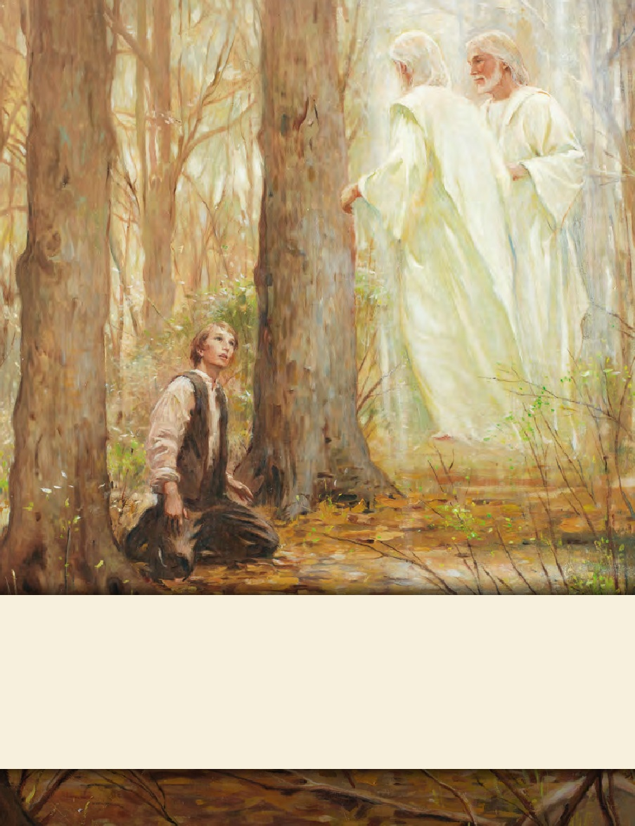
LESSON 15
SEMINARY
Doctrine and Covenants
and Church History

Slide 2
LESSON 102
Doctrine and Covenants 98:23-48.

Slide 3
LESSON 102
Doctrine and Covenants 98:23-32.
“The Lord reveals how the Saints are to
respond to persecution”

Slide 4
LESSON 102
The Lord’s Law on Retaliation (D&C 98:23–32) | The Lord’s Law on War (D&C 98:33–38) | The Lord’s Law on Forgiveness (D&C 98:39–48)

Slide 5
LESSON 102
Doctrine and Covenants 98:23–27
23 Now, I speak unto you concerning your families—if men will smite you, or your families, once, and ye bear it patiently and revile not against them, neither seek revenge, ye shall be rewarded;
24 But if ye bear it not patiently, it shall be accounted unto you as being meted out as a just measure unto you.
25 And again, if your enemy shall smite you the second time, and you revile not against your enemy, and bear it patiently, your reward shall be an hundred-fold.
26 And again, if he shall smite you the third time, and ye bear it patiently, your reward shall be doubled unto you four-fold;
27 And these three testimonies shall stand against your enemy if he repent not, and shall not be blotted out.
What repeated phrases teach about retaliation?
What did the Lord promise the Saints if they would bear persecution patiently and not seek revenge?
What principle can we learn from the Lord’s words in verses 23–27?
If we bear mistreatment patiently and without retaliating, the Lord will reward us.
The Lord’s Law on Retaliation

Slide 6
LESSON 102
“The mob caught Bishop Edward Partridge and Charles Allen, and dragged them through the maddened crowd, which insulted and abused them along the road to the public square. Here two alternatives were presented them; either they must renounce their faith in the Book of Mormon or leave the county. The Book of Mormon they would not deny, nor consent to leave the county. Bishop Partridge, being permitted to speak, said that the saints had to suffer persecution in all ages of the world, and that he was willing to suffer for the sake of Christ,
as the saints in former ages had done; that he had done nothing which ought to offend anyone, and that if they abused him, they would injure an innocent man. Here his voice was drowned by the tumult of the crowd, many of whom were shouting: ‘Call upon your God to deliver you…!’ The two brethren, Partridge and Allen, were stripped of their clothing, and bedaubed with tar, mixed with lime, or pearl-ash, or some other flesh-eating acid, and a quantity of feathers scattered over them. They bore this cruel indignity and abuse with so much resignation and meekness that the crowd grew still, and appeared astonished at what they witnessed. The brethren were permitted to retire in silence” (B. H. Roberts, A Comprehensive History of the Church,1:333; see also Church History in the Fulness of Times Student Manual,2nd ed. [Church Educational System manual], 2003,133).
What impresses you about how Charles Allen and Bishop Partridge responded to persecution?

Slide 7
LESSON 102
Doctrine and Covenants 98:32-38.
“The Lord explains when war is justified”

Slide 8
LESSON 102
What do you think the Lord’s law on war is?
Doctrine and Covenants 98:32-34.
32 Behold, this is the law I gave unto my servant Nephi, and thy fathers, Joseph, and Jacob, and Isaac, and Abraham, and all mine ancient prophets and apostles.
33 And again, this is the law that I gave unto mine ancients, that they should not go out unto battle against any nation, kindred, tongue, or people, save I, the Lord, commanded them.
34 And if any nation, tongue, or people should proclaim war against them, they should first lift a standard of peace unto that people, nation, or tongue;
What was the law given to ancient prophets?
The Lord’s Law on War.
What were the ancient prophets to do if someone declared war against them?
The Lord’s Law on War.

Slide 9
LESSON 102
Doctrine and Covenants 98:35-38.
35 And if that people did not accept the offering of peace, neither the second nor the third time, they should bring these testimonies before the Lord;
36 Then I, the Lord, would give unto them a commandment, and justify them in going out to battle against that nation, tongue, or people.
37 And I, the Lord, would fight their battles, and their children’s battles, and their children’s children’s, until they had avenged themselves on all their enemies, to the third and fourth generation.
38 Behold, this is an ensample unto all people, saith the Lord your God, for justification before me.
What can we learn from these verses about the Lord’s law on war?
War can be justified under circumstances prescribed by the Lord.
The Lord’s Law on War.

Slide 10
LESSON 102
Based on what we have learned about the Lord’s counsel on war, what should we do when we disagree with others?
We should seek peaceful resolutions to our disagreements.
What blessings might come from seeking peaceful resolutions?

Slide 11
LESSON 102
Doctrine and Covenants 98:39-48.
“The Lord teaches the Saints how they should respond to their enemies”

Slide 12
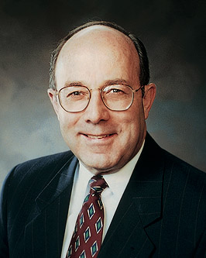
LESSON 102
“In Holland during World War II, the Casper ten Boom family used their home as a hiding place for those hunted by the Nazis. This was their way of living out their Christian faith. Four members of the family lost their lives for providing this refuge. Corrie ten Boom and her sister Betsie spent horrific months in the infamous Ravensbrück concentration camp. Betsie died there—Corrie survived.
“In Ravensbrück, Corrie and Betsie learned that God helps us to forgive. Following the war, Corrie was determined to share this message. On one occasion, she had just spoken to a group of people in Germany suffering from the ravages of war. Her message was ‘God forgives.’ It was then that Corrie ten Boom’s faithfulness brought forth its blessing.
“A man approached her. She recognized him as one of the cruelest guards in the camp. ‘You mentioned Ravensbrück in your talk,’ he said. ‘I was a guard there. … But since that
Elder
Keith B. Mcmullin
time, … I have become a Christian.’ He explained that he had sought God’s forgiveness for the cruel things he had done. He extended his hand and asked, ‘Will you forgive me?’
“Corrie ten Boom then said:
“‘It could not have been many seconds that he stood there—hand held out—but to me it seemed hours as I wrestled with the most difficult thing I had ever had to do.
“‘…The message that God forgives has a … condition: that we forgive those who have injured us.…
“…‘Help me!’ I prayed silently. ‘I can lift my hand. I can do that much. You supply the feeling.’
“‘…Woodenly, mechanically, I thrust my hand into the one stretched out to me. As I did, an incredible thing took place. The current started in my shoulder, raced down my arm, sprang into our joined hands. And then this healing warmth seemed to flood my whole being, bringing tears to my eyes. “‘I forgive you, brother!’ I cried. ‘With all my heart.’ “For a long moment we grasped each other’s hands, the former guard and the former prisoner. I had never known God’s love so intensely, as I did then.’ [Corrie ten Boom, Tramp for the Lord (1974), 54–55.]” (KeithB. McMullin,“ Our Path of Duty,” Ensignor Liahona, May 2010,13).

Slide 13
LESSON 102
What impresses you about this account?
Doctrine and Covenants 98:39-40.
39 And again, verily I say unto you, if after thine enemy has come upon thee the first time, he repent and come unto thee praying thy forgiveness, thou shalt forgive him, and shalt hold it no more as a testimony against thine enemy—
40 And so on unto the second and third time; and as oft as thine enemy repenteth of the trespass wherewith he has trespassed against thee, thou shalt forgive him, until seventy times seven.
What should we do when someone asks for forgiveness?
How many times are we to forgive someone who repents and seeks our forgiveness?
“Until seventy times seven”
“Until seventy times seven”

Slide 14
LESSON 102
Doctrine and Covenants 98:41-43.
41 And if he trespass against thee and repent not the first time, nevertheless thou shalt forgive him.
42 And if he trespass against thee the second time, and repent not, nevertheless thou shalt forgive him.
43 And if he trespass against thee the third time, and repent not, thou shalt also forgive him.
Why would these truths have been important for the Saints in Missouri to understand?
How would you summarize the Lord’s law on forgiveness?
He Lord has commanded us to forgive our enemies
The Lord’s Law on Forgiveness.
Why do you think we are commanded to forgive others even if they don’t ask for forgiveness?

