Slide 1
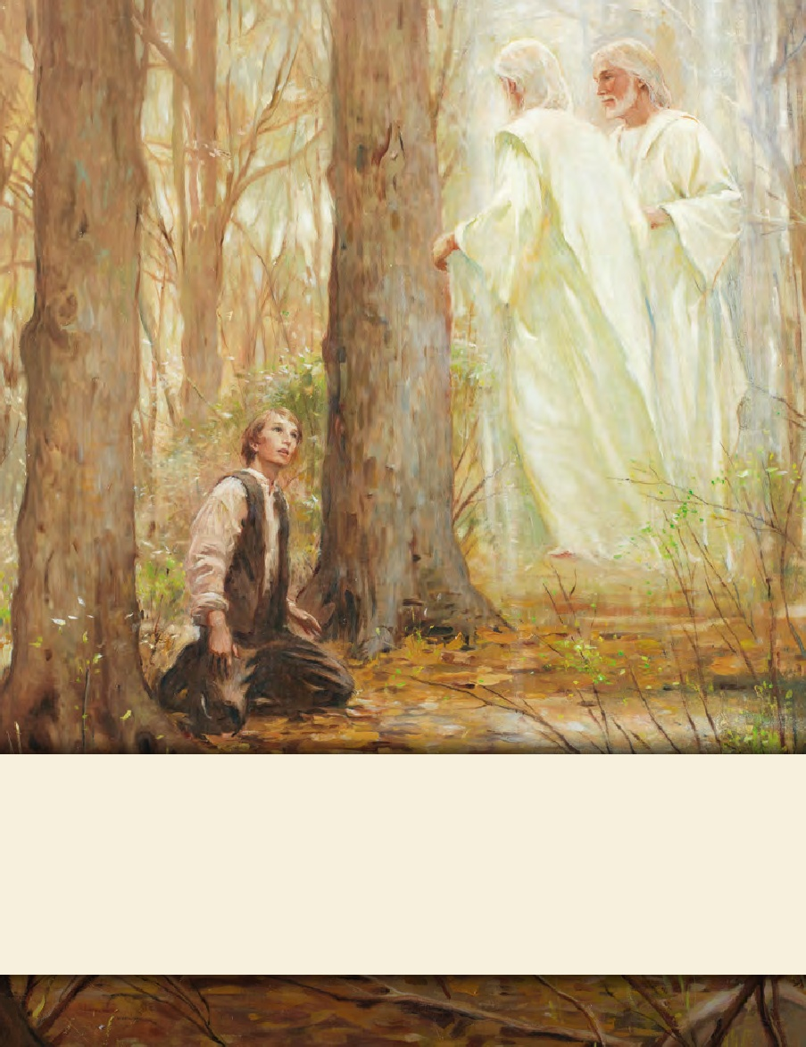
LESSON 15
SEMINARY
Doctrine and Covenants
and Church History

Slide 2
LESSON 100
Doctrine and Covenants 97.

Slide 3
LESSON 100
Doctrine and Covenants 97:1–9.
“The Lord teaches members of the school of elders in Missouri what they must do to be accepted of Him”

Slide 4
LESSON 100
I go to school because…
I go to church because…
Doctrine and Covenants 97:1.
Verily I say unto you my friends, I speak unto you with my voice, even the voice of my Spirit, that I may show unto you my will concerning your brethren in the land of Zion, many of whom are truly humble and are seeking diligently to learn wisdom and to find truth.
How did the Lord describe many of the brethren in Missouri?

Slide 5
LESSON 100
Doctrine and Covenants 97:2.
Verily, verily I say unto you, blessed are such, for they shall obtain; for I, the Lord, show mercy unto all the meek, and upon all whomsoever I will, that I may be justified when I shall bring them unto judgment.
What principle do you see regarding how we can obtain wisdom and truth?
If we humble ourselves and seek diligently to learn, we will obtain wisdom and truth.
How do you think humility and diligence help us obtain wisdom and truth?
Doctrine and Covenants 97:3-5.
3 Behold, I say unto you, concerning the school in Zion, I, the Lord, am well pleased that there should be a school in Zion, and also with my servant Parley P. Pratt, for he abideth in me.
4 And inasmuch as he continueth to abide in me he shall continue to preside over the school in the land of Zion until I shall give unto him other commandments.
5 And I will bless him with a multiplicity of blessings, in expounding all scriptures and mysteries to the edification of the school, and of the church in Zion.

Slide 6
LESSON 100
What do you think the fruits represent?
Church members’ works or actions.
Doctrine and Covenants 97:6
-7.
6 And to the residue of the school, I, the Lord, am willing to show mercy; nevertheless, there are those that must needs be chastened, and their works shall be made known.
7 The ax is laid at the root of the trees; and every tree that bringeth not forth good fruit shall be hewn down and cast into the fire. I, the Lord, have spoken it.

Slide 7
LESSON 100
Doctrine and Covenants 97:8-9.
8 Verily I say unto you, all among them who know their hearts are honest, and are broken, and their spirits contrite, and are willing to observe their covenants by sacrifice—yea, every sacrifice which I, the Lord, shall command—they are accepted of me.
9 For I, the Lord, will cause them to bring forth as a very fruitful tree which is planted in a goodly land, by a pure stream, that yieldeth much precious fruit.
What are some principles taught in these verses?
How might the descriptions of what happens to the trees motivate us to be more faithful?

Slide 8
LESSON 100
To be accepted of the Lord, we must…
Doctrine and Covenants 97:8.
Verily I say unto you, all among them who know their hearts are honest, and are broken, and their spirits contrite, and are willing to observe their covenants by sacrifice—yea, every sacrifice which I, the Lord, shall command—they are accepted of me.
To be accepted of the Lord we must have an honest and broken heart and a contrite spirit and be willing to observe our covenants by sacrifice.
What do you think it means to have a broken heart and a contrite spirit?
What do you think it means to observe our covenants by sacrifice?
What are some sacrifices you have made in order to keep your covenants?

Slide 9
LESSON 100
Doctrine and Covenants 97:10–21.
“The Lord emphasizes His will that the Saints in Missouri build a temple”

Slide 10
LESSON 100
Doctrine and Covenants 97:10-12.
10 Verily I say unto you, that it is my will that a house should be built unto me in the land of Zion, like unto the pattern which I have given you.
11 Yea, let it be built speedily, by the tithing of my people.
12 Behold, this is the tithing and the sacrifice which I, the Lord, require at their hands, that there may be a house built unto me for the salvation of Zion—
What sacrifice did the Lord require of the Saints in Missouri?
They were to build a temple—a house unto the Lord.

Slide 11
LESSON 100
Doctrine and Covenants 97:12-14.
12 Behold, this is the tithing and the sacrifice which I, the Lord, require at their hands, that there may be a house built unto me for the salvation of Zion—
13 For a place of thanksgiving for all saints, and for a place of instruction for all those who are called to the work of the ministry in all their several callings and offices;
14 That they may be perfected in the understanding of their ministry, in theory, in principle, and in doctrine, in all things pertaining to the kingdom of God on the earth, the keys of which kingdom have been conferred upon you.
How has the temple been “a place of thanks giving” for you?
How has it been “a place of instruction”?

Slide 12
LESSON 100
Doctrine and Covenants 97:15-20.
15 And inasmuch as my people build a house unto me in the name of the Lord, and do not suffer any unclean thing to come into it, that it be not defiled, my glory shall rest upon it;
16 Yea, and my presence shall be there, for I will come into it, and all the pure in heart that shall come into it shall see God.
17 But if it be defiled I will not come into it, and my glory shall not be there; for I will not come into unholy temples.
18 And, now, behold, if Zion do these things she shall prosper, and spread herself and become very glorious, very great, and very terrible.
19 And the nations of the earth shall honor her, and shall say: Surely Zion is the city of our God, and surely Zion cannot fall, neither be moved out of her place, for God is there, and the hand of the Lord is there;
20 And he hath sworn by the power of his might to be her salvation and her high tower.

Slide 13
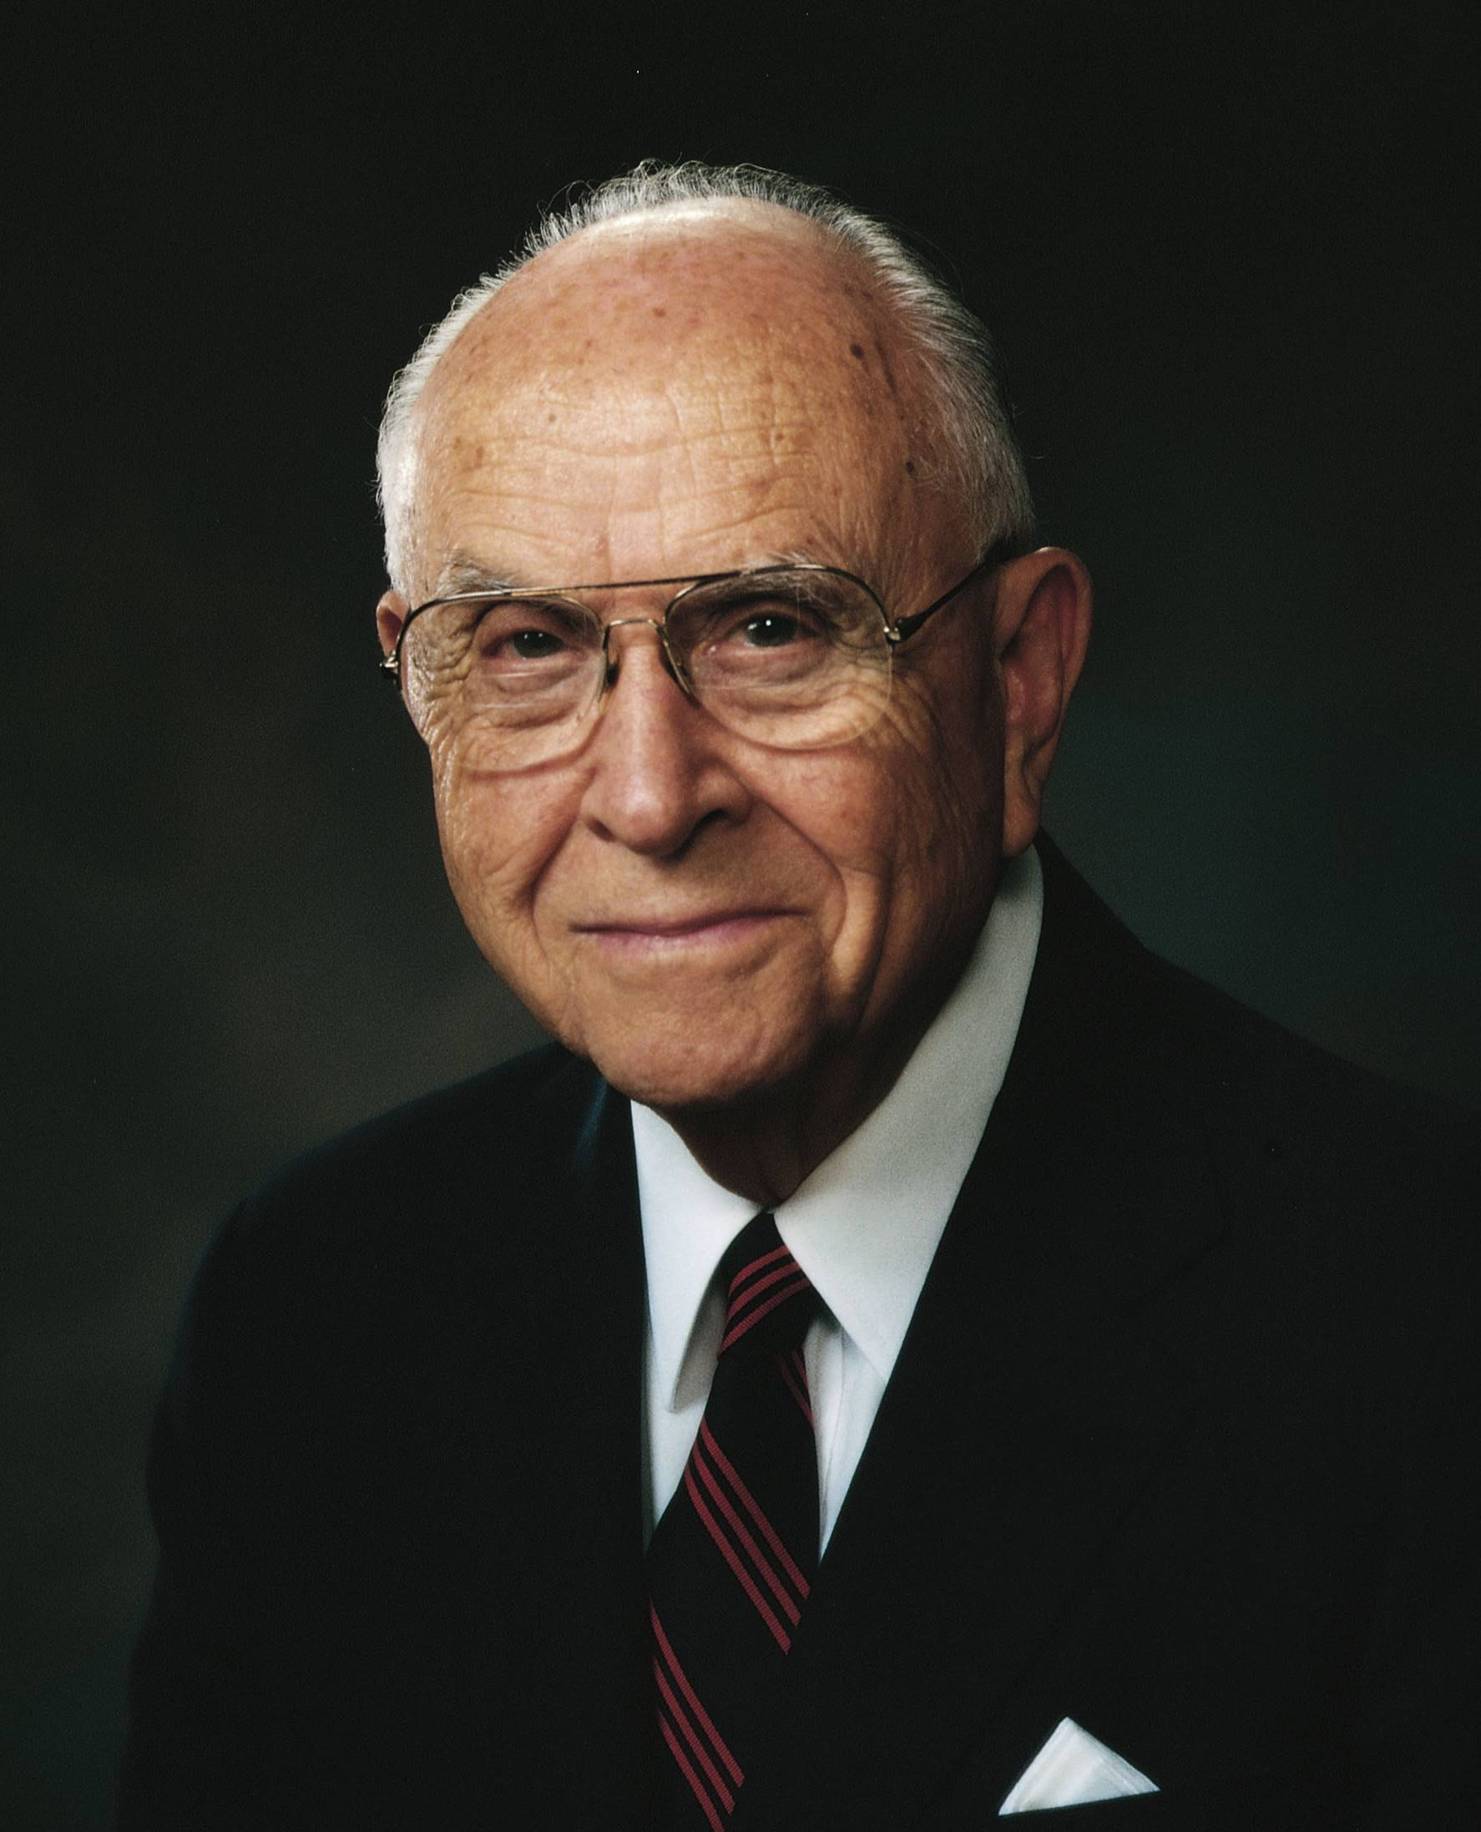
LESSON 100
“It is true that some have actually seen the Savior, but when one consults the dictionary, he learns that there are many other meanings of the word see, such as coming to know Him, discerning Him, recognizing Him and His work, perceiving His importance, or coming to understand Him” (“Temples and Work Therein,” Ensign,Nov. 1990,61).
Elder
David B. Haight
How do we qualify to experience the Lord’s glory and presence in the temple?
In the temple, God will manifest Himself to those who are pure in heart.
What do you think it means to be pure in heart?
What can we do to purify our hearts so we can receive the blessings of the temple?
How have you felt blessed as you have worthily attended the temple?
How have you felt blessed as you have sought to be pure in heart?

Slide 14
LESSON 100
Doctrine and Covenants 97:22–28
“The Lord explains what we must do to escape His indignation and receive His blessings”

Slide 15
LESSON 100
Doctrine and Covenants 97:22-24.
22 For behold, and lo, vengeance cometh speedily upon the ungodly as the whirlwind; and who shall escape it?
23 The Lord’s scourge shall pass over by night and by day, and the report thereof shall vex all people; yea, it shall not be stayed until the Lord come;
24 For the indignation of the Lord is kindled against their abominations and all their wicked works.
How might the Lord’s vengeance be like a whirlwind?

Slide 16
LESSON 100
Doctrine and Covenants 97:25-28.
25 Nevertheless, Zion shall escape if she observe to do all things whatsoever I have commanded her.
26 But if she observe not to do whatsoever I have commanded her, I will visit her according to all her works, with sore affliction, with pestilence, with plague, with sword, with vengeance, with devouring fire.
27 Nevertheless, let it be read this once to her ears, that I, the Lord, have accepted of her offering; and if she sin no more none of these things shall come upon her;
28 And I will bless her with blessings, and multiply a multiplicity of blessings upon her, and upon her generations forever and ever, saith the Lord your God. Amen.
What must we do to escape the Lord’s vengeance and receive His blessings?
How does the Lord’s message in these verses relate to the images of the two trees we discussed earlier?
What do verses 27–28 teach about repentance and forgiveness?
If we are obedient, we will escape the vengeance of the Lord and receive a multiplicity of His blessings.

