Slide 1
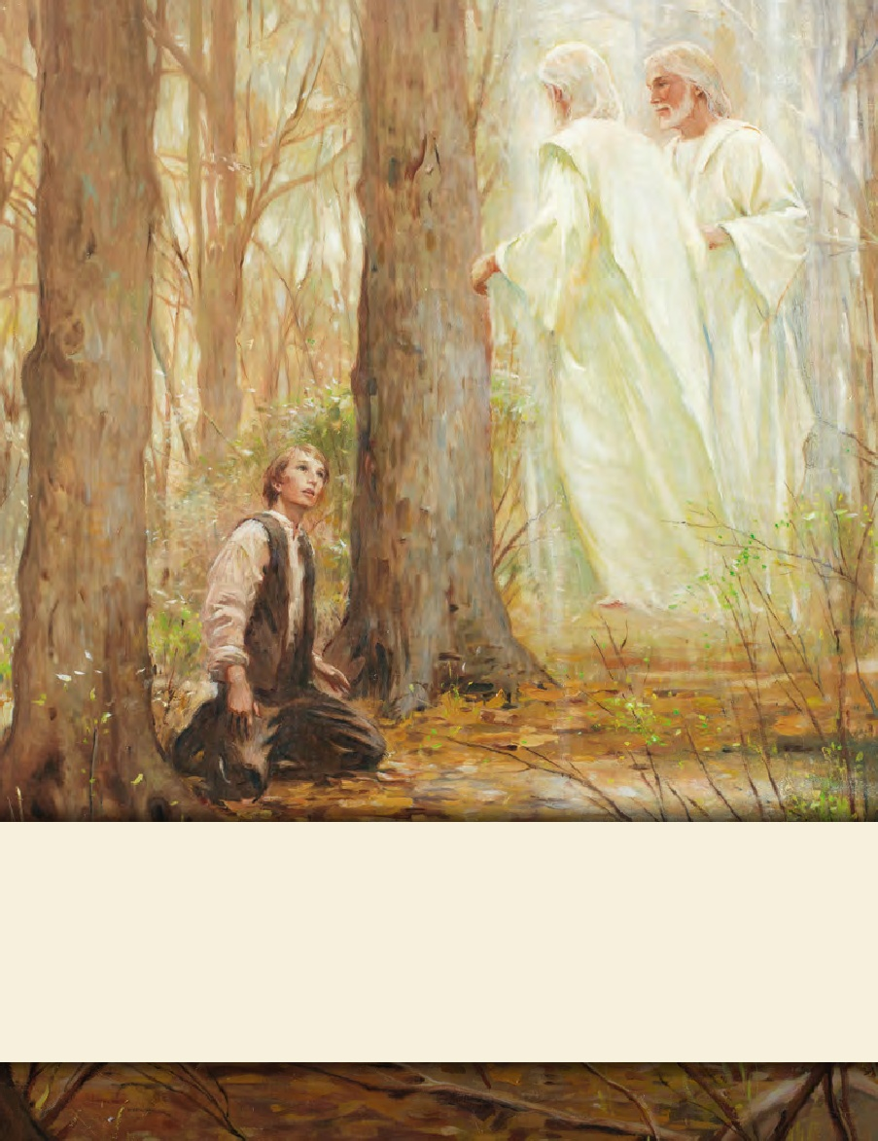
SEMINARY
Doctrine and Covenants
and Church History

Slide 2
LESSON 8
Joseph Smith
History 1:21–26

Slide 3
LESSON 8
Joseph Smith—History 1:21–23
Preachers and other men of high standing stir up persecution against Joseph Smith

Slide 4
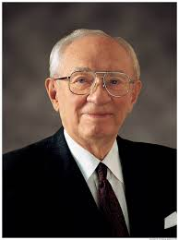
LESSON 8
“He said, ‘I’ve got to talk with someone. I’m all alone.…’
“And I said, ‘What’s your problem?’
“And he said, ‘When I joined the Church a little less than a year ago, my father told me to get out of his home and never come back. And I’ve never been back.’
“He continued, ‘A few months later the cricket club of which I was a member read me off its list, barring me from membership with the boys with whom I had grown up and with whom I had been so close and friendly.’
“Then he said, ‘Last month my boss fired me because I was a member
of this church, and I have been unable to get another job.…
“‘And last night the girl with whom I have gone for a year and a half said she would never marry me because I’m a Mormon’” (“The Loneliness of Leadership” [Brigham Young University devotional address, Nov. 4, 1969], 3,speeches.byu.edu).
Have you ever felt that you have been treated unkindly or criticized because of your religious beliefs? What was the situation?

Slide 5
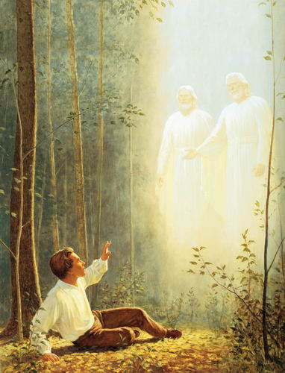
LESSON 8
Joseph Smith—History 1:21–23
21 Some few days after I had this vision, I happened to be in company with one of the Methodist preachers, who was very active in the before mentioned religious excitement; and, conversing with him on the subject of religion, I took occasion to give him an account of the vision which I had had. I was greatly surprised at his behavior; he treated my communication not only lightly, but with great contempt, saying it was all of the devil, that there were no such things as visions or revelations in these days; that all such things had ceased with the apostles, and that there would never be any more of them.
22 I soon found, however, that my telling the story had excited a great deal of prejudice against me among professors of religion, and was the cause of great persecution, which continued to increase; and though I was an obscure boy, only between fourteen and fifteen years of age, and my circumstances in life such as to make a boy of no consequence in the world, yet men of high standing would take notice sufficient to excite the public mind against me, and create a bitter persecution; and this was common among all the sects—all united to persecute me.
23 It caused me serious reflection then, and often has since, how very strange it was that an obscure boy, of a little over fourteen years of age, and one, too, who was doomed to the necessity of obtaining a scanty maintenance by his daily labor, should be thought a character of sufficient importance to attract the attention of the great ones of the most popular sects of the day, and in a manner to create in them a spirit of the most bitter persecution and reviling. But strange or not, so it was, and it was often the cause of great sorrow to myself.

Slide 6
LESSON 8
What words or phrases stood out to you?
Who initiated much of the persecution against Joseph Smith at this time?
“People of high standing in the community who claimed to be Christians”
As you consider Joseph Smith’s age and circumstances in life, how might persecution from these people have been especially difficult for him?
According to Joseph Smith, why did he experience this persecution at such a young age?
Satan recognized that Joseph Smith would be “a disturber and an annoyer of his kingdom”

Slide 7
LESSON 8
Joseph Smith—History 1:24–26
Although Joseph Smith is hated and persecuted, he remains true to his testimony

Slide 8
LESSON 8
Who is someone in the scriptures whom you admire because of his or her character or the strength of his or her example?
24 However, it was nevertheless a fact that I had beheld a vision. I have thought since, that I felt much like Paul, when he made his defense before King Agrippa, and related the account of the vision he had when he saw a light, and heard a voice; but still there were but few who believed him; some said he was dishonest, others said he was mad; and he was ridiculed and reviled. But all this did not destroy the reality of his vision. He had seen a vision, he knew he had, and all the persecution under heaven could not make it otherwise; and though they should persecute him unto death, yet he knew, and would know to his latest breath, that he had both seen a light and heard a voice speaking unto him, and all the world could not make him think or believe otherwise.
Joseph Smith—History 1:24

Slide 9
LESSON 8
Why was Joseph Smith able to look back on his experiences and identify with the Apostle Paul?
Paul had been mocked for his testimony of Jesus Christ and yet remained true to it.
How do you think it may have been helpful for Joseph Smith to see things he had in common with the Apostle Paul?

Slide 10
LESSON 8
23 Are they ministers of Christ? (I speak as a fool) I am more; in labours more abundant, in stripes above measure, in prisons more frequent, in deaths oft.
24 Of the Jews five times received I forty stripes save one.
25 Thrice was I beaten with rods, once was I stoned, thrice I suffered shipwreck, a night and a day I have been in the deep;
26 In journeyings often, in perils of waters, in perils of robbers, in perils by mine own countrymen, in perils by the heathen, in perils in the city, in perils in the wilderness, in perils in the sea, in perils among false brethren;
27 In weariness and painfulness, in watchings often, in hunger and thirst, in fastings often, in cold and nakedness.
2 Corinthians 11:23–27
What lesson can we learn from Joseph Smith’s example of studying and pondering the experiences of Paul?
During difficult times, we can draw strength from the examples of faithful individuals in the scriptures

Slide 11
LESSON 8
When have you been strengthened by studying the experience of a faithful individual in the scriptures?
“I had seen a vision; I knew it, and I knew that God knew it, and I could not deny it”
What does this phrase teach you about Joseph Smith’s testimony of the First Vision?
How can you gain a witness that Joseph Smith actually saw God the Father and Jesus Christ?

Slide 12
LESSON 8
Joseph Smith—History 1:24–25
24 However, it was nevertheless a fact that I had beheld a vision. I have thought since, that I felt much like Paul, when he made his defense before King Agrippa, and related the account of the vision he had when he saw a light, and heard a voice; but still there were but few who believed him; some said he was dishonest, others said he was mad; and he was ridiculed and reviled. But all this did not destroy the reality of his vision. He had seen a vision, he knew he had, and all the persecution under heaven could not make it otherwise; and though they should persecute him unto death, yet he knew, and would know to his latest breath, that he had both seen a light and heard a voice speaking unto him, and all the world could not make him think or believe otherwise.
25 So it was with me. I had actually seen a light, and in the midst of that light I saw two Personages, and they did in reality speak to me; and though I was hated and persecuted for saying that I had seen a vision, yet it was true; and while they were persecuting me, reviling me, and speaking all manner of evil against me falsely for so saying, I was led to say in my heart: Why persecute me for telling the truth? I have actually seen a vision; and who am I that I can withstand God, or why does the world think to make me deny what I have actually seen? For I had seen a vision; I knew it, and I knew that God knew it, and I could not deny it, neither dared I do it; at least I knew that by so doing I would offend God, and come under condemnation.

Slide 13
LESSON 8
How was Joseph Smith an example of that truth?
How might that truth be helpful to you?
How might living that truth influence our choices?
“I said, ‘If this has cost you so much, why don’t you leave the Church and go back to your father’s home and to your cricket club and to the job that meant so much to you and to the girl you think you love?’ “He said nothing for what seemed to be a long time. Then, putting his head down in his hands, he sobbed and sobbed. Finally, he looked up through his tears and said, ‘I couldn’t do that. I know this is true, and if it were to cost me my life, I could never give it up’” (“The Loneliness of Leadership,”3–4).

Slide 14
LESSON 8
26 I had now got my mind satisfied so far as the sectarian world was concerned—that it was not my duty to join with any of them, but to continue as I was until further directed. I had found the testimony of James to be true—that a man who lacked wisdom might ask of God, and obtain, and not be upbraided.
Joseph Smith—History 1:26
What blessings came to Joseph Smith because he believed the promise from James?
He learned that when we ask God in faith for wisdom, He will freely give it to us. He also learned that when we act on promises in the scriptures, we can gain a testimony of their truth.

