Slide 1
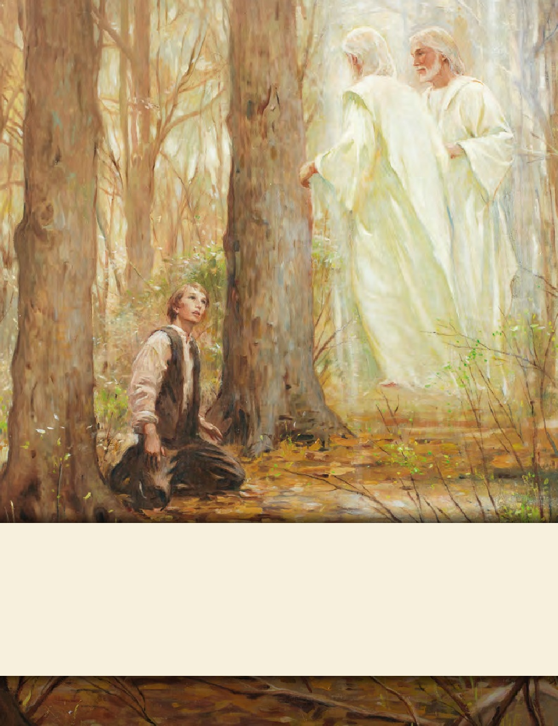
SEMINARY
Doctrine and Covenants
and Church History

Slide 2
LESSON 7
The Role of the Learn

Slide 3
LESSON 7
The roles of the teacher, the learner, and the Holy Ghost in gospel learning

Slide 4
LESSON 7
What benefit did you gain from the food (or drink) the other student described?
How well did the student’s description satisfy your hunger (or thirst)?
What must you do to gain any strength or benefit from this food (or drink)?

Slide 5
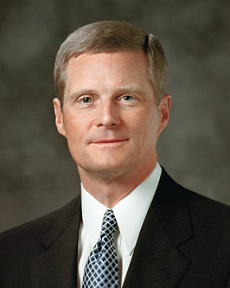
LESSON 7
Doctrine and Covenants 88:118
And as all have not faith, seek ye diligently and teach one another words of wisdom; yea, seek ye out of the best books words of wisdom; seek learning, even by study and also by faith.
What words or phrases describe our responsibility in gospel learning?
“Seek ye diligently”
“Teach one another”
“Seek learning, even by study and also by faith.”
“Learning by faith requires spiritual, mental, and physical exertion and not just passive reception.… “…A student must exercise faith and act in order to obtain the knowledge for himself or herself” (“Seek Learning by Faith” [address to CES religious educators, Feb. 3, 2006], 3,LDS.org)

Slide 6
LESSON 7
Spiritual learning requires?
Spiritual learning requires effort on our part.
Spiritual learning requires us to exercise faith and act.

Slide 7
LESSON 7
Doctrine and Covenants 50:13-14
13 Wherefore, I the Lord ask you this question—unto what were ye ordained?
14 To preach my gospel by the Spirit, even the Comforter which was sent forth to teach the truth.
Holy Ghost
Teacher
Learner

Slide 8
LESSON 7
What is the responsibility of the teacher?
To preach the gospel by the Spirit
Holy Ghost
What is the responsibility of the Spirit, or Comforter?
Teach the truth
To teach the truth
Teacher
Learner
Preach by the Spirit

Slide 9
LESSON 7
“The Holy Ghost is the true teacher”
When have you felt the Spirit teaching you?
19 And again, he that receiveth the word of truth, doth he receive it by the Spirit of truth or some other way?
20 If it be some other way it is not of God.
21 Therefore, why is it that ye cannot understand and know, that he that receiveth the word by the Spirit of truth receiveth it as it is preached by the Spirit of truth?
Doctrine and Covenants 50:19–21

Slide 10
LESSON 7
What does a person need to do in order to receive the ball?
“Hold up his or her hands and catch it”.
Holy Ghost
How is this like the effort a learner must make to receive the word of truth by the Spirit?
teach the truth
“To receive a ball, a person must prepare to catch it. Likewise, we must prepare our hearts and minds to receive truth by the Spirit”
Teacher
Learner
preach by the Spirit
Receive by the Spirit

Slide 11
LESSON 7
Doctrine and Covenants 50:22
22 Wherefore, he that preacheth and he that receiveth, understand one another, and both are edified and rejoice together.
What blessings do teachers and learners receive from the Spirit if they fulfill their responsibilities in gospel teaching and learning?
“Understanding, edification, and joy”

Slide 12
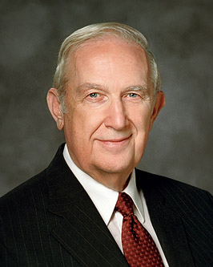
LESSON 7
“[A learner’s] decision to participate is an exercise in agency that permits the Holy Ghost to communicate a personalized message suited to [his or her] individual needs. Creating an atmosphere of participation enhances the probability that the Spirit will teach more important lessons than [the teacher] can communicate” (“To Learn and to Teach More Effectively” [BYU Campus Education Week devotional, Aug. 21, 2007], 4–5,speeches.byu.edu).
According to Elder Scott’s statement, how can we invite the Holy Spirit to teach us?
As we exercise our agency to participate in the learning process, we invite the Spirit to teach and testify of truth.

Slide 13
Joseph Smith—History 1:8, 10, 11, 12, 13, 14, 15, 16, 18
LESSON 7
8 During this time of great excitement my mind was called up to serious reflection and great uneasiness; but though my feelings were deep and often poignant, still I kept myself aloof from all these parties, though I attended their several meetings as often as occasion would permit. In process of time my mind became somewhat partial to the Methodist sect, and I felt some desire to be united with them; but so great were the confusion and strife among the different denominations, that it was impossible for a person young as I was, and so unacquainted with men and things, to come to any certain conclusion who was right and who was wrong.
12 Never did any passage of scripture come with more power to the heart of man than this did at this time to mine. It seemed to enter with great force into every feeling of my heart. I reflected on it again and again, knowing that if any person needed wisdom from God, I did; for how to act I did not know, and unless I could get more wisdom than I then had, I would never know; for the teachers of religion of the different sects understood the same passages of scripture so differently as to destroy all confidence in settling the question by an appeal to the Bible.
14 So, in accordance with this, my determination to ask of God, I retired to the woods to make the attempt. It was on the morning of a beautiful, clear day, early in the spring of eighteen hundred and twenty. It was the first time in my life that I had made such an attempt, for amidst all my anxieties I had never as yet made the attempt to pray vocally.
16 But, exerting all my powers to call upon God to deliver me out of the power of this enemy which had seized upon me, and at the very moment when I was ready to sink into despair and abandon myself to destruction—not to an imaginary ruin, but to the power of some actual being from the unseen world, who had such marvelous power as I had never before felt in any being—just at this moment of great alarm, I saw a pillar of light exactly over my head, above the brightness of the sun, which descended gradually until it fell upon me.
15 After I had retired to the place where I had previously designed to go, having looked around me, and finding myself alone, I kneeled down and began to offer up the desires of my heart to God. I had scarcely done so, when immediately I was seized upon by some power which entirely overcame me, and had such an astonishing influence over me as to bind my tongue so that I could not speak. Thick darkness gathered around me, and it seemed to me for a time as if I were doomed to sudden destruction.
10 In the midst of this war of words and tumult of opinions, I often said to myself: What is to be done? Who of all these parties are right; or, are they all wrong together? If any one of them be right, which is it, and how shall I know it?
13 At length I came to the conclusion that I must either remain in darkness and confusion, or else I must do as James directs, that is, ask of God. I at length came to the determination to “ask of God,” concluding that if he gave wisdom to them that lacked wisdom, and would give liberally, and not upbraid, I might venture.
18 My object in going to inquire of the Lord was to know which of all the sects was right, that I might know which to join. No sooner, therefore, did I get possession of myself, so as to be able to speak, than I asked the Personages who stood above me in the light, which of all the sects was right (for at this time it had never entered into my heart that all were wrong)—and which I should join.
11 While I was laboring under the extreme difficulties caused by the contests of these parties of religionists, I was one day reading the Epistle of James, first chapter and fifth verse, which reads: If any of you lack wisdom, let him ask of God, that giveth to all men liberally, and upbraideth not; and it shall be given him.

Slide 14
LESSON 7
How did Joseph make an effort to learn spiritual truths?
Joseph Smith—History 1:20
20 He again forbade me to join with any of them; and many other things did he say unto me, which I cannot write at this time. When I came to myself again, I found myself lying on my back, looking up into heaven. When the light had departed, I had no strength; but soon recovering in some degree, I went home. And as I leaned up to the fireplace, mother inquired what the matter was. I replied, “Never mind, all is well—I am well enough off.” I then said to my mother, “I have learned for myself that Presbyterianism is not true.” It seems as though the adversary was aware, at a very early period of my life, that I was destined to prove a disturber and an annoyer of his kingdom; else why should the powers of darkness combine against me? Why the opposition and persecution that arose against me, almost in my infancy?
20 He again forbade me to join with any of them; and many other things did he say unto me, which I cannot write at this time. When I came to myself again, I found myself lying on my back, looking up into heaven. When the light had departed, I had no strength; but soon recovering in some degree, I went home. And as I leaned up to the fireplace, mother inquired what the matter was. I replied, “Never mind, all is well—I am well enough off.” I then said to my mother, “I have learned for myself that Presbyterianism is not true.” It seems as though the adversary was aware, at a very early period of my life, that I was destined to prove a disturber and an annoyer of his kingdom; else why should the powers of darkness combine against me? Why the opposition and persecution that arose against me, almost in my infancy
Which phrase in Joseph’s statement to his mother reflects that he had learned the truth for himself?

