Slide 1
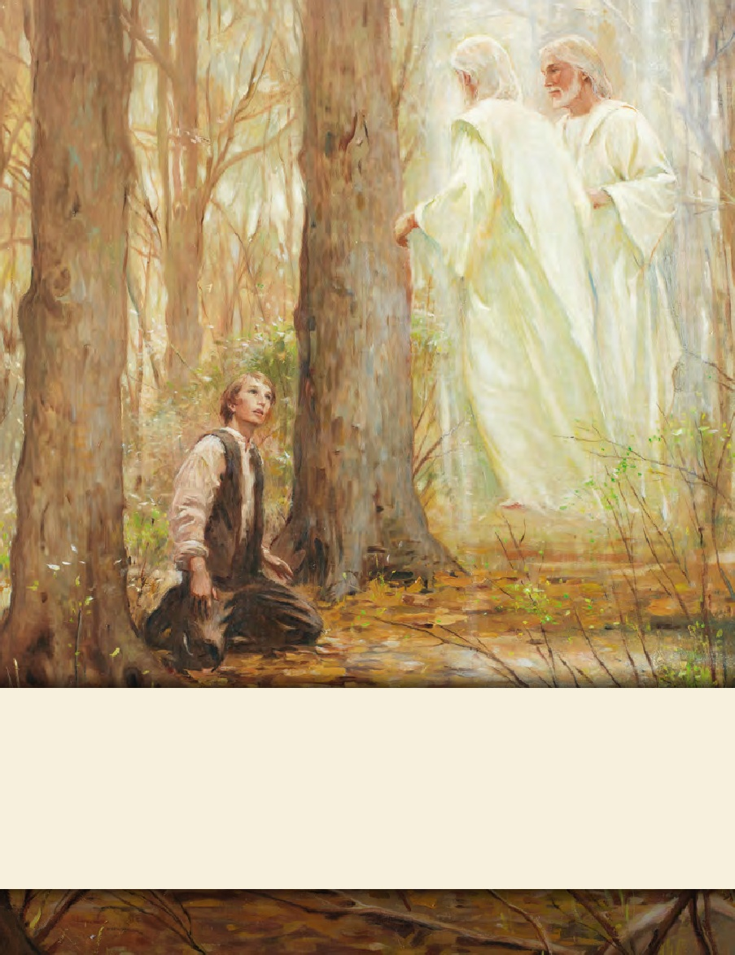
SEMINARY
Doctrine and Covenants
and Church History

Slide 2
LESSON 6
Joseph Smith History 1:1-20

Slide 3
LESSON 6
Joseph Smith—History 1:1–4
Joseph Smith writes a history of the Church

Slide 4
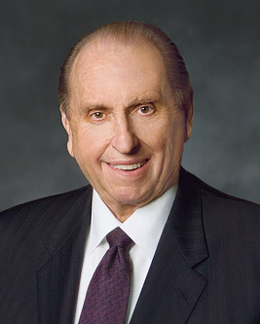
LESSON 6
“Two [missionaries] called at the home of Mr. Elmer Pollard. … They presented their message and asked if he would join in prayer. He agreed, on the provision that he could offer the prayer.
“The prayer he offered astonished the missionaries. He said, ‘Heavenly Father, bless these two unfortunate, misguided missionaries, that they may return to their homes and not waste their time telling the people of Canada about a message which is so fantastic and about which they know so little. “As they arose from their knees, Mr. Pollard asked the missionaries never to return to his home. As they left, he said mockingly to them, ‘You can’t tell me you really believe that Joseph Smith was a prophet of God, anyway!’ and he slammed the door” (“The Prophet Joseph Smith: Teacher by Example, ”Ensign or Liahona, Nov. 2005,69).
If you were one of those missionaries, what would you have said to Mr. Pollard?
How can someone know for themselves that Joseph Smith was a prophet of God?

Slide 5
LESSON 6
Joseph Smith—History 1:1–2
1 Owing to the many reports which have been put in circulation by evil-disposed and designing persons, in relation to the rise and progress of The Church of Jesus Christ of Latter-day Saints, all of which have been designed by the authors thereof to militate against its character as a Church and its progress in the world—I have been induced to write this history, to disabuse the public mind, and put all inquirers after truth in possession of the facts, as they have transpired, in relation both to myself and the Church, so far as I have such facts in my possession.
2 In this history I shall present the various events in relation to this Church, in truth and righteousness, as they have transpired, or as they at present exist, being now [1838] the eighth year since the organization of the said Church.
What was circulating among the people during the early days of the Church?
(Many false reports which were meant to turn people against the Church.)
What reason did Joseph give for writing his history?
(To provide the public with a reliable and accurate account of the events of the First Vision and the Restoration.)

Slide 6
LESSON 6
What can we learn from Joseph Smith’s reason for writing his history that can help us avoid being deceived by false or misleading information?
(Those who sincerely want the truth should diligently seek out credible sources of information about the Church and its history rather than simply accept any information they hear, including whatever comes up as a result of an Internet search.)
Why is it important that “inquirers after truth” about the Restoration go to Joseph Smith’s account?
(Relying on the Prophet’s account can help individuals avoid being deceived by false or misleading information.)
How can reading Joseph Smith’s own words help someone know the truth about his experiences?

Slide 7
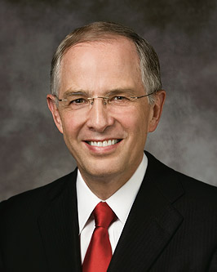
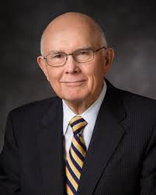
LESSON 6
“There have always been a few who want to discredit the Church and to destroy faith. Today they use the Internet. “Some of the information about the Church, no matter how convincing, is just not true” (“Trial of Your Faith, ”Ensign or Liahona, Nov. 2012,41).
“Latter-day Saint readers should … be … sophisticated in their evaluation of what they read.… “Our individual, personal testimonies are based on the witness of the Spirit, not on any combination or accumulation of historical facts. If we are so grounded, no alteration of historical facts can shake our testimonies. Our Heavenly Father gave us powers of reason, and we are expected to use them to the fullest. But he also gave us the Comforter, who he said would lead us into truth and by whose power we may know the truth of all things. That is the ultimate guide for Latter-day Saints who are worthy and willing to rely on it” (“Reading Church History” [address to CES religious educators, Aug. 16, 1985], 7, LDS.org).

Slide 8
LESSON 6
Acts 9:1-9
1 And Saul, yet breathing out threatenings and slaughter against the disciples of the Lord, went unto the high priest,
2 And desired of him letters to Damascus to the synagogues, that if he found any of this way, whether they were men or women, he might bring them bound unto Jerusalem.
3 And as he journeyed, he came near Damascus: and suddenly there shined round about him a light from heaven:
4 And he fell to the earth, and heard a voice saying unto him, Saul, Saul, why persecutest thou me?
5 And he said, Who art thou, Lord? And the Lord said, I am Jesus whom thou persecutest: it is hard for thee to kick against the pricks.
6 And he trembling and astonished said, Lord, what wilt thou have me to do? And the Lord said unto him, Arise, and go into the city, and it shall be told thee what thou must do.
7 And the men which journeyed with him stood speechless, hearing a voice, but seeing no man.
8 And Saul arose from the earth; and when his eyes were opened, he saw no man: but they led him by the hand, and brought him into Damascus.
9 And he was three days without sight, and neither did eat nor drink.

Slide 9
LESSON 6
Acts 22:5-11
5 As also the high priest doth bear me witness, and all the estate of the elders: from whom also I received letters unto the brethren, and went to Damascus, to bring them which were there bound unto Jerusalem, for to be punished.
6 And it came to pass, that, as I made my journey, and was come nigh unto Damascus about noon, suddenly there shone from heaven a great light round about me.
7 And I fell unto the ground, and heard a voice saying unto me, Saul, Saul, why persecutest thou me?
8 And I answered, Who art thou, Lord? And he said unto me, I am Jesus of Nazareth, whom thou persecutest.
9 And they that were with me saw indeed the light, and were afraid; but they heard not the voice of him that spake to me.
10 And I said, What shall I do, Lord? And the Lord said unto me, Arise, and go into Damascus; and there it shall be told thee of all things which are appointed for thee to do.
11 And when I could not see for the glory of that light, being led by the hand of them that were with me, I came into Damascus.

Slide 10
LESSON 6
Acts 26:12-20
12 Whereupon as I went to Damascus with authority and commission from the chief priests,
13 At midday, O king, I saw in the way a light from heaven, above the brightness of the sun, shining round about me and them which journeyed with me.
14 And when we were all fallen to the earth, I heard a voice speaking unto me, and saying in the Hebrew tongue, Saul, Saul, why persecutest thou me? it is hard for thee to kick against the pricks.
15 And I said, Who art thou, Lord? And he said, I am Jesus whom thou persecutest.
16 But rise, and stand upon thy feet: for I have appeared unto thee for this purpose, to make thee a minister and a witness both of these things which thou hast seen, and of those things in the which I will appear
unto thee;
17 Delivering thee from the people, and from the Gentiles, unto whom now I send thee,
18 To open their eyes, and to turn them from darkness to light, and from the power of Satan unto God, that they may receive forgiveness of sins, and inheritance among them which are sanctified by faith that is in me.
19 Whereupon, O king Agrippa, I was not disobedient unto the heavenly vision:
20 But shewed first unto them of Damascus, and at Jerusalem, and throughout all the coasts of Judea, and then to the Gentiles, that they should repent and turn to God, and do works meet for repentance.

Slide 11
LESSON 6
Why do you think Joseph Smith and Paul emphasized different things each time they related the accounts of their visions?
Joseph Smith—History 1:5–13
Joseph Smith was determines to ask God which church is right

Slide 12
LESSON 6
Joseph Smith—History 1:5–7
5 Some time in the second year after our removal to Manchester, there was in the place where we lived an unusual excitement on the subject of religion. It commenced with the Methodists, but soon became general among all the sects in that region of country. Indeed, the whole district of country seemed affected by it, and great multitudes united themselves to the different religious parties, which created no small stir and division amongst the people, some crying, “Lo, here!” and others, “Lo, there!” Some were contending for the Methodist faith, some for the Presbyterian, and some for the Baptist.
6 For, notwithstanding the great love which the converts to these different faiths expressed at the time of their conversion, and the great zeal manifested by the respective clergy, who were active in getting up and promoting this extraordinary scene of religious feeling, in order to have everybody converted, as they were pleased to call it, let them join what sect they pleased; yet when the converts began to file off, some to one party and some to another, it was seen that the seemingly good feelings of both the priests and the converts were more pretended than real; for a scene of great confusion and bad feeling ensued—priest contending against priest, and convert against convert; so that all their good feelings one for another, if they ever had any, were entirely lost in a strife of words and a contest about opinions.
7 I was at this time in my fifteenth year. My father’s family was proselyted to the Presbyterian faith, and four of them joined that church, namely, my mother, Lucy; my brothers Hyrum and Samuel Harrison; and my sister Sophronia.

Slide 13
LESSON 6
Joseph Smith—History 1:8, 10
8 During this time of great excitement my mind was called up to serious reflection and great uneasiness; but though my feelings were deep and often poignant, still I kept myself aloof from all these parties, though I attended their several meetings as often as occasion would permit. In process of time my mind became somewhat partial to the Methodist sect, and I felt some desire to be united with them; but so great were the confusion and strife among the different denominations, that it was impossible for a person young as I was, and so unacquainted with men and things, to come to any certain conclusion who was right and who was wrong.
10 In the midst of this war of words and tumult of opinions, I often said to myself: What is to be done? Who of all these parties are right; or, are they all wrong together? If any one of them be right, which is it, and how shall I know it?

Slide 14
LESSON 6
How did Joseph feel as a result of the religious excitement that surrounded him?
What were some of the questions he was struggling with?
Have any of you ever asked similar questions? What did you do to resolve them?

Slide 15
LESSON 6
11 While I was laboring under the extreme difficulties caused by the contests of these parties of religionists, I was one day reading the Epistle of James, first chapter and fifth verse, which reads: If any of you lack wisdom, let him ask of God, that giveth to all men liberally, and upbraideth not; and it shall be given him
11 While I was laboring under the extreme difficulties caused by the contests of these parties of religionists, I was one day reading the Epistle of James, first chapter and fifth verse, which reads: If any of you lack wisdom, let him ask of God, that giveth to all men liberally, and upbraideth not; and it shall be given him
Joseph Smith—History 1:11
Where did Joseph turn for help in answering his questions?
What principle taught in James 1:5 helped Joseph Smith have confidence that he could find answers to the questions he had?
If we ask God in faith, He will answer our prayers.

Slide 16
LESSON 6
Joseph Smith—History 1:12–13
12 Never did any passage of scripture come with more power to the heart of man than this did at this time to mine. It seemed to enter with great force into every feeling of my heart. I reflected on it again and again, knowing that if any person needed wisdom from God, I did; for how to act I did not know, and unless I could get more wisdom than I then had, I would never know; for the teachers of religion of the different sects understood the same passages of scripture so differently as to destroy all confidence in settling the question by an appeal to the Bible.
13 At length I came to the conclusion that I must either remain in darkness and confusion, or else I must do as James directs, that is, ask of God. I at length came to the determination to “ask of God,” concluding that if he gave wisdom to them that lacked wisdom, and would give liberally, and not upbraid, I might venture.

Slide 17
LESSON 6
Joseph Smith—History 14-20.
Joseph Smith sees God the Father and His Son, Jesus Christ

Slide 18
LESSON 6
Joseph Smith—History 1:14-15
14 So, in accordance with this, my determination to ask of God, I retired to the woods to make the attempt. It was on the morning of a beautiful, clear day, early in the spring of eighteen hundred and twenty. It was the first time in my life that I had made such an attempt, for amidst all my anxieties I had never as yet made the attempt to pray vocally.
15 After I had retired to the place where I had previously designed to go, having looked around me, and finding myself alone, I kneeled down and began to offer up the desires of my heart to God. I had scarcely done so, when immediately I was seized upon by some power which entirely overcame me, and had such an astonishing influence over me as to bind my tongue so that I could not speak. Thick darkness gathered around me, and it seemed to me for a time as if I were doomed to sudden destruction.
Why do you think Satan tried to stop Joseph Smith from praying?

Slide 19
LESSON 6
Joseph Smith—History 1:16-17
16 But, exerting all my powers to call upon God to deliver me out of the power of this enemy which had seized upon me, and at the very moment when I was ready to sink into despair and abandon myself to destruction—not to an imaginary ruin, but to the power of some actual being from the unseen world, who had such marvelous power as I had never before felt in any being—just at this moment of great alarm, I saw a pillar of light exactly over my head, above the brightness of the sun, which descended gradually until it fell upon me.
17 It no sooner appeared than I found myself delivered from the enemy which held me bound. When the light rested upon me I saw two Personages, whose brightness and glory defy all description, standing above me in the air. One of them spake unto me, calling me by name and said, pointing to the other—This is My Beloved Son. Hear Him!
Which phrases in these verses are meaningful to you? Why?
“Joseph Smith saw God the Father and His Son, Jesus Christ”

Slide 20
LESSON 6
Why is it important to have a testimony that Joseph Smith saw God the Father and His Son, Jesus Christ?
How do you know that Joseph Smith saw God the Father and His Son, Jesus Christ?
President Boyd K. Packer of the Quorum of the Twelve Apostles explained a blessing that can come from giving students opportunities to share their testimonies: “Oh, if I could teach you this one principle. A testimony is to be found in the bearing of it!… “It is one thing to receive a witness from what you have read or what another has said. … It is quite another to have the Spirit confirm to you in your bosom that what you have testified is true” (“The Candle of the Lord, ”Ensign, Jan. 1983,54–55).

Slide 21
LESSON 6
What principle can we learn from Joseph Smith—History 1:15–16 that can help us overcome temptation?
If we earnestly seek God’s help when Satan tries to discourage us, God can deliver us.
What do these verses teach about the nature of God the Father and Jesus Christ?
God the Father and His Son, Jesus Christ, live. Heavenly Father and His Son, Jesus Christ, are separate and distinct beings.
What was the first word God spoke to Joseph Smith? (Joseph.) Why is this important to know? What truths can we learn from this?
Heavenly Father knows us by name. God answers our prayers.

Slide 22
LESSON 6
Joseph Smith—History 1:18-20
18 My object in going to inquire of the Lord was to know which of all the sects was right, that I might know which to join. No sooner, therefore, did I get possession of myself, so as to be able to speak, than I asked the Personages who stood above me in the light, which of all the sects was right (for at this time it had never entered into my heart that all were wrong)—and which I should join.
19 I was answered that I must join none of them, for they were all wrong; and the Personage who addressed me said that all their creeds were an abomination in his sight; that those professors were all corrupt; that: “they draw near to me with their lips, but their hearts are far from me, they teach for doctrines the commandments of men, having a form of godliness, but they deny the power thereof.”
20 He again forbade me to join with any of them; and many other things did he say unto me, which I cannot write at this time. When I came to myself again, I found myself lying on my back, looking up into heaven. When the light had departed, I had no strength; but soon recovering in some degree, I went home. And as I leaned up to the fireplace, mother inquired what the matter was. I replied, “Never mind, all is well—I am well enough off.” I then said to my mother, “I have learned for myself that Presbyterianism is not true.” It seems as though the adversary was aware, at a very early period of my life, that I was destined to prove a disturber and an annoyer of his kingdom; else why should the powers of darkness combine against me? Why the opposition and persecution that arose against me, almost in my infancy?
What did Joseph learn in answer to his prayer?

Slide 23
LESSON 6
“The two returned to Mr. Pollard’s door. Mr. Pollard answered the knock and angrily said, ‘I thought I told you young men never to return!’ “The junior companion then said, with all the courage he could muster, ‘Mr. Pollard, when we left your door, you said that we didn’t really believe Joseph Smith was a prophet of God. I want to testify to you, Mr. Pollard, that I know Joseph Smith was a prophet of God, that by inspiration he translated the sacred record known as the Book of Mormon, that he did see God the Father and Jesus the Son.’ The missionaries then departed the doorstep. “[Mr. Pollard later testified:] ‘That evening, sleep would not come. I tossed and turned. Over and over in my mind I heard the words, “Joseph Smith was a prophet of God. I know it. … I know it. … I know it.” I could scarcely wait for morning to come. I telephoned the missionaries. … They returned, and this time my wife, my family, and I joined in the discussion as earnest seekers of truth. As a result, we have all embraced the gospel of Jesus Christ’” (“The Prophet Joseph Smith: Teacher by Example,”69).

