Slide 1
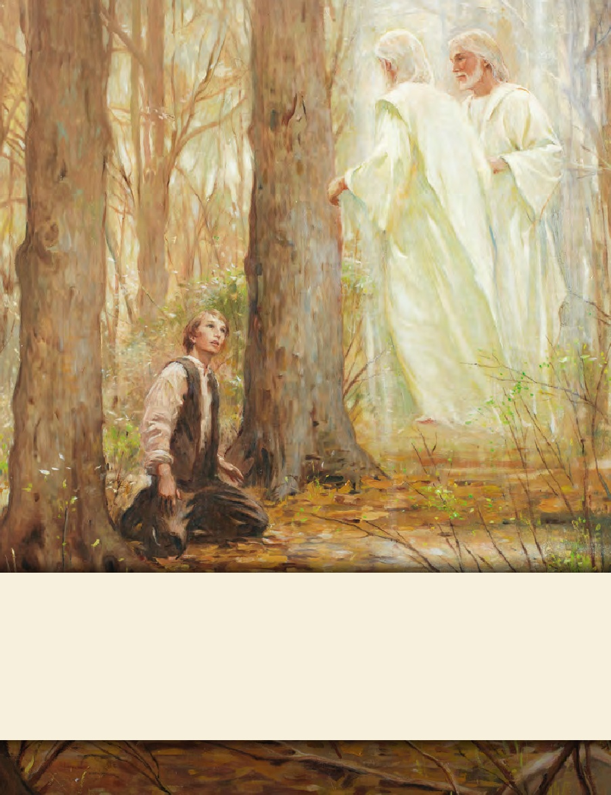
SEMINARY
Doctrine and Covenants
and Church History

Slide 2
LESSON 5
Studying the Scriptures

Slide 3
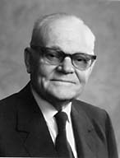
LESSON 5
The aim of scripture study.
Why was it easier to find what you were looking for the second time?
President Marion G. Romney said:
“One cannot honestly study the scriptures without learning gospel principles because the scriptures have been written to preserve principles” (“The Message of the Old Testament” [address to CES religious educators, Aug. 17, 1979], 3, LDS.org).

Slide 4
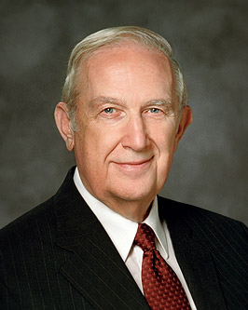
LESSON 5
What should we be looking for as we study the scriptures?
What is a principle?
“Principles are concentrated truth, packaged for application to a wide variety of circumstances. A true principle makes decisions clear even under the most confusing and compelling circumstances” (“Acquiring Spiritual Knowledge,” Ensign, Nov. 1993,86).
According to Elder Scott, what is a principle? Why is finding principles in the scriptures so important?

Slide 5
LESSON 5
Understanding the context and content of the scriptures.
What must you do before you can use this object for its intended purpose?
Remove the outer covering
What is the purpose of the outer covering?
To preserve and transport the contents

Slide 6
LESSON 5
Doctrine and Covenants 121:1-8
O God, where art thou? And where is the pavilion that covereth thy hiding place?
2 How long shall thy hand be stayed, and thine eye, yea thy pure eye, behold from the eternal
heavens the wrongs of thy people and of thy servants, and thine ear be penetrated with their cries?
3 Yea, O Lord, how long shall they suffer these wrongs and unlawful oppressions, before thine heart shall be softened toward them, and thy bowels be moved with compassion toward them?
4 O Lord God Almighty, maker of heaven, earth, and seas, and of all things that in them are, and who controllest and subjectest the devil, and the dark and benighted dominion of Sheol—stretch forth thy hand; let thine eye pierce; let thy pavilion be taken up; let thy hiding place no longer be covered; let thine ear be inclined; let thine heart be softened, and thy bowels moved with
compassion toward us.
5 Let thine anger be kindled against our enemies; and, in the fury of thine heart, with thy sword
avenge us of our wrongs.
6 Remember thy suffering saints, O our God; and thy servants will rejoice in thy name forever.
7 My son, peace be unto thy soul; thine adversity and thine afflictions shall be but a small moment;
8 And then, if thou endure it well, God shall exalt thee on high; thou shalt triumph over all thy foes.

Slide 7
LESSON 5
How does knowing that Joseph Smith had been imprisoned in Liberty Jail for months help us better understand these verses?
How does knowing this definition help you better understand this verse?

Slide 8
LESSON 5
Identifying doctrines and principles.
“As you seek spiritual knowledge, search for principles. Carefully separate them from the detail used to explain them. … It is worth great effort to organize the truth we gather to simple statements of principle” (“Acquiring Spiritual Knowledge,”86).
What phrases did Elder Scott use to describe the process of identifying truths in the scriptures?
“organize the truth we gather to simple statements of principle.”
Why do you think it is important to “organize the truth” we learn from a scripture passage into a simple statement of doctrine or principle?

Slide 9
LESSON 5
7 My son, peace be unto thy soul; thine adversity and thine afflictions shall be but a small moment;
8 And then, if thou endure it well, God shall exalt thee on high; thou shalt triumph over all thy foes.
Doctrine and Covenants 121:7-8
If we endure our trials well, God will exalt us and help us triumph over our foes.

Slide 10
LESSON 5
Applying doctrines and principles in our lives.
What value does the fruit have if it is never used once it is peeled?
What should we do once we identify those truths?
(Apply them in our lives.)

Slide 11
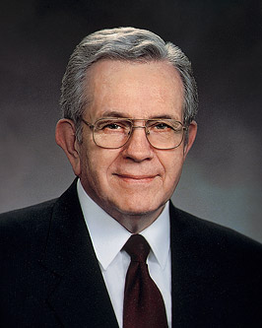
LESSON 5
“If [you] are acquainted with the revelations, there is no question—personal or social or political or occupational—that need go unanswered. Therein is contained the fulness of the everlasting gospel. Therein we find principles of truth that will resolve every confusion and every problem and every dilemma that will face the human family or any individual in it” (“Teach the Scriptures” [address to CES religious educators, Oct. 14, 1977], 3–4,LDS.org).
What phrases stood out to you? Why?

