Slide 1
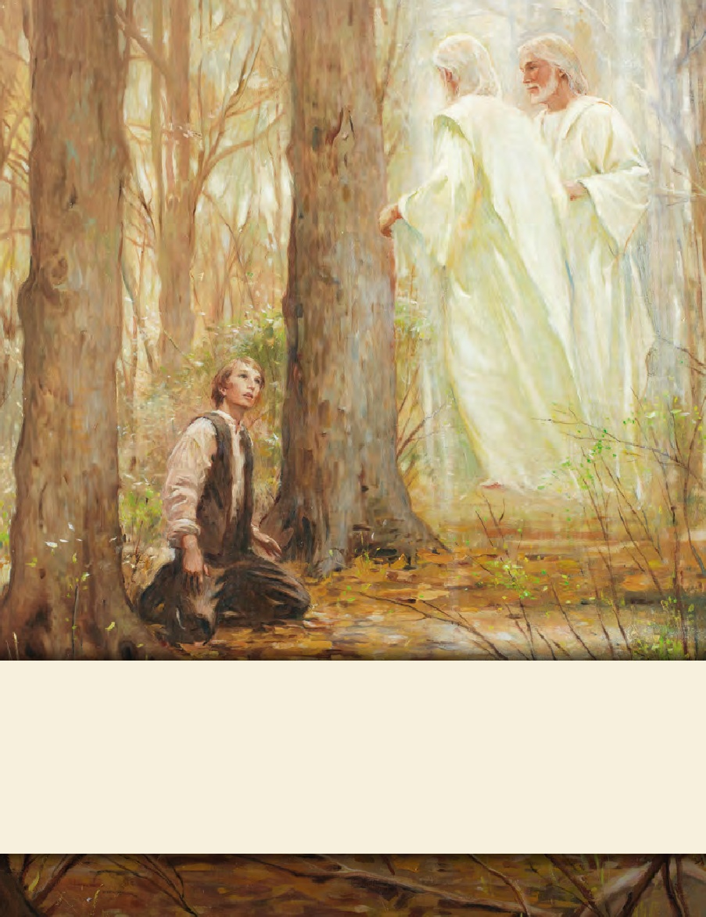
SEMINARY
Doctrine and Covenants
and Church History

Slide 2
LESSON 4
Doctrine and Covenants 1

Slide 3
LESSON 4
Introduction
By November 1831, Joseph Smith had received more than 60 revelations. However, most Church members did not have access to copies of the revelations. The Prophet convened a conference in Hiram, Ohio, to discuss publishing them as a book that would be called the Book of Commandments. A committee of elders drafted a preface to the book.
Unsatisfied with this draft, those who attended the conference requested that Joseph Smith ask the Lord for a preface. After petitioning the Lord in prayer, Joseph received a preface by revelation. The Lord’s preface to the Book of Commandments became section 1 of the Doctrine and Covenants.

Slide 4
LESSON 4
Doctrine and Covenants1:1–16
The Lord warns of the judgments that will come upon the rebellious at the Second Coming.
When has someone sought to get your attention and warn you about something? How did you respond?
How do you feel about that person’s efforts to warn you? Why do you feel this way?

Slide 5
LESSON 4
Doctrine and Covenants 1:1-3
1 Hearken, O ye people of my church, saith the voice of him who dwells on high, and whose eyes are upon all men; yea, verily I say: Hearken ye people from afar; and ye that are upon the islands of the sea, listen together.
2 For verily the voice of the Lord is unto all men, and there is none to escape; and there is no eye that shall not see, neither ear that shall not hear, neither heart that shall not be penetrated.
3 And the rebellious shall be pierced with much sorrow; for their iniquities shall be spoken upon the housetops, and their secret acts shall be revealed.

Slide 6
LESSON 4
To whom was the Lord speaking in these verses?
(The Lord was speaking to all the inhabitants of the earth, not just to members of the Church)
What do you think is the meaning of the phrase “their iniquities shall be spoken upon the housetops, and their secret acts shall be revealed”?

Slide 7
LESSON 4
4 And the voice of warning shall be unto all people, by the mouths of my disciples, whom I have chosen in these last days.
5 And they shall go forth and none shall stay them, for I the Lord have commanded them.
6 Behold, this is mine authority, and the authority of my servants, and my preface unto the book of my commandments, which I have given them to publish unto you, O inhabitants of the earth.
7 Wherefore, fear and tremble, O ye people, for what I the Lord have decreed in them shall be fulfilled.
4 And the voice of warning shall be unto all people, by the mouths of my disciples, whom I have chosen in these last days.
Doctrine and Covenants 1:4-7

Slide 8
LESSON 4
How did the Lord say He would deliver His warnings to all people?
How did the Lord say He would deliver His warnings to all people?
Who are the disciples through whom the Lord speaks and publishes His warnings?
Who are the disciples through whom the Lord speaks and publishes His warnings?

Slide 9
LESSON 4
11 Wherefore the voice of the Lord is unto the ends of the earth, that all that will hear may hear:
12 Prepare ye, prepare ye for that which is to come, for the Lord is nigh;
13 And the anger of the Lord is kindled, and his sword is bathed in heaven, and it shall fall upon the inhabitants of the earth.
14 And the arm of the Lord shall be revealed; and the day cometh that they who will not hear the voice of the Lord, neither the voice of his servants, neither give heed to the words of the prophets and apostles, shall be cut off from among the people;
Doctrine and Covenants 1:11-14

Slide 10
LESSON 4
What event was the Lord referring to in Doctrine and Covenants 1:12?
(Second coming)
What do you think the Lord meant when He warned that those who do not give heed to His prophets and apostles will be cut off?
(They will be separated from the righteous and lose the blessings that are available through gospel ordinances and covenants.)

Slide 11
LESSON 4
15 For they have strayed from mine ordinances, and have broken mine everlasting covenant;
16 They seek not the Lord to establish his righteousness, but every man walketh in his own way, and after the image of his own god, whose image is in the likeness of the world, and whose substance is that of an idol, which waxeth old and shall perish in Babylon, even Babylon the great, which shall fall.
Doctrine and Covenants 1:15-16
In what ways do people in our day walk “in [their] own way, and after the image of [their] own god”?

Slide 12
LESSON 4
Doctrine and Covenants1:17-33
The gospel was restored through Joseph Smith to prepare the world for the calamity of the last days
CALAMITY
17 Wherefore, I the Lord, knowing the calamity which should come upon the inhabitants of the earth, called upon my servant Joseph Smith, Jun., and spake unto him from heaven, and gave him commandments;
Doctrine and Covenants1:17

Slide 13
LESSON 4
The Lord called Joseph Smith
Gave him revelations and commandments
The Lord has commanded His servants
Proclaim His gospel and establish His covenant
The Lord revealed the Book of Mormon
The Lord restored His Church upon the earth

Slide 14
LESSON 4
How would you explain to someone why The Church of Jesus Christ of Latter-day Saints is the only true and living church upon the earth?
What makes this church “living”?
Why is it important to you to know that you belong to the only true and living Church upon the earth?
What do you think the Lord meant when He stated that He was pleased with His Church “collectively and not individually”?
(Although the Church is true and as a whole is pleasing to the Lord, some individual members of the Church may not live in a way that is pleasing to Him.)

Slide 15
LESSON 4
31 For I the Lord cannot look upon sin with the least degree of allowance;
32 Nevertheless, he that repents and does the commandments of the Lord shall be forgiven;
33 And he that repents not, from him shall be taken even the light which he has received; for my Spirit shall not always strive with man, saith the Lord of Hosts.
Doctrine and Covenants1:31-33
33 And he that repents not, from him shall be taken even the light which he has received; for my Spirit shall not always strive with man, saith the Lord of Hosts.
How does the Lord look upon sin? How can we be forgiven?
What happens to those who don’t repent?

Slide 16
Doctrine and Covenants1:34-39
LESSON 4
The Lord directs us to search the revelations and commandments contained in the Doctrine and Covenants
37 Search these commandments, for they are true and faithful, and the prophecies and promises which are in them shall all be fulfilled.
38 What I the Lord have spoken, I have spoken, and I excuse not myself; and though the heavens and the earth pass away, my word shall not pass away, but shall all be fulfilled, whether by mine own voice or by the voice of my servants, it is the same.
39 For behold, and lo, the Lord is God, and the Spirit beareth record, and the record is true, and the truth abideth forever and ever. Amen.
Doctrine and Covenants 1:37–39

Slide 17
LESSON 4
What truths did the Lord emphasize in Doctrine and Covenants 1:37–39?
We are to search the commandments the Lord has given. The Lord’s words will all be fulfilled. The Lord’s words are true whether they are stated by Him or by His servants
How can you be blessed if you search the commandments and revelations the Lord has given in the Doctrine and Covenants?

