Slide 1
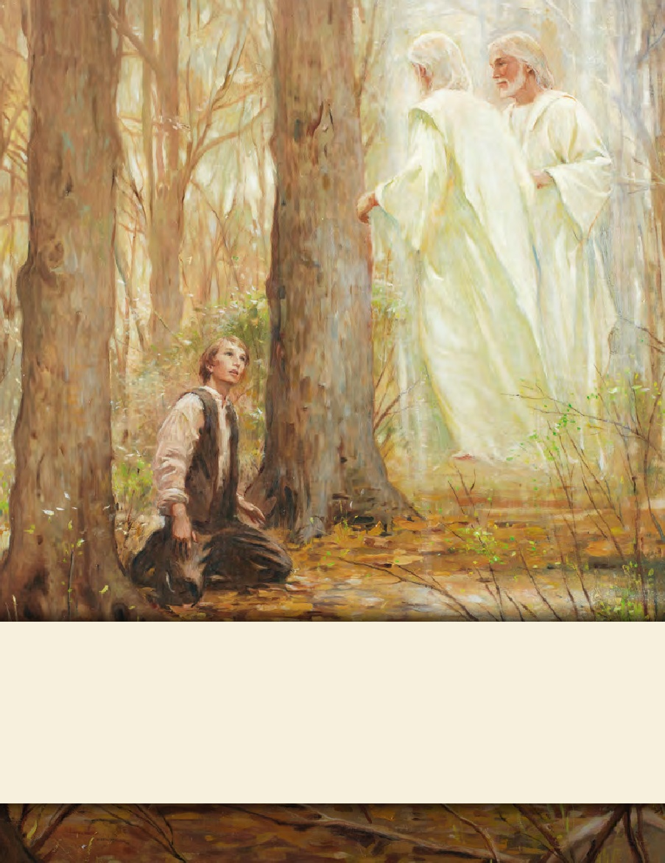
LESSON 15
SEMINARY
Doctrine and Covenants
and Church History

Slide 2
LESSON 35
Doctrine and Covenants 29:1-29.

Slide 3
LESSON 35
Doctrine and Covenants 29:1-13.
“The Lord testifies of His Atonement and His desire to gather His people”

Slide 4
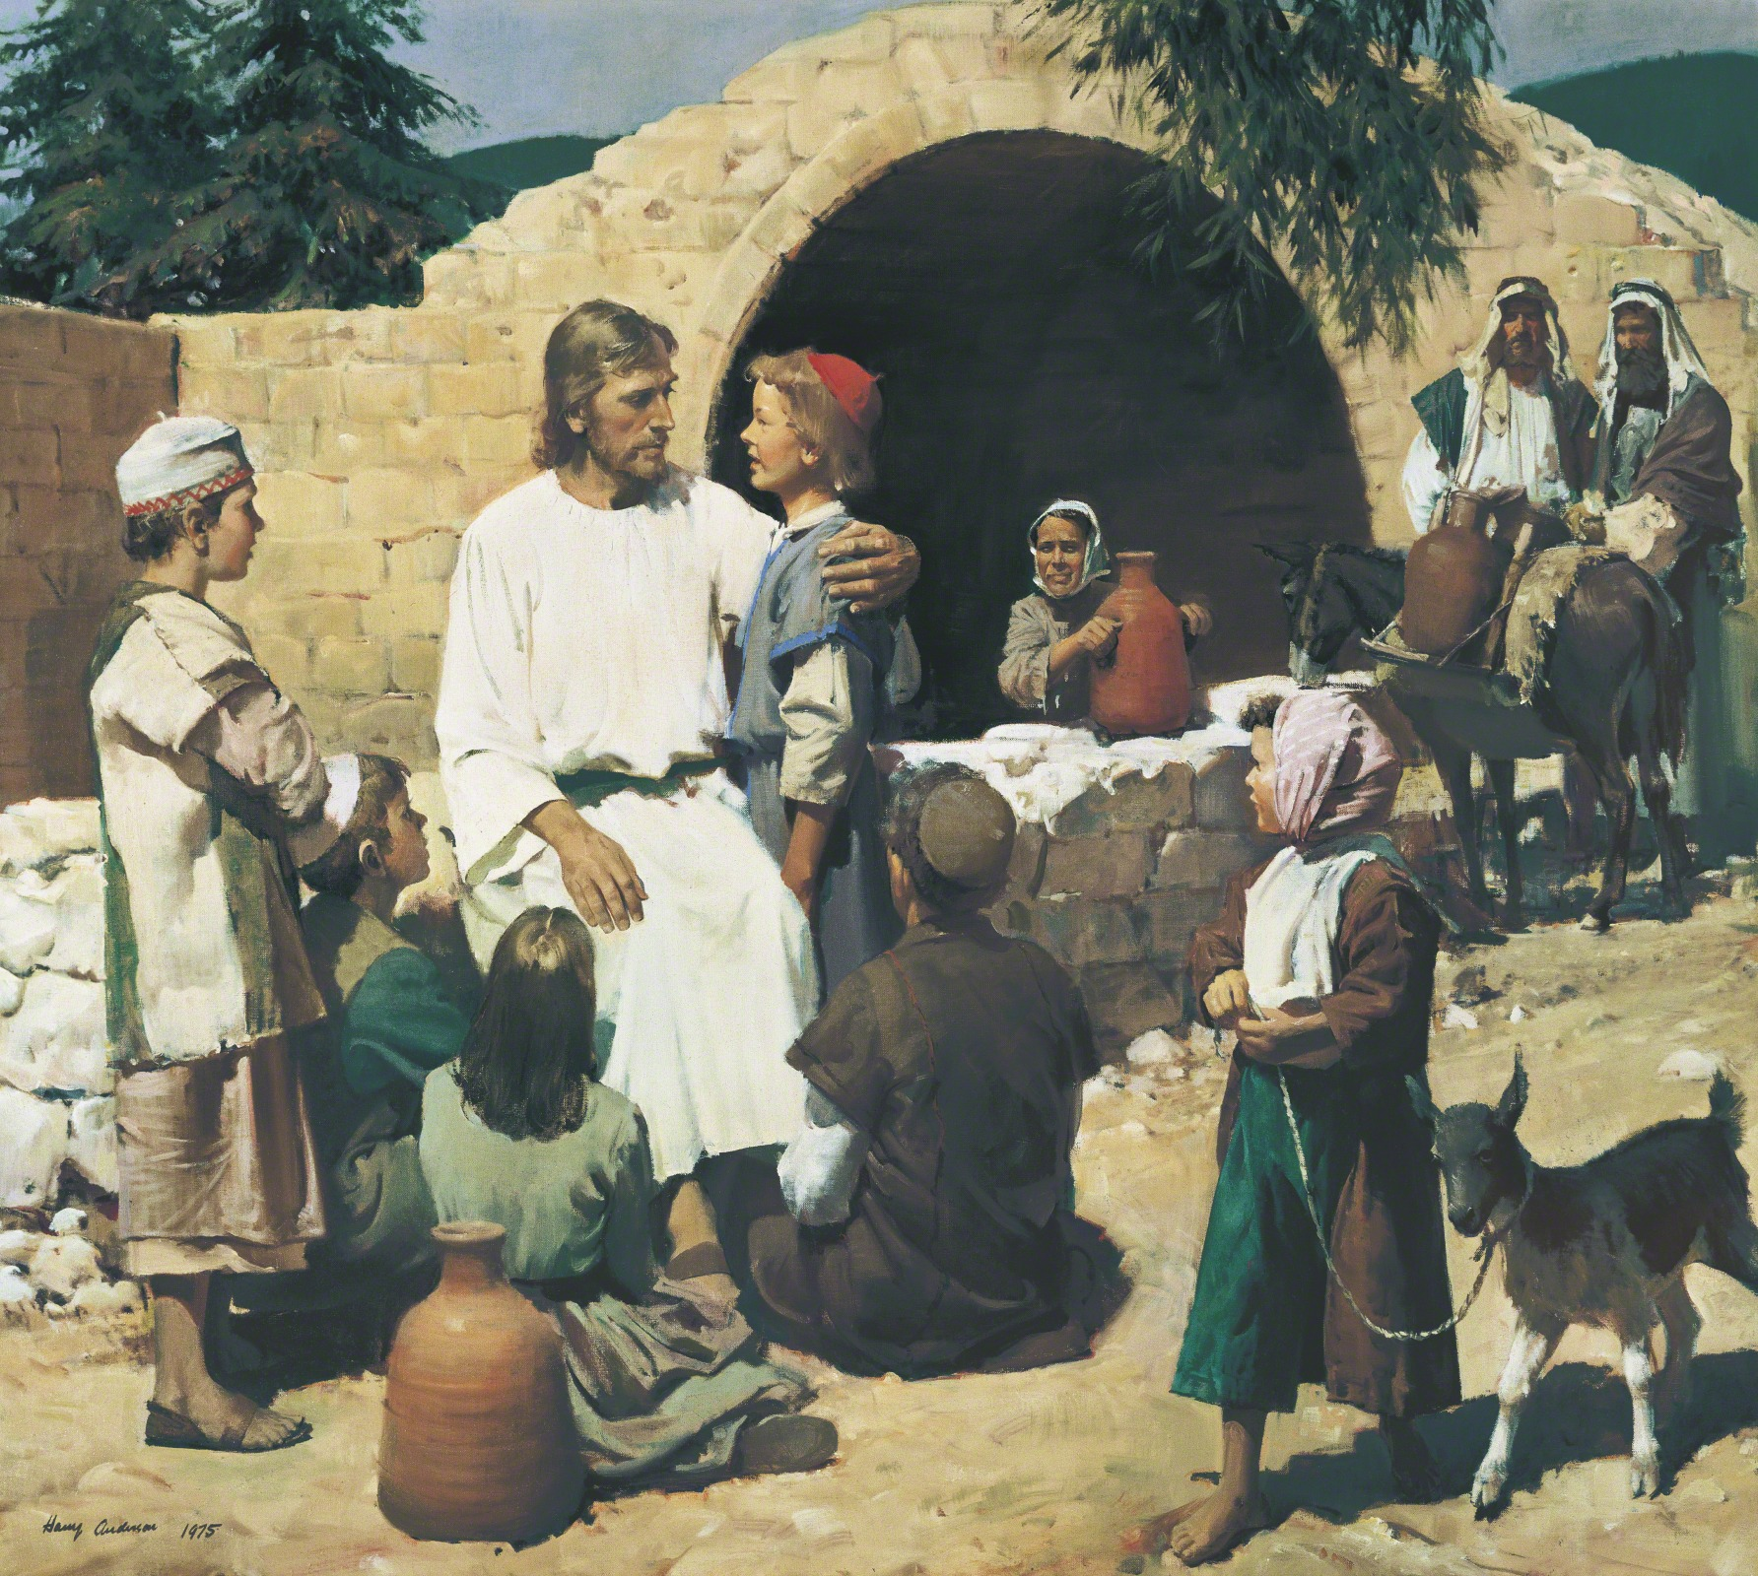
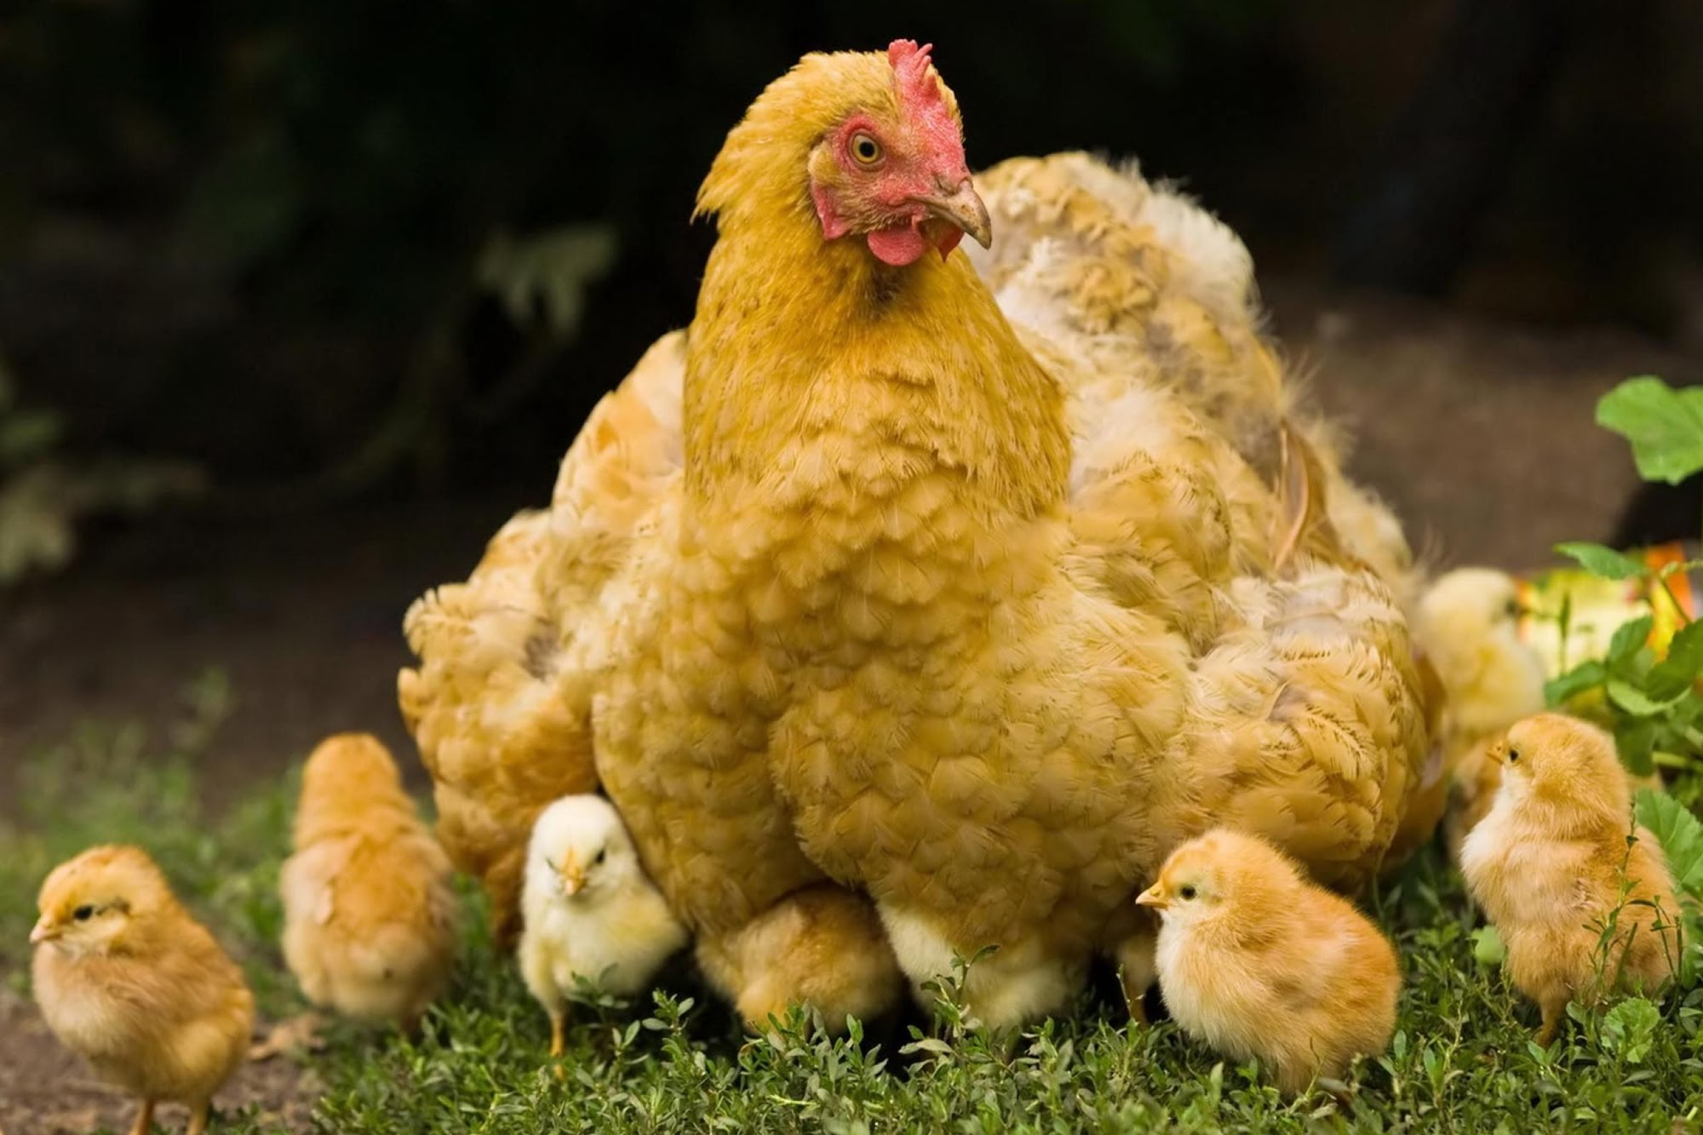
LESSON 35
“Lift up your hearts and be glad”
Why is it sometimes difficult to obey this counsel? What are some ways you have found to obey this counsel?

Slide 5
LESSON 35
Doctrine and Covenants 29:2.
Who will gather his people even as a hen gathereth her chickens under her wings, even as many as will hearken to my voice and humble themselves before me, and call upon me in mighty prayer.
How is the Savior like a hen gathering and protecting her chicks?
What must the chicks do in order to be safely gathered under the protection of their mother’s wings?

Slide 6
LESSON 35
Jesus Christ will gather us as we…
What do we need to do to be gathered by the Savior?
Jesus Christ will gather us as we hearken to His voice, humble ourselves, and call upon Him in prayer.
What are some ways we hear the Savior’s voice?
How is hearkening to the Savior’s voice different from just hearing His voice?
Why do you think we need to be humble in order to be gathered by the Savior?

Slide 7
LESSON 35
“Lift up your hearts and be glad”
How can the thought of being gathered by the Savior help you lift up your heart and be glad?
Doctrine and Covenants 29:1, 3.
1 Listen to the voice of Jesus Christ, your Redeemer, the Great I Am, whose arm of mercy hath atoned for your sins;
3 Behold, verily, verily, I say unto you, that at this time your sins are forgiven you, therefore ye receive these things; but remember to sin no more, lest perils shall come upon you.
Because the Savior has atoned for our sins, we can lift up our hearts and be glad.
How has your testimony of the Atonement of Jesus Christ brought happiness to your life?

Slide 8
LESSON 35
Doctrine and Covenants 29:4-6.
4 Verily, I say unto you that ye are chosen out of the world to declare my gospel with the sound of rejoicing, as with the voice of a trump.
5 Lift up your hearts and be glad, for I am in your midst, and am your advocate with the Father; and it is his good will to give you the kingdom.
6 And, as it is written—Whatsoever ye shall ask in faith, being united in prayer according to my command, ye shall receive.
What words and phrases did you find? What do these words and phrases teach about the experience of sharing the gospel?

Slide 9
LESSON 35
Doctrine and Covenants 29:7-8.
7 And ye are called to bring to pass the gathering of mine elect; for mine elect hear my voice and harden not their hearts;
8 Wherefore the decree hath gone forth from the Father that they shall be gathered in unto one place upon the face of this land, to prepare their hearts and be prepared in all things against the day when tribulation and desolation are sent forth upon the wicked.
What did the Savior call these elders to do?
“To bring to pass the gathering of [His] elect.”
How did the Savior describe His elect?
Those who “hear [His] voice and harden not their hearts.”
How do missionaries help bring to pass the gathering of the elect?
In what places do we gather today?

Slide 10
LESSON 35
Doctrine and Covenants 29:14-21.
“Jesus Christ describes some of the signs that will precede His Second Coming”

Slide 11
LESSON 35
Doctrine and Covenants 29:14-21.
14 But, behold, I say unto you that before this great day shall come the sun shall be darkened, and the moon shall be turned into blood, and the stars shall fall from heaven, and there shall be greater signs in heaven above and in the earth beneath;
15 And there shall be weeping and wailing among the hosts of men;
16 And there shall be a great hailstorm sent forth to destroy the crops of the earth.
17 And it shall come to pass, because of the wickedness of the world, that I will take vengeance upon the wicked, for they will not repent; for the cup of mine indignation is full; for behold, my blood shall not cleanse them if they hear me not.
18 Wherefore, I the Lord God will send forth flies upon the face of the earth, which shall take hold of the inhabitants thereof, and shall eat their flesh, and shall cause maggots to come in upon them;
19 And their tongues shall be stayed that they shall not utter against me; and their flesh shall fall from off their bones, and their eyes from their sockets;
20 And it shall come to pass that the beasts of the forest and the fowls of the air shall devour them up.
21 And the great and abominable church, which is the whore of all the earth, shall be cast down by devouring fire, according as it is spoken by the mouth of Ezekiel the prophet, who spoke of these things, which have not come to pass but surely must, as I live, for abominations shall not reign.

Slide 12
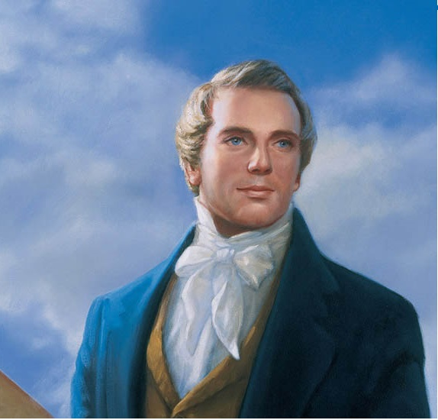
LESSON 35
“Concerning the coming of the Son of Man … it is a false idea that the Saints will escape all the judgments, whilst the wicked suffer; for all flesh is subject to suffer, and ‘the righteous shall hardly escape’ [see D&C 63:34]; still many of the Saints will escape, for the just shall live by faith [see Habakkuk 2:4]; yet many of the righteous shall fall a prey to disease, to pestilence, etc., by reason of the weakness of the flesh, and yet be saved in the Kingdom of God” (Teachings of Presidents of the Church: Joseph Smith[2007],253).
Joseph Smith
Why would you want to be gathered as one of the Savior’s elect when these things happen?

Slide 13
LESSON 35
John 14:27
Peace I leave with you, my peace I give unto you: not as the world giveth, give I unto you. Let not your heart be troubled, neither let it be afraid.
John 16:33
These things I have spoken unto you, that in me ye might have peace. In the world ye shall have tribulation: but be of good cheer; I have overcome the world.
Doctrine and Covenants 59:23
But learn that he who doeth the works of righteousness shall receive his reward, even peace in this world, and eternal life in the world to come.

Slide 14
LESSON 35
Doctrine and Covenants 29:17.
And it shall come to pass, because of the wickedness of the world, that I will take vengeance upon the wicked, for they will not repent; for the cup of mine indignation is full; for behold, my blood shall not cleanse them if they hear me not.
What is the consequence of refusing to repent?
If we do not repent, Jesus Christ’s atoning blood will not cleanse us

Slide 15
LESSON 35
Doctrine and Covenants 29:22-29.
“The Savior reveals truths about what will happen after the Millennium, including the Final Judgment”

Slide 16
LESSON 35
Doctrine and Covenants 29:27.
And the righteous shall be gathered on my right hand unto eternal life; and the wicked on my left hand will I be ashamed to own before the Father;
What blessing will come to us if we have gathered to the Savior?
Those who have lived righteously and come to Jesus Christ will receive eternal life.
Me

