Slide 1
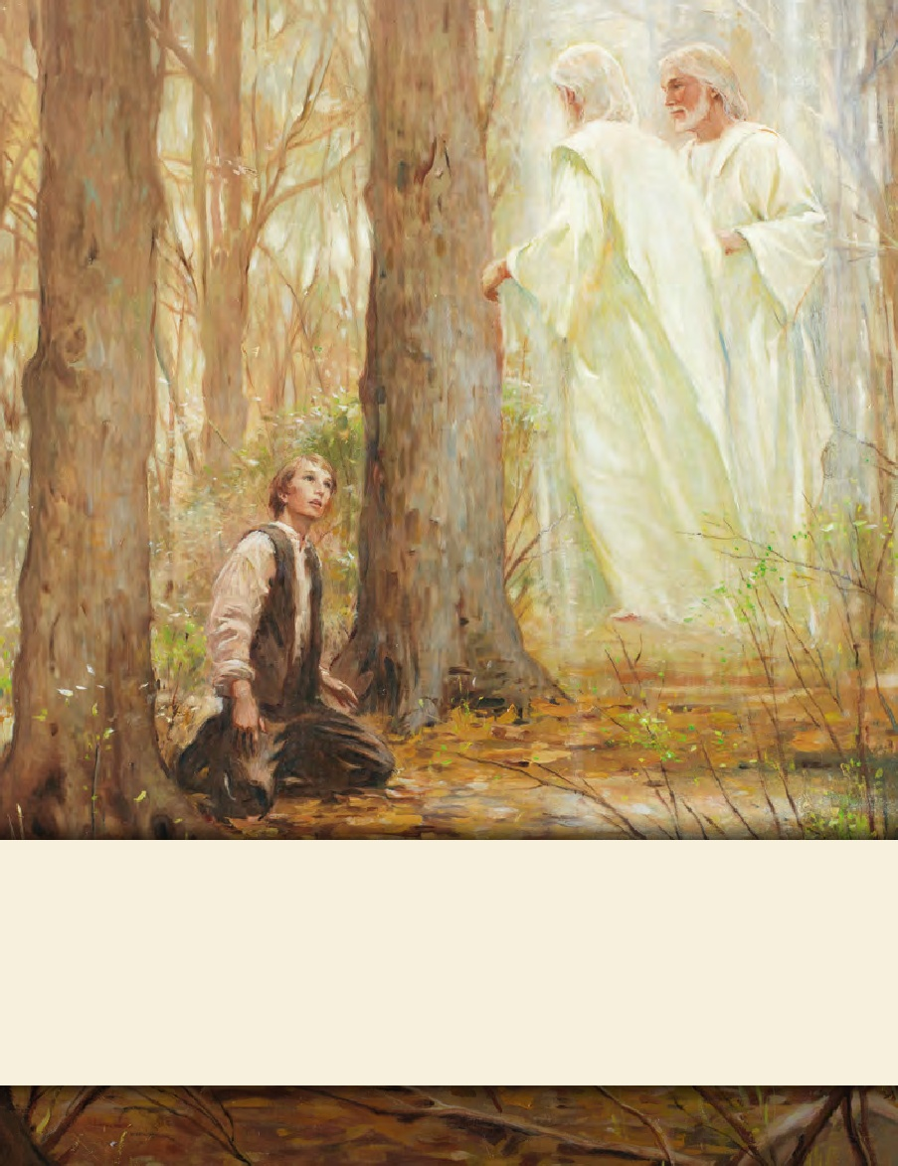
LESSON 15
SEMINARY
Doctrine and Covenants
and Church History

Slide 2
LESSON 34
Doctrine and Covenants 28

Slide 3
LESSON 34
Doctrine and Covenants 28:1-7.
“The Lord declares that the President of the Church is the only person who can receive revelation to govern the Church”

Slide 4
LESSON 34
Imitation.
What are some examples of things that are just imitations?
Real
Imitation
Why might it be harmful to mistake an imitation for something that is real?

Slide 5
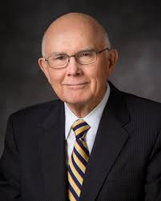
LESSON 34
“The devil is the father of lies, and he is ever anxious to frustrate the work of God by his clever imitations” (“Two Lines of Communication, ”Ensign or Liahona, Nov. 2010, 84).
Dallin H. Oaks

Slide 6
LESSON 34
Introduction Doctrine and Covenants 28
Revelation given through Joseph Smith the Prophet to Oliver Cowdery, at Fayette, New York, September 1830. Hiram Page, a member of the Church, had a certain stone and professed to be receiving revelations by its aid concerning the upbuilding of Zion and the order of the Church. Several members had been deceived by these claims, and even Oliver Cowdery was wrongly influenced thereby. Just prior to an appointed conference, the Prophet inquired earnestly of the Lord concerning the matter, and this revelation followed.
What imitation did Satan use to deceive Church members?

Slide 7
LESSON 34
Doctrine and Covenants 28:1-4
1 Behold, I say unto thee, Oliver, that it shall be given unto thee that thou shalt be heard by the church in all things whatsoever thou shalt teach them by the Comforter, concerning the revelations and commandments which I have given.
2 But, behold, verily, verily, I say unto thee, no one shall be appointed to receive commandments and revelations in this church excepting my servant Joseph Smith, Jun., for he receiveth them even as Moses.
3 And thou shalt be obedient unto the things which I shall give unto him, even as Aaron, to declare faithfully the commandments and the revelations, with power and authority unto the church.
4 And if thou art led at any time by the Comforter to speak or teach, or at all times by the way of commandment unto the church, thou mayest do it.

Slide 8
LESSON 34
How were Oliver Cowdery’s responsibilities different from Joseph Smith’s?
What important truth about the President of the Church can we learn from Doctrine and Covenants 28:2?
The President of the Church is the only person who can receive revelation for the whole Church.
How can our knowledge of this truth help us avoid being deceived?

Slide 9
LESSON 34
Joseph Smith was living in Harmony, Pennsylvania, when he received a letter from Oliver Cowdery, who was in Fayette, New York, about 100 miles (160 kilometers) away. Oliver said he had discovered an error in the revelation we now call Doctrine and Covenants 20. Oliver wrote: “I command you in the name of God to erase those words.” Joseph traveled to Fayette and learned that the Whitmer family agreed with Oliver about the supposed error in the revelation. Joseph wrote, “It was not without both labor and perseverance that I could prevail with any of them to reason calmly on the subject.” Eventually, the Prophet “succeeded in bringing not only the Whitmer family, but … Oliver Cowdery also to acknowledge that they had been in error” (Histories, Volume 1: 1832–1844,vol. 1 of the Histories series of The Joseph Smith Papers[2012], 426; see also pages 424–25).

Slide 10
LESSON 34
Doctrine and Covenants 28:6-7.
6 And thou shalt not command him who is at thy head, and at the head of the church;
7 For I have given him the keys of the mysteries, and the revelations which are sealed, until I shall appoint unto them another in his stead.
What did the Lord teach Oliver Cowdery?
In the Church of Jesus Christ, individuals do not receive revelation to direct someone who presides over them.
How does this truth relate to the account we just read?
How can this truth help us today?

Slide 11
LESSON 34
Doctrine and Covenants 28:8-10.
“The Lord calls Oliver Cowdery to preach the gospel to the Lamanites”

Slide 12
LESSON 34
Doctrine and Covenants 28:8-10.
8 And now, behold, I say unto you that you shall go unto the Lamanites and preach my gospel unto them; and inasmuch as they receive thy teachings thou shalt cause my church to be established among them; and thou shalt have revelations, but write them not by way of commandment.
9 And now, behold, I say unto you that it is not revealed, and no man knoweth where the city Zion shall be built, but it shall be given hereafter. Behold, I say unto you that it shall be on the borders by the Lamanites.
10 Thou shalt not leave this place until after the conference; and my servant Joseph shall be appointed to preside over the conference by the voice of it, and what he saith to thee thou shalt tell.
What did the Lord call Oliver to do?
Preach the gospel among the Lamanites.
What can we learn about personal revelation from Doctrine and Covenants 28:8?
We may receive revelation for our own benefit and to help us in the callings and assignments we are given.

Slide 13
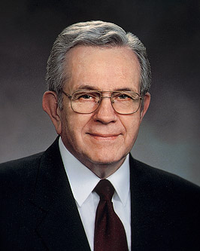
LESSON 34
“We are entitled to personal revelation. However, unless we are set apart to some presiding office, we will not receive revelations concerning what others should do.… “An unusual spiritual experience should not be regarded as a personal call to direct others. It is my conviction that experiences of a special, sacred nature are individual and should be kept to oneself” (“Revelation in a Changing World,” Ensign, Nov. 1989,14–15).
Boyd K. Packer

Slide 14
LESSON 34
Doctrine and Covenants 28:11-16.
“The Lord directs Oliver Cowdery to correct Hiram Page and help set the Church in order”

Slide 15
LESSON 34
Doctrine and Covenants 28:11-14.
11 And again, thou shalt take thy brother, Hiram Page, between him and thee alone, and tell him that those things which he hath written from that stone are not of me and that Satan deceiveth him;
12 For, behold, these things have not been appointed unto him, neither shall anything be appointed unto any of this church contrary to the church covenants.
13 For all things must be done in order, and by common consent in the church, by the prayer of faith.
14 And thou shalt assist to settle all these things, according to the covenants of the church, before thou shalt take thy journey among the Lamanites.
What did the Lord command Oliver to do to help resolve the problem with Hiram Page?
What can we learn from these verses about the responsibilities of Church leaders?
Church leaders have the responsibility to correct those who are leading others astray.

Slide 16
LESSON 34
What can we learn from Doctrine and Covenants 28:13 about the way the Lord leads His Church?
In the Church of Jesus Christ, all things must be done in order.
Why do you think it is important that individuals are publicly sustained in their callings?

Slide 17
LESSON 34
“Revelation in the Church comes to those who have been properly called, sustained, ordained, or set apart. A bishop, for instance, will not receive any revelation concerning a neighboring ward, because that is out of his jurisdiction. “Occasionally someone will claim to have received authority to teach and bless without having been called and set apart.… “That is why the process of sustaining those called to office is so carefully protected in the Church—that all might know who has authority to teach and to bless” (“Revelation in a Changing World,”15).
Boyd K. Packer
According to President Packer, why do we publicly sustain those who receive Church callings?
After we raise our hands to say that we will sustain people in their callings, what should we do to truly sustain them?

Slide 18
LESSON 34
You receive an electronic communication claiming to be new revelation. It contains teachings that are not in harmony with the scriptures or the words of the living prophets.
You notice that a member of your ward makes a statement that is doctrinally incorrect as she bears her testimony during sacrament meeting. You are concerned that if the message is mistaken for truth, it might have a hurtful impact on others.
Who should correct the member who spoke incorrectly?
Doctrine and Covenants 28:15-16.
15 And it shall be given thee from the time thou shalt go, until the time thou shalt return, what thou shalt do.
16 And thou must open thy mouth at all times, declaring my gospel with the sound of rejoicing. Amen.

