Slide 1
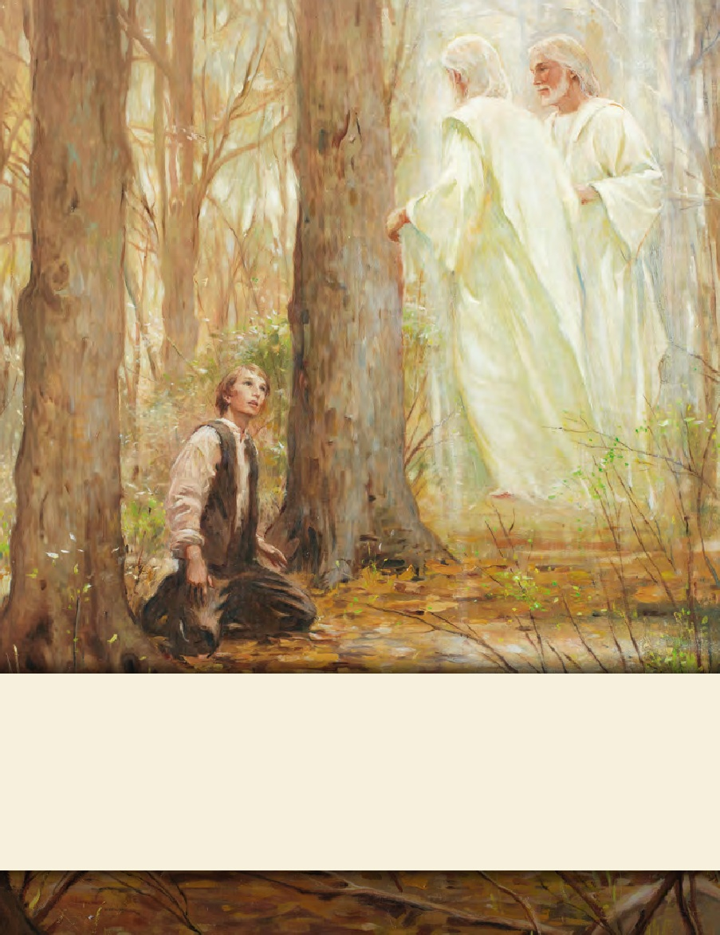
LESSON 15
SEMINARY
Doctrine and Covenants
and Church History

Slide 2
LESSON 33
Doctrine and Covenants 27

Slide 3
LESSON 33
Doctrine and Covenants 27:1-4.
“The Lord gives instructions concerning the emblems of the sacrament”

Slide 4
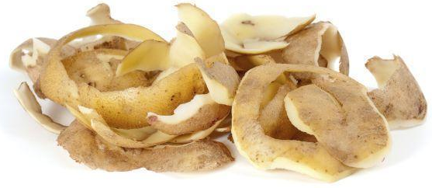
LESSON 33

Slide 5
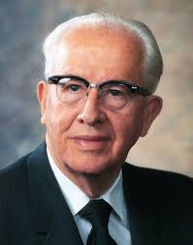
LESSON 33
“I cannot forget the French Saints who, unable to obtain bread, used potato peelings for the emblems of the sacrament” (“Prepare for the Days of Tribulation, ”Ensign, Nov. 1980,33–34).
Ezra Taft Benson
What would you think if you saw potato peelings being used for the sacrament?
Why do you think it was acceptable for the French Saints to use something other than bread for the emblems of the sacrament?

Slide 6
LESSON 33
Doctrine and Covenants 27:1-2.
1 Listen to the voice of Jesus Christ, your Lord, your God, and your Redeemer, whose word is quick and powerful.
2 For, behold, I say unto you, that it mattereth not what ye shall eat or what ye shall drink when ye partake of the sacrament, if it so be that ye do it with an eye single to my glory—remembering unto the Father my body which was laid down for you, and my blood which was shed for the remission of your sins.
What did the messenger teach Joseph Smith about what we should eat or drink as we partake of the sacrament?
What we use as emblems of the sacrament is not as important as what those emblems help us remember.
What should be our focus as we partake of the sacrament?
As we partake of the sacrament, we are to remember the atoning sacrifice of Jesus Christ.

Slide 7
LESSON 33
What have you experienced when you have reflected upon the Savior’s atoning sacrifice during the administration of the sacrament?
What can we do to improve our ability to remember the sacrifice of Jesus Christ and partake of the sacrament “with an eye single to [His]glory”?

Slide 8
LESSON 33
Doctrine and Covenants 27:5-14.
“The Lord will partake of the sacrament again on the earth”

Slide 9
LESSON 33
Doctrine and Covenants 27:5-12.
5 Behold, this is wisdom in me; wherefore, marvel not, for the hour cometh that I will drink of the fruit of the vine with you on the earth, and with Moroni, whom I have sent unto you to reveal the Book of Mormon, containing the fulness of my everlasting gospel, to whom I have committed the keys of the record of the stick of Ephraim;
6 And also with Elias, to whom I have committed the keys of bringing to pass the restoration of all things spoken by the mouth of all the holy prophets since the world began, concerning the last days;
7 And also John the son of Zacharias, which Zacharias he (Elias)visited and gave promise that he should have a son, and his name should be John, and he should be filled with the spirit of Elias;
8 Which John I have sent unto you, my servants, Joseph Smith, Jun., and Oliver Cowdery, to ordain you unto the first priesthood which you have received, that you might be called and ordained even as Aaron;
9 And also Elijah, unto whom I have committed the keys of the power of turning the hearts of the fathers to the children, and the hearts of the children to the fathers, that the whole earth may not be smitten with a curse;
10 And also with Joseph and Jacob, and Isaac, and Abraham, your fathers, by whom the promises remain;
11 And also with Michael, or Adam, the father of all, the prince of all, the ancient of days;
12 And also with Peter, and James, and John, whom I have sent unto you, by whom I have ordained you and confirmed you to be apostles, and especial witnesses of my name, and bear the keys of your ministry and of the same things which I revealed unto them;

Slide 10
LESSON 33
Doctrine and Covenants 27:12-13.
12 And also with Peter, and James, and John, whom I have sent unto you, by whom I have ordained you and confirmed you to be apostles, and especial witnesses of my name, and bear the keys of your ministry and of the same things which I revealed unto them;
13 Unto whom I have committed the keys of my kingdom, and a dispensation of the gospel for the last times; and for the fulness of times, in the which I will gather together in one all things, both which are in heaven, and which are on earth;
12 And also with Peter, and James, and John, whom I have sent unto you, by whom I have ordained you and confirmed you to be apostles, and especial witnesses of my name, and bear the keys of your ministry and of the same things which I revealed unto them;
13 Unto whom I have committed the keys of my kingdom, and a dispensation of the gospel for the last times; and for the fulness of times, in the which I will gather together in one all things, both which are in heaven, and which are on earth;
What keys did the Lord commit, or give, to the Prophet Joseph Smith?
Joseph Smith and keys of the Lord’s kingdom.
What does the Lord say He will do during the dispensation of the fulness of times?
“Gather together in one all things.”

Slide 11
LESSON 33
The dispensation of the fulness of times gathers together all gospel keys, ordinances, and truths of past dispensations.
Doctrine and Covenants 27:14.
And also with all those whom my Father hath given me out of the world.
Whom do you think the phrase “all those whom my Father hath given me out of the world” refers to?

Slide 12
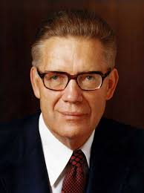
LESSON 33
“Every faithful person in the whole history of the world, every person who has so lived as to merit eternal life in the kingdom of the Father will be in attendance and will partake, with the Lord, of the sacrament” (The Promised Messiah: The First Coming of Christ[1978],595).
Bruce R. McConkie
According to Elder McConkie, how must we live in order to be present at this special sacrament meeting?

Slide 13
LESSON 33
Doctrine and Covenants 27:15-18.
“The Lord commands His people to put on the whole armor of God”

Slide 14
LESSON 33
Doctrine and Covenants 27:15.
Wherefore, lift up your hearts and rejoice, and gird up your loins, and take upon you my whole armor, that ye may be able to withstand the evil day, having done all, that ye may be able to stand.
What does the Lord counsel us to do to prepare for spiritual battles?
If we take upon ourselves the whole armor of God…
What blessing does the Lord promise those who put on the whole armor of God?
If we take upon ourselves the whole armor of God, we will be able to withstand evil

Slide 15
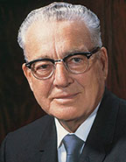
LESSON 33
“We have the four parts of the body that the Apostle Paul said [are] the most vulnerable to the powers of darkness. The loins, typifying virtue, chastity. The heart, typifying our conduct. Our feet, our goals or objectives in life and finally our head, our thoughts” (Harold B. Lee, Feet Shod with the Preparation of the Gospel of Peace, Brigham Young University Speeches of the Year [Nov.9, 1954],2).
Harold B. Lee

Slide 16
LESSON 33
“Loins girt about with truth”(see D&C 27:15–16):
President Lee said, “The loins is that part of the body between the lower rib and the hip into which you will recognize are the vital organs which have to do with reproduction” (Feet Shod,2). To gird implies tying firmly with a belt.
Why do you think Satan attacks our purity, virtue, and chastity?
How do you think knowing God’s standard of morality can help us stay pure, virtuous, and chaste?
Loins girt
Scripture study helps gird us in truth and helps protect virtue and chastity.

Slide 17
LESSON 33
Breastplate of righteousness”(D&C 27:16):
According to President Lee, what does the breastplate protect?
How do you think the righteousness of our hearts (our conduct and desires) influences our ability to fight our spiritual battles?
Breastplate
Loins girt

Slide 18
LESSON 33
“Feet shod with the preparation of the gospel of peace”(D&C 27:16):
Having your feet “shod” means wearing shoes or protection on your feet.
According to President Lee, what do our feet represent?
How does Satan attack our goals and objectives in life?
What has God given us to “hold to” in order to help us keep our feet moving along the path of life toward our goals? (See 1Nephi 8:24.)
How can focusing on righteous goals and objectives help us overcome temptation?
Breastplate
Loins girt
Feet shod

Slide 19
LESSON 33
“The shield of faith”(D&C 27:17):
What do you think it means to “quench all the fiery darts of the wicked”?
How has your faith shielded and protected you?
The shield
Breastplate
Loins girt
Feet shod

Slide 20
LESSON 33
The helmet
“The helmet of salvation”(D&C 27:18):
According to President Lee, what is protected when our head is covered?
Why is it important to protect our thoughts?
How does Satan attack our thoughts?
What specific things can we do to protect our thoughts?
The shield
Breastplate
Loins girt
Feet shod

Slide 21
LESSON 33
The helmet
The sword
“The sword of my Spirit”(D&C 27:18):
How can the Spirit help us overcome Satan’s attacks?
What advantage does having the Spirit give us in our fight against evil?
How does the word of God help us use the sword of the Spirit?
What can you do to invite the Spirit into your life more?
The shield
Breastplate
Loins girt
Feet shod

Slide 22
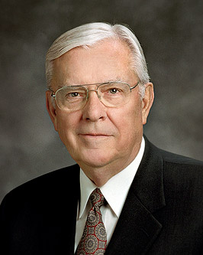
LESSON 33
“I like to think of this spiritual armor not as a solid piece of metal molded to fit the body but more like chain mail. Chain mail consists of dozens of tiny pieces of steel fastened together to allow the user greater flexibility without losing protection. I say that because it has been my experience that there is not one great and grand thing we can do to arm ourselves spiritually. True spiritual power lies in numerous smaller acts woven together in a fabric of spiritual fortification that protects and shields from all evil” (“Be Strong in the Lord,” Ensign, July 2004,8).
M. Russell Ballard
What are some small acts that, combined in their strength, will help protect us against temptation and evil?

Slide 23
LESSON 33
Doctrine and Covenants 27:15.
Wherefore, lift up your hearts and rejoice, and gird up your loins, and take upon you my whole armor, that ye may be able to withstand the evil day, having done all, that ye may be able to stand.
What attitude should we have as we put on the armor of God?
(We should “lift up [our] hearts and rejoice.”)
Why should we have this attitude?

