Slide 1
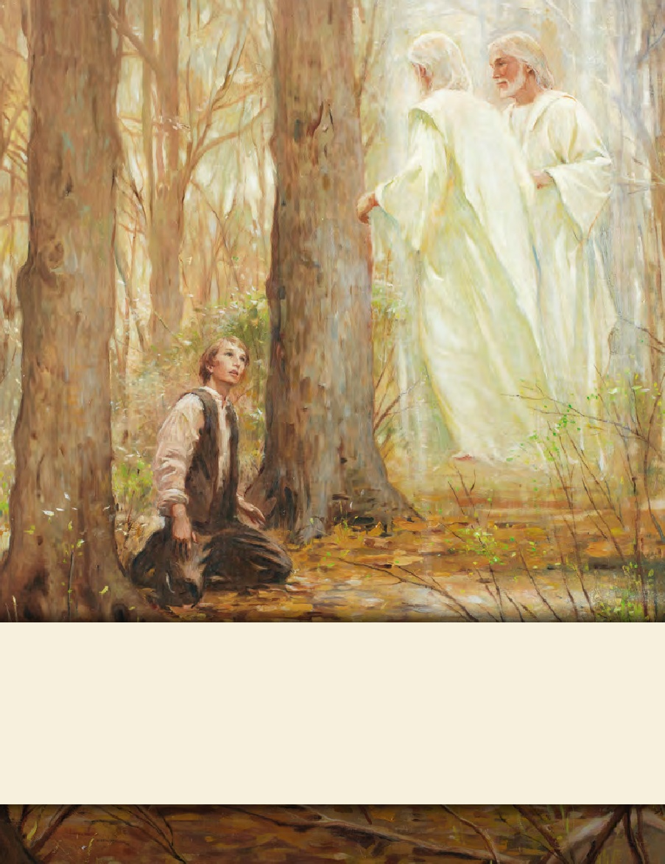
LESSON 15
SEMINARY
Doctrine and Covenants
and Church History

Slide 2
LESSON 32
Doctrine and Covenants 25

Slide 3
LESSON 32
Doctrine and Covenants 25:1-3.
“The Lord addresses Emma Smith as an elect lady”

Slide 4
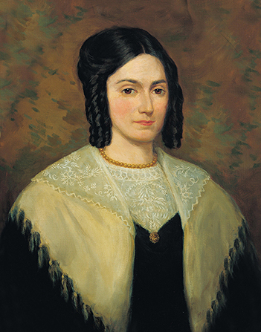
LESSON 32
Emma assisted Joseph Smith during the translation of the Book of Mormon.
Shortly after Emma Hale married Joseph Smith, the angel Moroni told Joseph that the time had come for him to receive the gold plates. Early in the morning on September 22, 1827, Joseph and Emma rode together in a wagon to the Hill Cumorah, where Joseph received the plates. Because of persecution in New York, Joseph and Emma then moved to Harmony, Pennsylvania, where they eventually purchased land from Emma’s parents. There in Harmony, the Prophet began to translate the plates. For a time, Emma acted as scribe while Joseph translated. Up to this point, Joseph had been commanded that he should show the plates to no one, not even Emma. Although Emma observed the plates lying on the table covered by a linen cloth, she never lifted the cloth to look at them.

Slide 5
LESSON 32
Emma experienced tragedy, heartache, and persecution.
While living in Harmony, Pennsylvania, Emma gave birth to a son named Alvin who did not long survive. Emma herself became critically ill, and Joseph feared she would not live. When she recovered, she heard the devastating news that the 116 translated pages of manuscript had been lost by Joseph’s friend Martin Harris. Even in her frail health, Emma consoled her heartbroken husband, who had lost the power to translate. Together, they awaited the Lord’s will for the translation of the plates. She was later forced to leave her home in Harmony because of threats from malicious people.

Slide 6
LESSON 32
The day Emma was baptized, Joseph was arrested. In June 1830, Joseph and a small group of believers built a dam in a stream near Colesville, New York, to create a pool deep enough to perform baptisms. However, a mob tore down the dam before any baptisms could be performed. The next day, the Saints rebuilt the dam and performed baptisms for 13 people, including Emma Smith. That night, just before the confirmations were to be performed, Joseph was arrested on charges of “being a disorderly person” (History of the Church,1:88). He was tried and acquitted, but immediately after the trial he was arrested again on the same charge by a constable from a neighboring county. He was again released. Because of continuous opposition to their missionary efforts, Church members had to delay their confirmation meetings. Emma wasn’t confirmed a member of the Church and given the gift of the Holy Ghost until early August. In late June, between her baptism and confirmation, Joseph received a revelation directed to Emma, which is now recorded in Doctrine and Covenants 25.

Slide 7
LESSON 32
What impressed you about Emma Smith as you learned about some of her experiences?
Doctrine and Covenants 25:1-3.
1 Hearken unto the voice of the Lord your God, while I speak unto you, Emma Smith, my daughter; for verily I say unto you, all those who receive my gospel are sons and daughters in my kingdom.
2 A revelation I give unto you concerning my will; and if thou art faithful and walk in the paths of virtue before me, I will preserve thy life, and thou shalt receive an inheritance in Zion.
3 Behold, thy sins are forgiven thee, and thou art an elect lady, whom I have called.

Slide 8
LESSON 32
How does knowing that you are a son or daughter in the Lord’s kingdom help you during difficult times?
What did the Lord promise Emma if she would be faithful and “walk in the paths of virtue”?
What do you think it means to “walk in the paths of virtue”? How might a person be protected by walking in paths of virtue?

Slide 9
LESSON 32
Doctrine and Covenants 25:4-16.
“Emma Smith receives counsel regarding her family and Church duties”

Slide 10
LESSON 32
Counsel
Calling
Promise

Slide 11
LESSON 32
Doctrine and Covenants 25:4-16.
4 Murmur not because of the things which thou hast not seen, for they are withheld from thee and from the world, which is wisdom in me in a time to come.
5 And the office of thy calling shall be for a comfort unto my servant, Joseph Smith, Jun., thy husband, in his afflictions, with consoling words, in the spirit of meekness.
6 And thou shalt go with him at the time of his going, and be unto him for a scribe, while there is no one to be a scribe for him, that I may send my servant, Oliver Cowdery, whithersoever I will.
7 And thou shalt be ordained under his hand to expound scriptures, and to exhort the church, according as it shall be given thee by my Spirit.
8 For he shall lay his hands upon thee, and thou shalt receive the Holy Ghost, and thy time shall be given to writing, and to learning much.
9 And thou needest not fear, for thy husband shall support thee in the church; for unto them is his calling, that all things might be revealed unto them, whatsoever I will, according to their faith.
10 And verily I say unto thee that thou shalt lay aside the things of this world, and seek for the things of a better.
11 And it shall be given thee, also, to make a selection of sacred hymns, as it shall be given thee, which is pleasing unto me, to be had in my church.
12 For my soul delighteth in the song of the heart; yea, the song of the righteous is a prayer unto me, and it shall be answered with a blessing upon their heads.
13 Wherefore, lift up thy heart and rejoice, and cleave unto the covenants which thou hast made.
14 Continue in the spirit of meekness, and beware of pride. Let thy soul delight in thy husband, and the glory which shall come upon him.
15 Keep my commandments continually, and a crown of righteousness thou shalt receive. And except thou do this, where I am you cannot come.
16 And verily, verily, I say unto you, that this is my voice unto all. Amen.

Slide 12
LESSON 32
Which of the phrases or ideas you identified show that the Lord knew and loved Emma Smith?
What are some lessons you learn from the Lord’s words to Emma?
We are to lay aside the things of the world and seek for that which is eternal.
As we worship the Lord through righteous music, He will bless us.
We can find joy and comfort in cleaving to the covenants we have made with God.
If we will keep God’s commandments continually, we will receive a crown of righteousness.

Slide 13
LESSON 32
We are to lay aside the things of the world and seek for that which is eternal.
How do you think the counsel to put eternal things before the things of this world might have been helpful to Emma, especially as Joseph Smith’s wife?
How is the counsel to put eternal things before the things of the world helpful to us today?
What are some things of the world that people tend to place ahead of God?
What can we do to seek for things that are eternal?

Slide 14
LESSON 32
As we worship the Lord through righteous music, He will bless us.
What is one thing the Lord delights in? What does He say about the blessings that come through “the song of the righteous”?
What blessings have you received as a result of worshipping the Lord through appropriate music?

Slide 15
LESSON 32
We can find joy and comfort in cleaving to the covenants we have made with God.
How has that faithfulness been a blessing to him or her?
When have you been blessed because you have been faithful to the covenants you have made?

Slide 16
LESSON 32
If we will keep God’s commandments continually, we will receive a crown of righteousness.
How might this promise help someone who has been through or is going through hard times?
Why is it important to be obedient continually and not just periodically?

