Slide 1
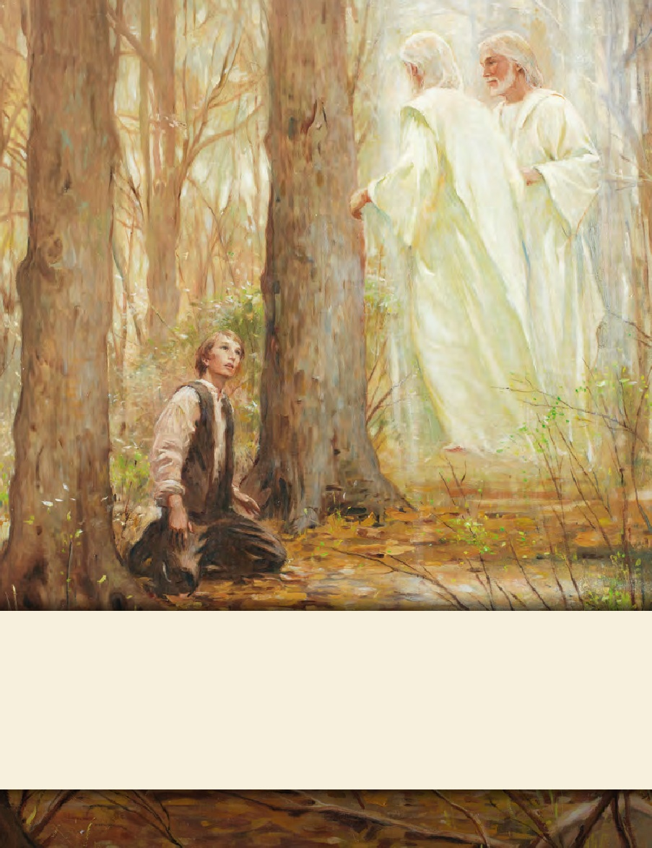
LESSON 15
SEMINARY
Doctrine and Covenants
and Church History

Slide 2
LESSON 31
Doctrine and Covenants 24-26

Slide 3
LESSON 31
Doctrine and Covenants 24:1-12.
“Joseph Smith and Oliver Cowdery receive counsel regarding their callings”

Slide 4
LESSON 31
What do you do when life is difficult?

Slide 5
LESSON 31
The heading to section 24
Revelation given to Joseph Smith the Prophet and Oliver Cowdery, at Harmony, Pennsylvania, July 1830. Though less than four months had elapsed since the Church was organized, persecution had become intense, and the leaders had to seek safety in partial seclusion. The following three revelations were given at this time to strengthen, encourage, and instruct them.

Slide 6
LESSON 31
Read the following historical background:
In June 1830, Joseph Smith and a few colleagues went to Colesville, New York, to visit with people who were interested in being baptized. A stream was dammed to prepare for baptisms the next day (Sunday), but a hostile mob destroyed the dam during the night. Early Monday morning, the dam was rebuilt and 13 people were baptized, including Emma Smith. By the time the baptisms were completed, however, a mob of nearly 50 men had gathered, insulting and threatening to harm the Saints. That evening, the Saints met to confirm those who had been baptized earlier that day, but before the confirmations could be performed, Joseph was arrested on charges of “being a disorderly person, of setting the country in an uproar by preaching the Book of Mormon.” (See History of the Church,1:86–88.)
En route to his trial, Joseph escaped a mob with the help of the sympathetic constable who escorted him. After standing trial and being acquitted of the charges, Joseph was immediately arrested again by a constable from a different county. That night Joseph was ridiculed and abused by “a number of men,” and the next morning he stood trial. Joseph was again acquitted of the charges and escaped another mob as he traveled home. (See History of the Church,1:88–96.)
Joseph Smith and Oliver Cowdery made another attempt to unite with the recently baptized members in Colesville, but a mob gathered shortly after they arrived. Joseph and Oliver were forced to flee, barely escaping as the mob pursued them throughout the night (see History of the Church,1:97). Joseph said of this trying time, “Notwithstanding all the rage of our enemies, we had much consolation, and many things occurred to strengthen our faith and cheer our hearts” (in History of the Church,1:101).

Slide 7
LESSON 31
Strengthen and Encourage
Instruct

Slide 8
LESSON 31
Doctrine and Covenants 24
1 Behold, thou wast called and chosen to write the Book of Mormon, and to my ministry; and I have lifted thee up out of thine afflictions, and have counseled thee, that thou hast been delivered from all thine enemies, and thou hast been delivered from the powers of Satan and from darkness!
2 Nevertheless, thou art not excusable in thy transgressions; nevertheless, go thy way and sin no more.
3 Magnify thine office; and after thou hast sowed thy fields and secured them, go speedily unto the church which is in Colesville, Fayette, and Manchester, and they shall support thee; and I will bless them both spiritually and temporally;
4 But if they receive thee not, I will send upon them a cursing instead of a blessing.
5 And thou shalt continue in calling upon God in my name, and writing the things which shall be given thee by the Comforter, and expounding all scriptures unto the church.
6 And it shall be given thee in the very moment what thou shalt speak and write, and they shall hear it, or I will send unto them a cursing instead of a blessing.
7 For thou shalt devote all thy service in Zion; and in this thou shalt have strength.
8 Be patient in afflictions, for thou shalt have many; but endure them, for, lo, I am with thee, even unto the end of thy days.
9 And in temporal labors thou shalt not have strength, for this is not thy calling. Attend to thy calling and thou shalt have wherewith to magnify thine office, and to expound all scriptures, and continue in laying on of the hands and confirming the churches.
10 And thy brother Oliver shall continue in bearing my name before the world, and also to the church. And he shall not suppose that he can say enough in my cause; and lo, I am with him to the end.
11 In me he shall have glory, and not of himself, whether in weakness or in strength, whether in bonds or free;
12 And at all times, and in all places, he shall open his mouth and declare my gospel as with the voice of a trump, both day and night. And I will give unto him strength such as is not known among men.

Slide 9
LESSON 31
What principle can we learn from Doctrine and Covenants 24:8 regarding what can help us in our afflictions?
If we are patient and endure our afflictions, the Lord will be with us.
Why can it be hard to be patient during afflictions?
When have you seen people exercise patience and remain faithful during afflictions?
How did the Lord show those people that He was with them?

Slide 10
LESSON 31
Doctrine and Covenants 24:10-12
10 And thy brother Oliver shall continue in bearing my name before the world, and also to the church. And he shall not suppose that he can say enough in my cause; and lo, I am with him to the end.
11 In me he shall have glory, and not of himself, whether in weakness or in strength, whether in bonds or free;
12 And at all times, and in all places, he shall open his mouth and declare my gospel as with the voice of a trump, both day and night. And I will give unto him strength such as is not known among men.
10 And thy brother Oliver shall continue in bearing my name before the world, and also to the church. And he shall not suppose that he can say enough in my cause; and lo, I am with him to the end.
11 In me he shall have glory, and not of himself, whether in weakness or in strength, whether in bonds or free;
12 And at all times, and in all places, he shall open his mouth and declare my gospel as with the voice of a trump, both day and night. And I will give unto him strength such as is not known among men.
What blessings did the Lord promise Oliver if he would continue faithfully in doing what the Lord asked?

Slide 11
LESSON 31
If then…
we faithfully do what the Lord asks of us, then He will strengthen us.
How has the Lord strengthened you as you have been faithful to Him?

Slide 12
LESSON 31
Doctrine and Covenants 24:13-19.
“The Lord instructs Joseph Smith and Oliver Cowdery about their work and about those who oppose them”

Slide 13
LESSON 31
Doctrine and Covenants 26.
The Lord instructs Joseph Smith, Oliver Cowdery, and John Whitmer

Slide 14
LESSON 31
Doctrine and Covenants 26:2.
And all things shall be done by common consent in the church, by much prayer and faith, for all things you shall receive by faith. Amen.
What do you think “common consent” means?
Refers to Church members using their agency to express their willingness or unwillingness to support a proposal from a Church leader.
What is the difference between sustaining by common consent and voting?
The law of common consent applies for Church callings, priesthood ordinations, and revelations. We participate in the law of comment consent each time we raise our hands to sustain a person or decision in a Church meeting.

Slide 15
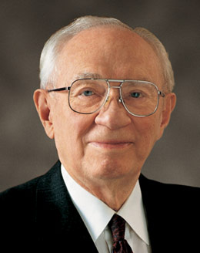
LESSON 31
“The procedure of sustaining is much more than a ritualistic raising of the hand. It is a commitment to uphold, to support, to assist those who have been selected” (“This Work Is Concerned with People,” Ensign, May 1995,51).
Gordon B. Hinckley
What do we commit to do when we raise our hands to sustain others?
How did you feel about being sustained?
How can we sustain others in the three ways President Hinckley described?

