Slide 1
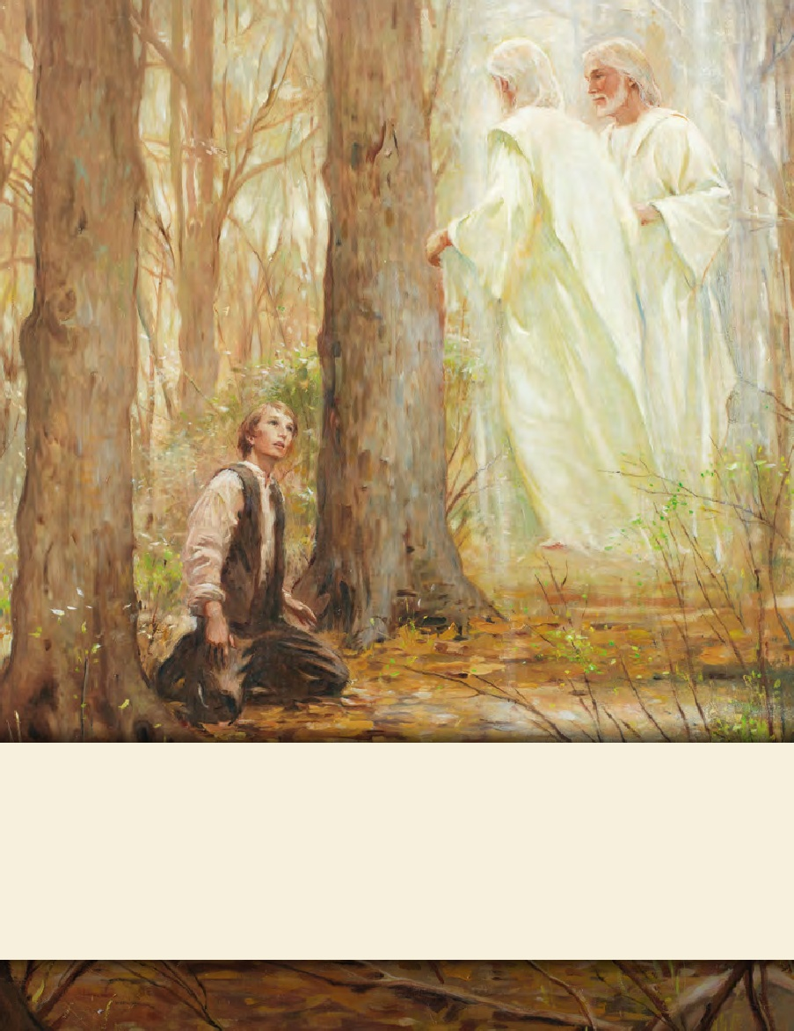
LESSON 15
SEMINARY
Doctrine and Covenants
and Church History

Slide 2
LESSON 30
Doctrine and Covenants 22-23

Slide 3
LESSON 30
Doctrine and Covenants 22.
“Baptism must be performed by those who have the proper authority”

Slide 4
LESSON 30
Doctrine and Covenants 22:1
Behold, I say unto you that all old covenants have I caused to be done away in this thing; and this is a new and an everlasting covenant, even that which was from the beginning.
What phrase in this verse relates to the Restoration of the gospel?
(“A new and an everlasting covenant.”)

Slide 5
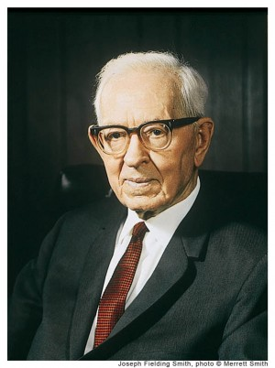
LESSON 30
“The new and everlasting covenant is the fulness of the gospel. [See D&C 66:2.] It is composed of ‘All covenants, contracts, bonds, obligations, oaths, vows, performances, connections, associations, or expectations’ that are sealed upon members of the Church by the Holy Spirit of promise, or the Holy Ghost, by the authority of the President of the Church who holds the keys. [See D&C 132:7.] The President of the Church holds the keys of the Melchizedek Priesthood. He delegates authority to others and authorizes them to perform the sacred ordinances of the
Joseph Fielding Smith
priesthood. “Marriage for eternity is a new and everlasting covenant. Baptism is also a new and everlasting covenant [see D&C 132:22], and likewise ordination to the priesthood, and every other covenant is everlasting and a part of the new and everlasting covenant which embraces all things” (Answers to Gospel Questions, comp. Joseph Fielding Smith Jr., 5 vols. [1957–66],1:65).

Slide 6
LESSON 30
How might learning about the new and everlasting covenant be helpful to those who have been baptized without priesthood authority?
By what authority are ordinances administered under the new and everlasting covenant?
(The authority of the priesthood.)
Baptism must be performed by one having authority from God.

Slide 7
LESSON 30
Doctrine and Covenants 22:2–4
2 Wherefore, although a man should be baptized an hundred times it availeth him nothing, for you cannot enter in at the strait gate by the law of Moses, neither by your dead works.
3 For it is because of your dead works that I have caused this last covenant and this church to be built up unto me, even as in days of old.
4 Wherefore, enter ye in at the gate, as I have commanded, and seek not to counsel your God. Amen.
In what sense are unauthorized baptisms “dead works”?
(They provide no eternal benefit to those who participate in them.)
What did the Lord do because of the dead works that were being performed at that time?
(He caused His covenant to be reestablished and His Church to be built up.)
How have you been blessed because you belong to The Church of Jesus Christ of Latter-day Saints—the only church that has the authority to perform essential ordinances?

Slide 8
LESSON 30
Doctrine and Covenants 23.
“Five men are called to strengthen the Church”

Slide 9
LESSON 30
The Introduction to Doctrine and Covenants 23
A series of five revelations given through Joseph Smith the Prophet, at Manchester, New York, April 1830, to Oliver Cowdery, Hyrum Smith, Samuel H. Smith, Joseph Smith Sr., and Joseph Knight Sr. As the result of earnest desire on the part of the five persons named to know of
respective duties, the Prophet inquired of the Lord and received a revelation for each person.

Slide 10
LESSON 30
Doctrine and Covenants 23:1–2
1 Behold, I speak unto you, Oliver, a few words. Behold, thou art blessed, and art under no condemnation. But beware of pride, lest thou shouldst enter into temptation.
2 Make known thy calling unto the church, and also before the world, and thy heart shall be opened to preach the truth from henceforth and forever. Amen.
What warning did the Lord give to Oliver? How can pride lead to temptation?
What are some ways we can avoid feelings of pride that would lead us to temptation?
What blessing would Oliver have? (The ability to “preach the truth.”)

Slide 11
LESSON 30
Doctrine and Covenants 23:3–5
3 Behold, I speak unto you, Hyrum, a few words; for thou also art under no condemnation, and thy heart is opened, and thy tongue loosed; and thy calling is to exhortation, and to strengthen the church continually. Wherefore thy duty is unto the church forever, and this because of thy family. Amen.
4 Behold, I speak a few words unto you, Samuel; for thou also art under no condemnation, and thy calling is to exhortation, and to strengthen the church; and thou art not as yet called to preach before the world. Amen.
5 Behold, I speak a few words unto you, Joseph; for thou also art under no condemnation, and thy calling also is to exhortation, and to strengthen the church; and this is thy duty from henceforth and forever. Amen.
How were the Lord’s instructions to these men similar?

Slide 12
LESSON 30
The biographical sketch of:
Hyrum Smith, an older brother of the Prophet, assisted in the publication of the Book of Mormon by working directly with the printer. He served as president of the first branch of the Church in Colesville, New York. Hyrum was faithful to the Lord and the Church throughout his life.
Samuel Smith, a younger brother of the Prophet, was baptized in May 1829. In June 1830, he departed on a mission and placed a Book of Mormon that would eventually lead to the conversion of Brigham Young and many of his family members. Samuel was loyal to his family and to the Church throughout his life. Samuel was not ready to preach when this revelation was given, but two months later he would begin his missionary service.
Joseph Smith Sr., the Prophet’s father, joined the Church the day it was organized. The following summer, he and his son Don Carlos embarked on a mission to extended family in New York. He became a high priest and the first patriarch of the Church. Joseph Smith Jr. described his father as “a man faithful to his God and to the Church in every situation and under all circumstances through which he was called to pass” (History of the Church,4:192).

Slide 13
LESSON 30
What are the similarities and differences between the instructions to Hyrum Smith and Samuel Smith?
What are some ways in which we can exhort and strengthen the Church?

Slide 14
LESSON 30
The biographical sketch
of Joseph Knight Sr
Joseph Knight Sr. was a close friend of Joseph Smith Jr. and had shown him great kindness. He provided the Prophet with supplies while he worked on the translation of the Book of Mormon. He had felt a desire to be baptized with others on the day the Church was organized, but he refrained because he wanted to study the Book of Mormon further. He later wrote, “I should [have] felt better if I had … gone forward” to be baptized (as quoted in Larry Porter, “The Joseph Knight Family,” Ensign, Oct. 1978, 40; spelling and capitalization standardized).
6 Behold, I manifest unto you, Joseph Knight, by these words, that you must take up your cross, in the which you must pray vocally before the world as well as in secret, and in your family, and among your friends, and in all places.
7 And, behold, it is your duty to unite with the true church, and give your language to exhortation continually, that you may receive the reward of the laborer. Amen.
Doctrine and Covenants 23:6–7

Slide 15
LESSON 30
What was Joseph Knight commanded to do?
What evidence do you see in Doctrine and Covenants 23:7 that the Lord desired to bless Joseph Knight Sr.?

