Slide 1
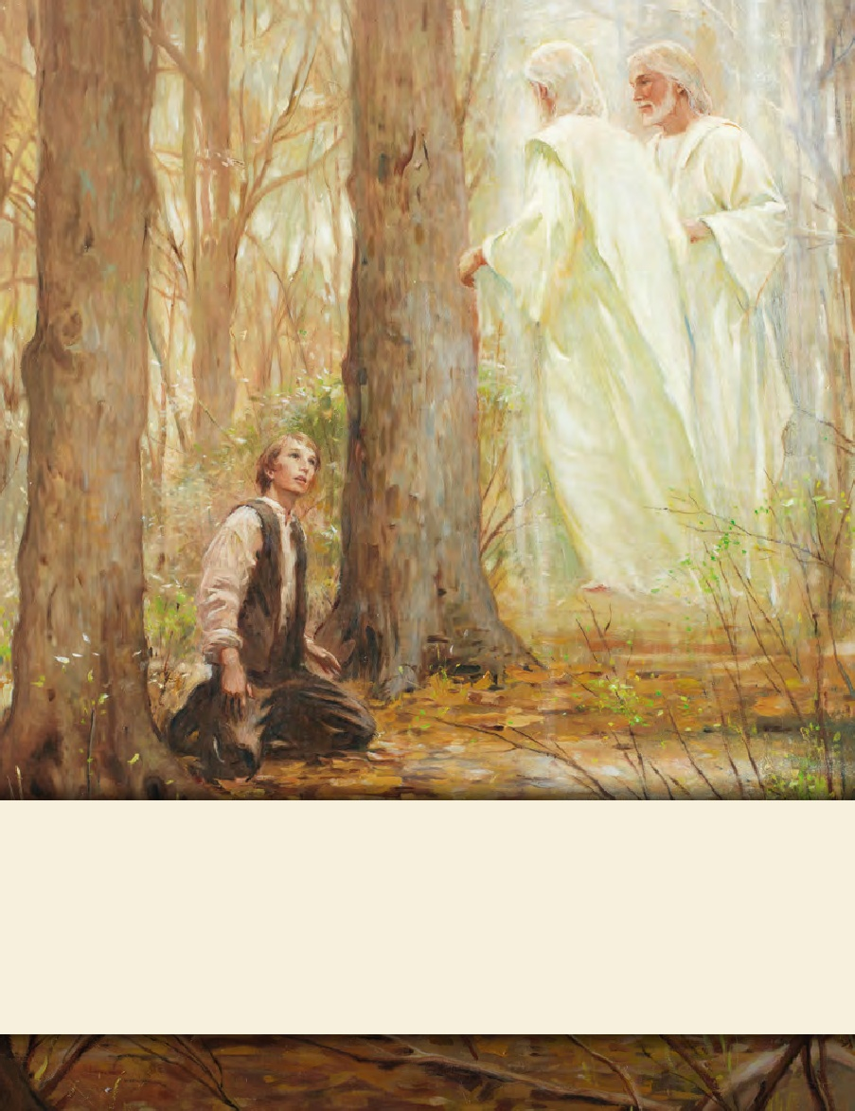
SEMINARY
Doctrine and Covenants
and Church History

Slide 2
LESSON 3
The Great Apostasy

Slide 3
LESSON 3
Introduction
Jesus Christ established His Church during His ministry on the earth. “The Apostles, after the Ascension of Christ, continued to exercise the keys He left with them. But because of disobedience and loss of faith by the members, the Apostles died without the keys being passed on to successors. We call that tragic episode ‘the Apostasy’” (Henry B. Eyring, “The True and Living Church, ”Ensign or Liahona, May 2008, 21). Because of this widespread apostasy, the Lord took the priesthood authority away from the people. Understanding the Great Apostasy helps us better understand the need for the Restoration of the gospel of Jesus Christ in the latter days.

Slide 4
LESSON 3
Jesus Christ established His Church when He was on the earth.
What happens when this part is missing from the piece of equipment it belongs to?
How might this example be compared to the Church of Jesus Christ?

Slide 5
LESSON 3
Essential Elements of Jesus Christ’s Church
19 Now therefore ye are no more strangers and foreigners, but fellow citizens with the saints, and of the household of God;
20 And are built upon the foundation of the apostles and prophets, Jesus Christ himself being the chief corner stone;
21 In whom all the building fitly framed together groweth unto an holy temple in the Lord:
22 In whom ye also are builded together for an habitation of God through the Spirit.
Ephesians 2:19–22

Slide 6
LESSON 3
Apostles and prophets form the foundation of the Church of Jesus Christ.
Why do you think apostles and prophets are considered the “foundation” of the Church?

Slide 7
LESSON 3
Mark 3:13-14:
13 And he goeth up into a mountain, and calleth unto him whom he would: and they came unto him.
14 And he ordained twelve, that they should be with him, and that he might send them forth to preach,
“Priesthood authority is necessary to receive the ordinances and covenants of salvation”.

Slide 8
LESSON 3
“The truths and doctrine we have received have come and will continue to come by divine revelation. In some faith traditions … doctrinal matters may become a contest of opinions. … But in the Church today, just as anciently, establishing the doctrine of Christ or correcting doctrinal deviations is a matter of divine revelation to those the Lord endows with apostolic authority” (“The Doctrine of Christ,” Ensign or Liahona, May 2012,86)
According to Elder Christofferson, what is one essential role of prophets and apostles?
“The apostles and prophets establish correct doctrine through divine revelation”

Slide 9
LESSON 3
Why it is essential that true doctrine is taught and understood correctly in the Lord’s Church?
President Boyd K. Packer of the Quorum of the Twelve Apostles: “True doctrine, understood, changes attitudes and behavior”

Slide 10
Ordinances:
LESSON 3
Confirmation
Sealing
Baptism
The sacrament

Slide 11
LESSON 3
What is an ordinance?
A sacred, formal act performed by the authority of the priesthood.
Why do you think ordinances are an essential part of Jesus Christ’s Church?
John 3:5 “ Jesus answered, Verily, verily, I say unto thee, Except a man be born of water and of the Spirit, he cannot enter into the kingdom of God.”

Slide 12
LESSON 3
The Great Apostasy occurred during the centuries following the Lord’s mortal ministry.
Apostasy occurs when people turn away from the true doctrine of the gospel and reject the Lord’s authorized servants.
1 Now we beseech you, brethren, by the coming of our Lord Jesus Christ, and by our gathering together unto him,
2 That ye be not soon shaken in mind, or be troubled, neither by spirit, nor by word, nor by letter as from us, as that the day of Christ is at hand.
3 Let no man deceive you by any means: for that day shall not come, except there come a falling away first, and that man of sin be revealed, the son of perdition;
2 Thessalonians 2:1–3

Slide 13
LESSON 3
Let´s read:
Acts 12:1–3
2 Timothy 4:3–4
2 Peter 2:1–2
1 Now about that time Herod the king stretched forth his hands to vex certain of the church.
2 And he killed James the brother of John with the sword.
3 And because he saw it pleased the Jews, he proceeded further to take Peter also. (Then were the days of unleavened bread.)
3 For the time will come when they will not endure sound doctrine; but after their own lusts shall they heap to themselves teachers, having itching ears;
4 And they shall turn away their ears from the truth, and shall be turned unto fables.
1 But there were false prophets also among the people, even as there shall be false teachers among you, who privily shall bring in damnable heresies, even denying the Lord that bought them, and bring upon themselves swift destruction.
2 And many shall follow their pernicious ways; by reason of whom the way of truth shall be evil spoken of.

Slide 14
LESSON 3
Why do you think these threats were so dangerous to the Church?
“James was killed in Jerusalem by Herod. Peter and Paul died in Rome. Tradition holds that Philip went to the East. Much more than this we do not know.
“They scattered; they taught, testified, and established the Church. And they died for their beliefs, and with their deaths came the dark centuries of apostasy” (“The Twelve,” Ensign or Liahona, May 2008,84).

Slide 15
LESSON 3
“The most precious thing lost in the Apostasy was the authority held by the Twelve—the priesthood keys. For the Church to be His Church, there must be a Quorum of the Twelve who hold the keys and confer them on others” (“The Twelve,”84).
How would the loss of priesthood authority affect the other essential elements of the Church?
Was there any way that people could repair the Church without the apostles and prophets, priesthood authority, or correct knowledge of Jesus Christ’s doctrine? Why or why not?

Slide 16
LESSON 3
“As the centuries passed, the flame flickered and dimmed. Ordinances were changed or abandoned. The line was broken, and the authority to confer the Holy Ghost as a gift was gone. The Dark Ages of apostasy settled over the world” (“The Cloven Tongues of Fire, ”Ensign, May 2000,8).
Why do you think it is important to understand the Great Apostasy and its consequences?
A restoration of Jesus Christ’s doctrine and authority was necessary to overcome the effects of the Great Apostasy.

