Slide 1
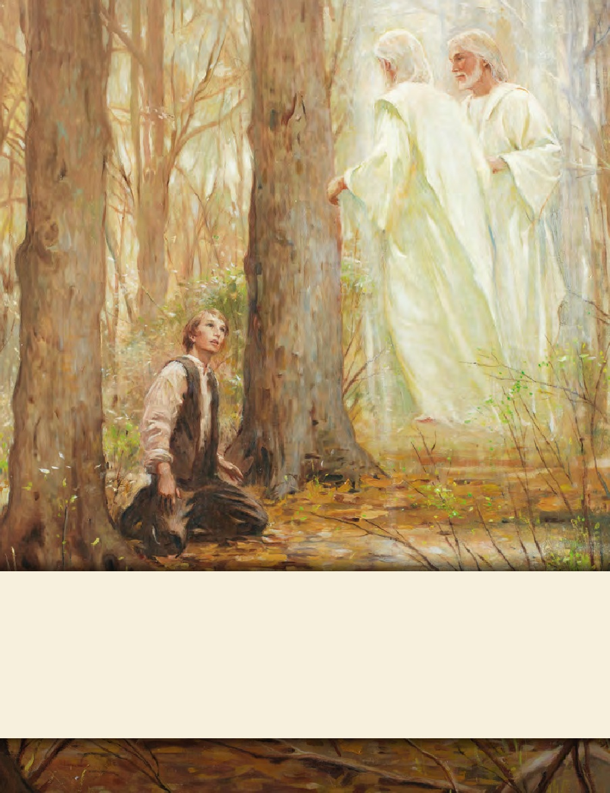
LESSON 15
SEMINARY
Doctrine and Covenants
and Church History

Slide 2
LESSON 29
Doctrine and Covenants 21

Slide 3
LESSON 29
Doctrine and Covenants 21:1-3.
“Joseph Smith is designated as the prophet and seer of the Church”

Slide 4
LESSON 29
What are some reasons you feel thankful for a prophet?
Doctrine and Covenants 21:1
Behold, there shall be a record kept among you; and in it thou shalt be called a seer, a translator, a prophet, an apostle of Jesus Christ, an elder of the church through the will of God the Father, and the grace of your Lord Jesus Christ.
What does it mean that the Lord called Joseph Smith to be a seer?
What does it mean that the Lord called Joseph Smith to be a prophet?

Slide 5
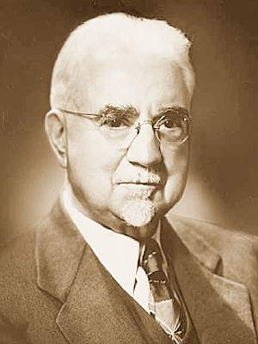
LESSON 29
“A seer is one who sees with spiritual eyes. He perceives the meaning of that which seems obscure to [unclear to or hidden from] others; therefore he is an interpreter and clarifier of eternal truth. He foresees the future from the past and the present. This he does by the power of the Lord operating through him directly, or indirectly with the aid of divine instruments such as the Urim and Thummim. In short, he is one who sees, who walks in the Lord’s light with open eyes” (John A. Widtsoe, Evidences and Reconciliations, arr. G. Homer Durham, 3 vols. in 1 [1960],258).
Elder John A. Widtsoe
A prophet is “a person who has been called by and speaks for God. As a messenger of God, a prophet receives commandments, prophecies, and revelations from God. His responsibility is to make known God’s will and true character to mankind and to show the meaning of his dealings with them. A prophet denounces sin and foretells its consequences. He is a preacher of righteousness. On occasion, prophets may be inspired to foretell the future for the benefit of mankind. His primary responsibility, however, is to bear witness of Christ” (Guide to the Scriptures, “Prophet,” scriptures.lds.org).

Slide 6
LESSON 29
Translator: someone who (1)converts written or spoken words to another language or (2)gives clearer meaning to an existing translation by improving or correcting it or by restoring lost material (see Guide to the Scriptures, “Translate,” scriptures.lds.org).
Apostle: a special witness of Jesus Christ to the world (see Bible Dictionary, “Apostle”).
Elder: “the proper title given to all holders of the Melchizedek Priesthood” and to someone who has been called to be a full-time minister for Jesus Christ (see Bible Dictionary, “Elders”).
How do the titles given to Joseph Smith help you to understand his important role in the Restoration?

Slide 7
LESSON 29
Doctrine and Covenants 21:2-3.
1 Behold, there shall be a record kept among you; and in it thou shalt be called a seer, a translator, a prophet, an apostle of Jesus Christ, an elder of the church through the will of God the Father, and the grace of your Lord Jesus Christ,
2 Being inspired of the Holy Ghost to lay the foundation thereof, and to build it up unto the most holy faith.
God directed Joseph Smith to restore the Church of Jesus Christ.

Slide 8
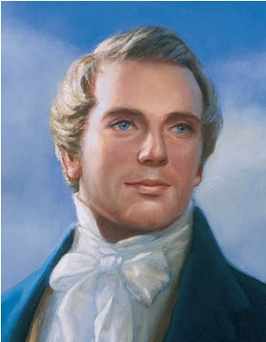
LESSON 29
Why do you think it is important for us to know that Joseph Smith was called by God to restore and lead the Church of Jesus Christ?

Slide 9
LESSON 29
Doctrine and Covenants 21:4–9
“Members of the Church should heed the words of Joseph Smith"

Slide 10
LESSON 29
the church
(members of The Church of Jesus Christ of Latter-day Saints in Joseph Smith’s day as well as our own).
the church
his
(specifically Joseph Smith, but can also refer to the current Church President).
his
words and commandments
words and commandments
(could refer to all of a prophet’s teachings and counsel, including specific instructions given by the Lord through the prophet)
in all patience and faith
in all patience and faith
(could mean that we can trust completely in the prophet’s teachings, that we should not be critical of him, that we should follow his counsel in spite of any personal shortcomings he may have, and that we should await promised blessings patiently)
Doctrine and Covenants 21:4–5
4 Wherefore, meaning the church, thou shalt give heed unto all his words and commandments which he shall give unto you as he receiveth them, walking in all holiness before me;
5 For his word ye shall receive, as if from mine own mouth, in all patience and faith.

Slide 11
LESSON 29
Which of the prophet’s teachings are we to heed?
Why might it sometimes require patience and faith to heed the words of a prophet?
How does knowing that the prophet receives counsel and commandments from the Lord help you to receive his words “in all patience and faith”?

Slide 12
LESSON 29
Doctrine and Covenants 21:6.
For by doing these things the gates of hell shall not prevail against you; yea, and the Lord God will disperse the powers of darkness from before you, and cause the heavens to shake for your good, and his name’s glory.
How would you summarize the promises given to those who heed the words of the prophet?
“If we heed the words of the prophet, we will be protected against the adversary”
How does heeding the words of the prophet “disperse the powers of darkness”?

Slide 13
LESSON 29
“A date is a planned activity that allows a young man and a young woman to get to know each other better. In cultures where dating is acceptable, it can help you learn and practice social skills, develop friendships, have wholesome fun, and eventually find an eternal companion.
“You should not date until you are at least 16 years old. When you begin dating, go with one or more additional couples. Avoid going on frequent dates with the same person. Developing serious relationships too early in life can limit the number of other people you meet and can perhaps lead to immorality. Invite your parents to become acquainted with those you date.
“Choose to date only those who have high moral standards and in whose company you can maintain your standards. Remember that a young man and a young woman on a date are responsible to protect each other’s honor and virtue” (For the Strength of Youth[booklet, 2011],4; see alsoLDS.org).
When have you or someone you know been blessed for heeding the words and commandments of the living prophet?

Slide 14
LESSON 29
Doctrine and Covenants 21:7–9
7 For thus saith the Lord God: Him have I inspired to move the cause of Zion in mighty power for good, and his diligence I know, and his prayers I have heard.
8 Yea, his weeping for Zion I have seen, and I will cause that he shall mourn for her no longer; for his days of rejoicing are come unto the remission of his sins, and the manifestations of my blessings upon his works.
9 For, behold, I will bless all those who labor in my vineyard with a mighty blessing, and they shall believe on his words, which are given him through me by the Comforter, which manifesteth that Jesus was crucified by sinful men for the sins of the world, yea, for the remission of sins unto the contrite heart.
What do we learn about the Prophet Joseph Smith from these verses?
How do you think these verses also apply to the current President of The Church of Jesus Christ of Latter-day Saints?

Slide 15
LESSON 29
Doctrine and Covenants 21:10–12
“Oliver Cowdery is acknowledged as an elder and a preacher”

Slide 16
LESSON 29
Doctrine and Covenants 21:10–12.
10 Wherefore it behooveth me that he should be ordained by you, Oliver Cowdery mine apostle;
11 This being an ordinance unto you, that you are an elder under his hand, he being the first unto you, that you might be an elder unto this church of Christ, bearing my name—
12 And the first preacher of this church unto the church, and before the world, yea, before the Gentiles; yea, and thus saith the Lord God, lo, lo! to the Jews also. Amen.
What was Oliver Cowdery asked to do?
(Bear the Lord’s name.)
What does it mean to you to bear the Lord’s name?

