Slide 1
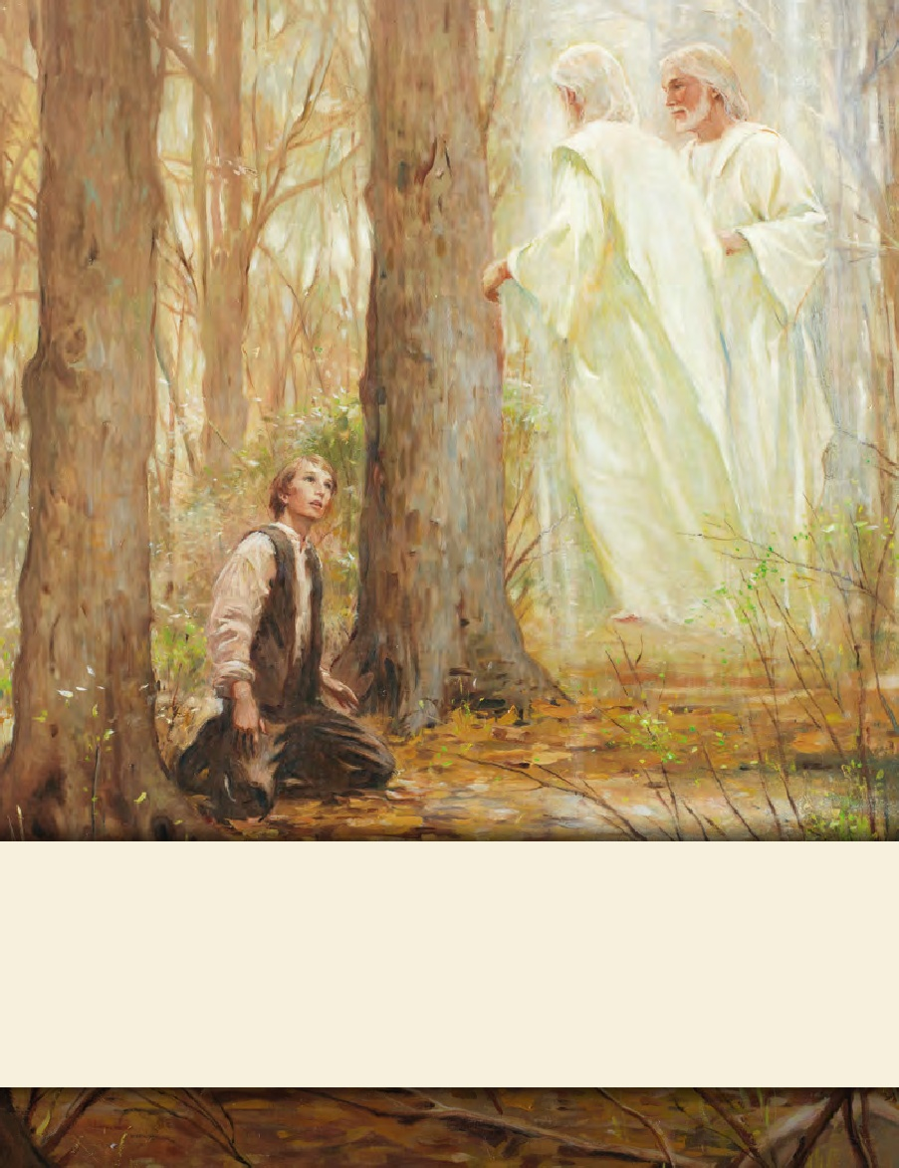
LESSON 15
SEMINARY
Doctrine and Covenants
and Church History

Slide 2
LESSON 28
Doctrine and Covenants 20:37, 68-84.

Slide 3
LESSON 28
Doctrine and Covenants 20:37, 68–74.
“The Lord reveals the requirements for individuals before and after baptism”

Slide 4
LESSON 28
Doctrine and Covenants 20:37.
And again, by way of commandment to the church concerning the manner of baptism—All those who humble themselves before God, and desire to be baptized, and come forth with broken hearts and contrite spirits, and witness before the church that they have truly repented of all their sins, and are willing to take upon them the name of Jesus Christ, having a determination to serve him to the end, and truly manifest by their works that they have received of the Spirit of Christ unto the remission of their sins, shall be received by baptism into his church.

Slide 5
LESSON 28
Before people can be baptized, they must…
What must a person demonstrate before he or she can be baptized?
Before people can be baptized, they must be humble, repentant, willing to take upon themselves the name of Jesus Christ, and determined to serve Him to the end.
Why do you think a person needs to meet these requirements before being baptized?

Slide 6
LESSON 28
Doctrine and Covenants 20:72–74.
72 Baptism is to be administered in the following manner unto all those who repent—
73 The person who is called of God and has authority from Jesus Christ to baptize, shall go down into the water with the person who has presented himself or herself for baptism, and shall say, calling him or her by name: Having been commissioned of Jesus Christ, I baptize you in the name of the Father, and of the Son, and of the Holy Ghost. Amen.
74 Then shall he immerse him or her in the water, and come forth again out of the water.
How does the Lord want baptisms to be performed?
Baptism must be done by immersion and performed by one holding proper authority.

Slide 7
LESSON 28
Doctrine and Covenants 20:68–69.
68 The duty of the members after they are received by baptism—The elders or priests are to have a sufficient time to expound all things concerning the church of Christ to their understanding, previous to their partaking of the sacrament and being confirmed by the laying on of the hands of the elders, so that all things may be done in order.
69 And the members shall manifest before the church, and also before the elders, by a godly walk and conversation, that they are worthy of it, that there may be works and faith agreeable to the holy scriptures—walking in holiness before the Lord.
What are some things you discovered that the Lord expects from us after we are baptized?

Slide 8
LESSON 28
From verse 69, what do you learn about how we show the Lord our worthiness after we are baptized?
After baptism, we show the Lord our worthiness through our godly walk and conversation.
What do you think it means to “manifest … a godly walk and conversation”?
When have you seen others “manifest … a godly walk and conversation”? How do you think their actions and attitude influence others around them?

Slide 9
LESSON 28
Doctrine and Covenants 20:75–79
The Lord gives instructions on administering the sacrament.

Slide 10
LESSON 28
Doctrine and Covenants 20:75
It is expedient that the church meet together often to partake of bread and wine in the remembrance of the Lord Jesus.
Doctrine and Covenants 27:1-2.
1 Listen to the voice of Jesus Christ, your Lord, your God, and your Redeemer, whose word is quick and powerful.
2 For, behold, I say unto you, that it mattereth not what ye shall eat or what ye shall drink when ye partake of the sacrament, if it so be that ye do it with an eye single to my glory—remembering unto the Father my body which was laid down for you, and my blood which was shed for the remission of your sins.
Why do you think we are directed to partake of the sacrament together often?

Slide 11
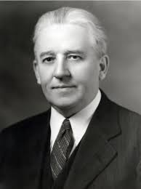
LESSON 28
“The one thing that would make for the safety of every man and woman would be to appear at the sacrament table every Sabbath day. We would not get very far away in one week—not so far away that, by the process of self-investigation, we could not rectify the wrongs we may have done. … The road to the sacrament table is the path of safety for Latter-day Saints” (in Bryant S. Hinckley, Sermons and Missionary Services of Melvin Joseph Ballard[1949], 151).
Elder Melvin J. Ballard

Slide 12
LESSON 28
What we promise What the Lord promises
Doctrine and Covenants 20:77–79
77 O God, the Eternal Father, we ask thee in the name of thy Son, Jesus Christ, to bless and sanctify this bread to the souls of all those who partake of it, that they may eat in remembrance of the body of thy Son, and witness unto thee, O God, the Eternal Father, that they are willing to take upon them the name of thy Son, and always remember him and keep his commandments which he has given them; that they may always have his Spirit to be with them. Amen.
78 The manner of administering the wine—he shall take the cup also, and say:
79 O God, the Eternal Father, we ask thee in the name of thy Son, Jesus Christ, to bless and sanctify this wine to the souls of all those who drink of it, that they may do it in remembrance of the blood of thy Son, which was shed for them; that they may witness unto thee, O God, the Eternal Father, that they do always remember him, that they may have his Spirit to be with them. Amen.

Slide 13
LESSON 28
What we promise What the Lord promises
When we partake of the sacrament, we witness that we are willing to take upon ourselves the name of Jesus Christ, that we will always remember Him, and that we will keep His commandments.
When we are faithful to the promises we make during the sacrament, we can always have the Spirit to be with us.
What similarities do you see in the promises made during the sacrament and the covenant of baptism?

Slide 14
LESSON 28
How can we show our willingness to take upon ourselves the name of Jesus Christ?
Standing for what is right, telling others that we are members of The Church of Jesus Christ of Latter-day Saints, sharing our belief in Him, and participating in His work.
What are some things we can do to always remember the Savior?
How does partaking of the sacrament help us “manifest … a godly walk and conversation”?

Slide 15
LESSON 28
“You receive great blessings when you keep the baptismal covenant. As you renew it, the Lord renews the promised remission of your sins. Cleansed from sin, you are able to ‘always have his Spirit to be with [you]’ (D&C 20:77). The Spirit’s constant companionship is one of the greatest gifts you can receive in mortality. The Spirit will guide you in the paths of righteousness and peace, leading you to eternal life with your Father in Heaven and Jesus Christ” (True to the Faith: A Gospel Reference[2004],148).

Slide 16
LESSON 28
Doctrine and Covenants 20:80–84
The Lord instructs Church leaders to keep accurate Church membership records.

