Slide 1
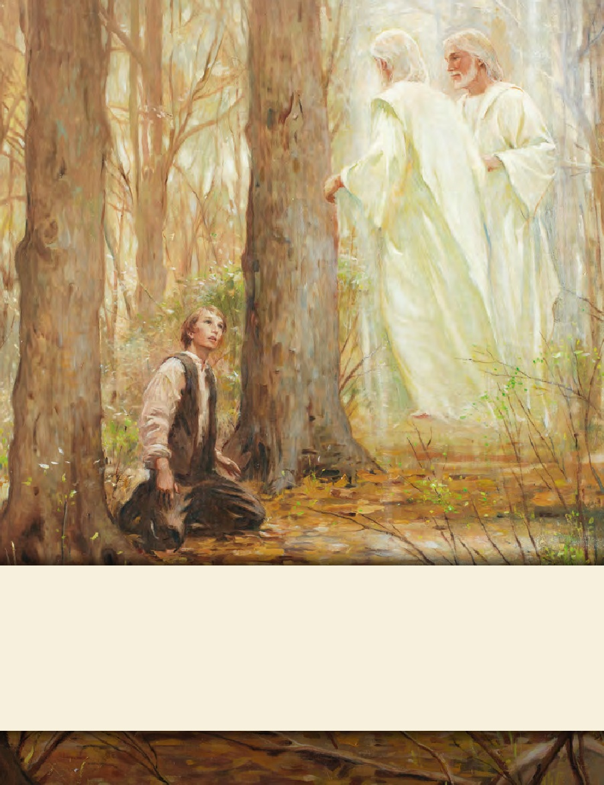
LESSON 15
SEMINARY
Doctrine and Covenants
and Church History

Slide 2
LESSON 27
Doctrine and Covenants 20:38–67

Slide 3
LESSON 27
Doctrine and Covenants 20:38–59.
“The duties of priesthood offices are set forth”

Slide 4
LESSON 27
Preach, teach, expound, exhort, warn, invite all to come unto Christ.
Who has these responsibilities?
Elders
Priests
Teachers and Deacons
D&C 20:38–45
D&C 20:46–52
D&C 20:53–59

Slide 5
LESSON 27
What differences do you notice between the duties of elders, priests, teachers, and deacons? What similarities do you see?
Which office has the authority to bestow the gift of the Holy Ghost?
(Elder; see verse 41.)
Which offices have the authority to administer the sacrament?
(Elder and priest; see verses 40 and 46.)
Which offices have the authority to ordain priests, teachers, and deacons?
(Elder and priest; see verses 39 and 48.)
Which offices have the authority to expound, exhort, and teach?
(Elder, priest, teacher, and deacon; see verses 42, 46, and 59.)

Slide 6
LESSON 27
What truths can we learn about priesthood offices by comparing and contrasting their duties?
As Heavenly Father’s sons receive higher offices of the priesthood, they receive more responsibilities and opportunities to serve others.
As a priesthood holder is ordained to additional offices of the priesthood, he retains the lesser offices and their associated responsibilities.
All priesthood holders have the responsibility to perform ordinances and to watch over members of the Church and minister to them.
What are some ways Aaronic Priesthood holders can “watch over the church” and “be with and strengthen them”?
Ministering, caring for the poor and needy, caring for the meetinghouse and grounds, and fulfilling other assignments from the bishop and quorum leaders.

Slide 7
LESSON 27
What are some ways Aaronic Priesthood holders can “invite all to come unto Christ”?
“If you are a priesthood holder, remember that the priesthood should be a part of you at all times and in all circumstances. It is not like a cloak that you can put on and take off at will. Any ordination to a priesthood office is a call to lifelong service, with the promise that the Lord will qualify you to do His work according to your faithfulness.
“You must be worthy in order to receive and exercise priesthood power. The words you speak and your everyday behavior affect your ability to serve. Your behavior in public must be above reproach. Your behavior in private is even more important” (True to the Faith: A Gospel Reference [2004],127).

Slide 8
LESSON 27
“The purpose of priesthood authority is to give, to serve, to lift, to inspire” (Elder Richard G. Scott).

Slide 9
LESSON 27
Doctrine and Covenants 20:60–67.
Guidelines on priesthood ordinations are given.

Slide 10
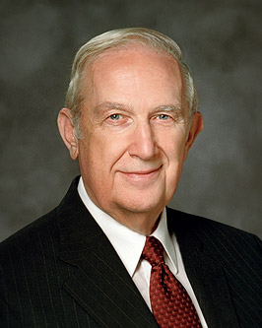
LESSON 27
Doctrine and Covenants 20:60.
Every elder, priest, teacher, or deacon is to be ordained according to the gifts and callings of God unto him; and he is to be ordained by the power of the Holy Ghost, which is in the one who ordains him.
How was the Holy Ghost part of the ordination?
Elder Richard G. Scott of the Quorum of the Twelve Apostles taught, “Efforts to share knowledge are often rewarded with more understanding as additional light flows into your mind and heart (see D&C 8:2–3)” (“Acquiring Spiritual Knowledge,” Ensign, Nov. 1993,88).

Slide 11
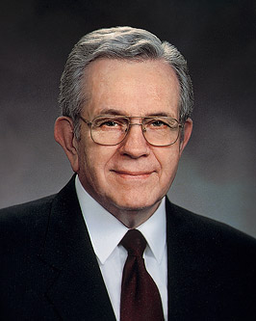
LESSON 27
Priesthood holders need the power of the Holy Ghost with them as they perform their duties.
“Your authority comes through your ordination; your power comes through obedience and worthiness.… “Power in the priesthood comes from doing your duty in ordinary things: attending meetings, accepting assignments, reading the scriptures, keeping the Word of Wisdom” (“The Aaronic Priesthood,” Ensign, Nov. 1981,32–33).

Slide 12
LESSON 27
Doctrine and Covenants 20:65.
No person is to be ordained to any office in this church, where there is a regularly organized branch of the same, without the vote of that church.
How did you feel when you saw that members of your ward (or branch) sustained your ordination?
How might remembering their sustaining vote help you in your priesthood service?

