Slide 1
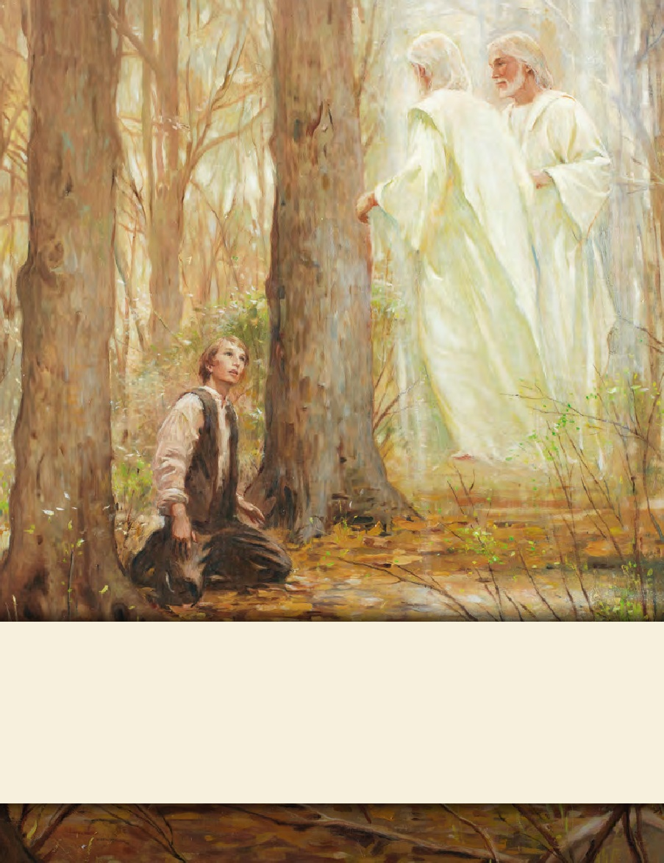
LESSON 15
SEMINARY
Doctrine and Covenants
and Church History

Slide 2
LESSON 26
Doctrine and Covenants 20:1–3

Slide 3
LESSON 26
Doctrine and Covenants 20:1–4.
“God commands that the Church be established”

Slide 4
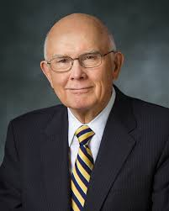
LESSON 26
“A testimony of the gospel is a personal witness borne to our souls by the Holy Ghost that certain facts of eternal significance are true and that we know them to be true” (“Testimony,” Ensign or Liahona, May 2008,26).
We know that…

Slide 5
LESSON 26
Doctrine and Covenants 20:1-2.
1 The rise of the Church of Christ in these last days, being one thousand eight hundred and thirty years since the coming of our Lord and Savior Jesus Christ in the flesh, it being regularly organized and established agreeable to the laws of our country, by the will and commandments of God, in the fourth month, and on the sixth day of the month which is called April—
2 Which commandments were given to Joseph Smith, Jun., who was called of God, and ordained an apostle of Jesus Christ, to be the first elder of this church;
What truths concerning the Restoration of the gospel do these verses testify of?
Joseph Smith was called of God and commanded to organize the Church of Jesus Christ.

Slide 6
LESSON 26
What do you think the word “rise” in Doctrine and Covenants 20:1 means in relation to the organization of the Church?
How can we help the Lord’s Church to continue to “rise” in our day?

Slide 7
LESSON 26
Doctrine and Covenants 20:5-16.
The Lord briefly recounts some of the events of the Restoration.

Slide 8
LESSON 26
Doctrine and Covenants 20:5-8.
5 After it was truly manifested unto this first elder that he had received a remission of his sins, he was entangled again in the vanities of the world;
6 But after repenting, and humbling himself sincerely, through faith, God ministered unto him by an holy angel, whose countenance was as lightning, and whose garments were pure and white above all other whiteness;
7 And gave unto him commandments which inspired him;
8 And gave him power from on high, by the means which were before prepared, to translate the Book of Mormon;
What did Joseph experience that enabled him to organize the true Church again on the earth?
He was instructed by God and angels and was given power to translate the Book of Mormon.

Slide 9
LESSON 26
Doctrine and Covenants 20:9-12.
9 Which contains a record of a fallen people, and the fulness of the gospel of Jesus Christ to the Gentiles and to the Jews also;
10 Which was given by inspiration, and is confirmed to others by the ministering of angels, and is declared unto the world by them—
11 Proving to the world that the holy scriptures are true, and that God does inspire men and call them to his holy work in this age and generation, as well as in generations of old;
12 Thereby showing that he is the same God yesterday, today, and forever. Amen.
The Book of Mormon proves to the world that…

Slide 10
LESSON 26
Why is it so important to gain a testimony that the Book of Mormon is true?
If the Book of Mormon is true, then what does that imply about Joseph Smith?
We know that…
“The Book of Mormon is evidence that God has restored the gospel in our day.”

Slide 11
LESSON 26
Doctrine and Covenants 20:14-15.
14 And those who receive it in faith, and work righteousness, shall receive a crown of eternal life;
15 But those who harden their hearts in unbelief, and reject it, it shall turn to their own condemnation
What blessings does the Lord promise to those who receive the Book of Mormon in faith?
What will happen to those who harden their hearts in unbelief and reject the Book of Mormon?
What are some ways we can receive the Book of Mormon in faith?
How can the Book of Mormon lead a person to “work righteousness”?

Slide 12
LESSON 26
Doctrine and Covenants 20:17-36.
The Book of Mormon teaches and clarifies key doctrines of the gospel.

Slide 13
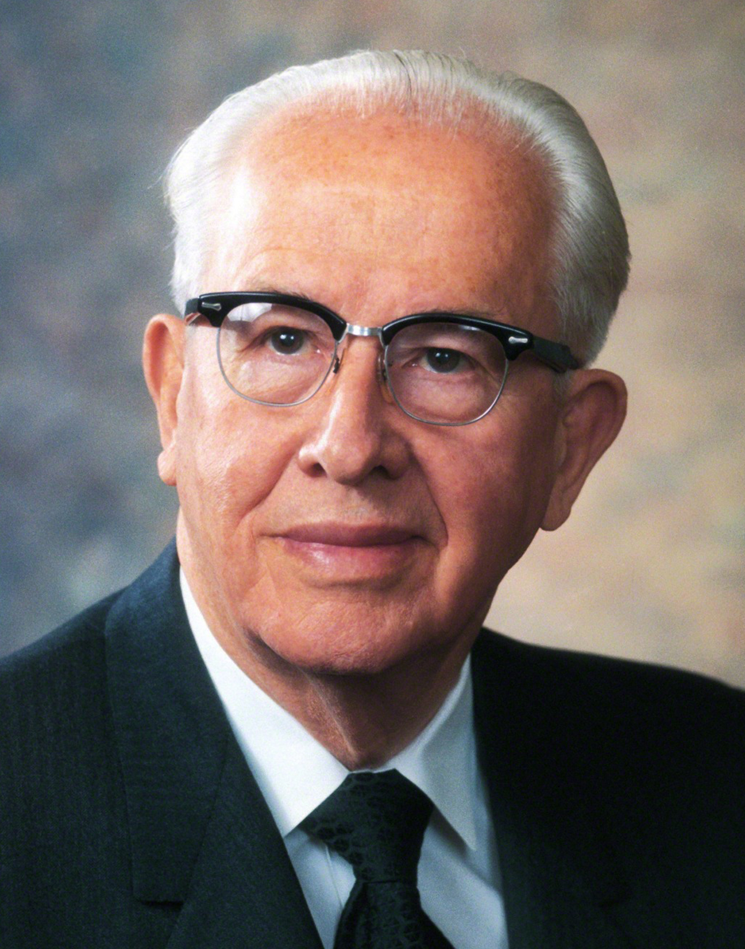
LESSON 26
“In the twentieth section of the Doctrine and Covenants, the Lord devotes several verses to summarizing the vital truths which the Book of Mormon teaches. (See vs. 17–36.) It speaks of God, the creation of man, the Fall, the Atonement, the ascension of Christ into heaven, prophets, faith, repentance, baptism, the Holy Ghost, endurance, prayer, justification and sanctification through grace, and loving and serving God” (“A New Witness for Christ,” Ensign ,Nov. 1984,7).

Slide 14
LESSON 26
Doctrine and Covenants 20.
17 By these things we know that there is a God in heaven, who is infinite and eternal, from everlasting to everlasting the same unchangeable God, the framer of heaven and earth, and all things which are in them;
17 By these things we know that there is a God in heaven, who is infinite and eternal, from everlasting to everlasting the same unchangeable God, the framer of heaven and earth, and all things which are in them;
29 And we know that all men must repent and believe on the name of Jesus Christ, and worship the Father in his name, and endure in faith on his name to the end, or they cannot be saved in the kingdom of God.
29 And we know that all men must repent and believe on the name of Jesus Christ, and worship the Father in his name, and endure in faith on his name to the end, or they cannot be saved in the kingdom of God.
30 And we know that justification through the grace of our Lord and Savior Jesus Christ is just and true;
30 And we know that justification through the grace of our Lord and Savior Jesus Christ is just and true;
31 And we know also, that sanctification through the grace of our Lord and Savior Jesus Christ is just and true, to all those who love and serve God with all their mights, minds, and strength.
31 And we know also, that sanctification through the grace of our Lord and Savior Jesus Christ is just and true, to all those who love and serve God with all their mights, minds, and strength.
35 And we know that these things are true and according to the revelations of John, neither adding to, nor diminishing from the prophecy of his book, the holy scriptures, or the revelations of God which shall come hereafter by the gift and power of the Holy Ghost, the voice of God, or the ministering of angels.
35 And we know that these things are true and according to the revelations of John, neither adding to, nor diminishing from the prophecy of his book, the holy scriptures, or the revelations of God which shall come hereafter by the gift and power of the Holy Ghost, the voice of God, or the ministering of angels.

Slide 15
LESSON 26
Doctrine and Covenants 20:17–19.
17 By these things we know that there is a God in heaven, who is infinite and eternal, from everlasting to everlasting the same unchangeable God, the framer of heaven and earth, and all things which are in them;
18 And that he created man, male and female, after his own image and in his own likeness, created he them;
19 And gave unto them commandments that they should love and serve him, the only living and true God, and that he should be the only being whom they should worship.
Doctrine and Covenants 20:21–25.
21 Wherefore, the Almighty God gave his Only Begotten Son, as it is written in those scriptures which have been given of him.
22 He suffered temptations but gave no heed unto them.
23 He was crucified, died, and rose again the third day;
24 And ascended into heaven, to sit down on the right hand of the Father, to reign with almighty power according to the will of the Father;
25 That as many as would believe and be baptized in his holy name, and endure in faith to the end, should be saved.
Doctrine and Covenants 20:26–28.
26 Not only those who believed after he came in the meridian of time, in the flesh, but all those from the beginning, even as many as were before he came, who believed in the words of the holy prophets, who spake as they were inspired by the gift of the Holy Ghost, who truly testified of him in all things, should have eternal life,
27 As well as those who should come after, who should believe in the gifts and callings of God by the Holy Ghost, which beareth record of the Father and of the Son;
28 Which Father, Son, and Holy Ghost are one God, infinite and eternal, without end. Amen.

Slide 16
LESSON 26
We know that…
God lives and is infinite, eternal, and unchanging (verse17).
We are created in the image and likeness of God (verse18).
God gave His Only Begotten Son to be crucified and rise again so that all who believe, are baptized, and endure in faith may be saved(verses21–25).
The Holy Ghost testifies of the Father and the Son (verse27).
The Father, the Son, and the Holy Ghost work together to prepare us for eternal life (verses17–28).

Slide 17
LESSON 26
Doctrine and Covenants 20:29-34.
29 And we know that all men must repent and believe on the name of Jesus Christ, and worship the Father in his name, and endure in faith on his name to the end, or they cannot be saved in the kingdom of God.
30 And we know that justification through the grace of our Lord and Savior Jesus Christ is just and true;
31 And we know also, that sanctification through the grace of our Lord and Savior Jesus Christ is just and true, to all those who love and serve God with all their mights, minds, and strength.
32 But there is a possibility that man may fall from grace and depart from the living God;
33 Therefore let the church take heed and pray always, lest they fall into temptation;
34 Yea, and even let those who are sanctified take heed also.
29 And we know that all men must repent and believe on the name of Jesus Christ, and worship the Father in his name, and endure in faith on his name to the end, or they cannot be saved in the kingdom of God.
30 And we know that justification through the grace of our Lord and Savior Jesus Christ is just and true;
31 And we know also, that sanctification through the grace of our Lord and Savior Jesus Christ is just and true, to all those who love and serve God with all their mights, minds, and strength.
32 But there is a possibility that man may fall from grace and depart from the living God;
33 Therefore let the church take heed and pray always, lest they fall into temptation;
34 Yea, and even let those who are sanctified take heed also.
What do these verses teach that we must do to be saved in the kingdom of God?

Slide 18
LESSON 26
Doctrine and Covenants 20:35–36
35 And we know that these things are true and according to the revelations of John, neither adding to, nor diminishing from the prophecy of his book, the holy scriptures, or the revelations of God which shall come hereafter by the gift and power of the Holy Ghost, the voice of God, or the ministering of angels.
36 And the Lord God has spoken it; and honor, power and glory be rendered to his holy name, both now and ever. Amen.
How can we give honor and glory to the Lord’s name?

Slide 19
LESSON 26
We know that…
God lives and is infinite, eternal, and unchanging (verse17).
We are created in the image and likeness of God (verse18).
God gave His Only Begotten Son to be crucified and rise again so that all who believe, are baptized, and endure in faith may be saved(verses21–25).
The Holy Ghost testifies of the Father and the Son (verse27).
The Father, the Son, and the Holy Ghost work together to prepare us for eternal life (verses17–28).

