Slide 1
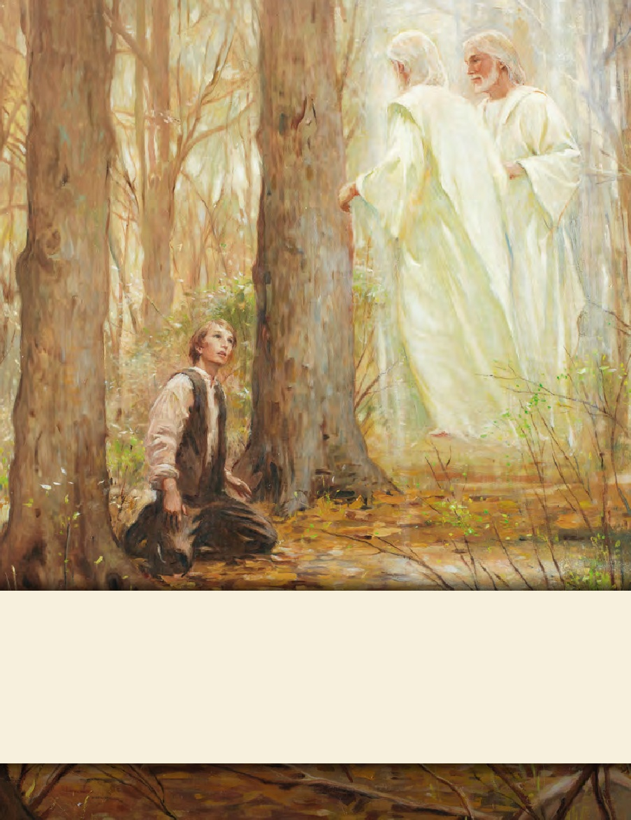
LESSON 15
SEMINARY
Doctrine and Covenants
and Church History

Slide 2
LESSON 25
Doctrine and Covenants 19:23–41

Slide 3
LESSON 25
Doctrine and Covenants 19:23–24.
“The Savior testifies that
He does the will of the Father”

Slide 4
LESSON 25
When have you had to do something that you knew was right, but you were unsure or nervous about how it would turn out?
What would help you have the faith to follow through even though it was hard?
Would your reaction change depending on who had asked you to do the difficult thing?
Why or why not?

Slide 5
LESSON 25
Introduction
In order to guarantee E.B. Grandin payment for printing the Book of Mormon, Martin Harris signed a mortgage agreement on his farm in August 1829. In the revelation contained in Doctrine and Covenants 19, the Lord exhorted Martin to impart of his property freely to the printing of the Book of Mormon (see D&C 19:26). Martin eventually sold 151 acres of his farm to cover the printing costs.
Introduction D&C 19
Revelation given through Joseph Smith, at Manchester, New York, likely in the summer of 1829. In his history, the Prophet introduces it as “a commandment of God and not of man, to Martin Harris, given by him who is Eternal.”
If you were in Martin’s position, how might knowing that this commandment came from God help you?

Slide 6
LESSON 25
To Do
To Know
Learn of Jesus Christ.
Listen to Jesus Christ’s words.
Walk in the meekness of the Spirit.
This revelation came from Jesus Christ.
Jesus Christ was obedient to the will of Heavenly Father.
Doctrine and Covenants 19:23–24.
23 Learn of me, and listen to my words; walk in the meekness of my Spirit, and you shall have peace in me.
24 I am Jesus Christ; I came by the will of the Father, and I do his will.

Slide 7
LESSON 25
What can we do to learn of Christ, listen to His words, and walk in the meekness of His Spirit?
How do you think doing these things might have helped Martin make the difficult decision to mortgage his property to fund the printing of the Book of Mormon?
Doctrine and Covenants 19:23.
Learn of me, and listen to my words; walk in the meekness of my Spirit, and you shall have peace in me.
What truth did the Lord teach Martin Harris that we can also apply in our own lives?
If we learn of Christ, listen to His words, and walk in the meekness of His Spirit, then we will have peace.

Slide 8
LESSON 25
Doctrine and Covenants 19:25-35.
The Lord commands Martin Harris to sell his property for the printing of the Book of Mormon.

Slide 9
LESSON 25
Doctrine and Covenants 19:25-35.
25 And again, I command thee that thou shalt not covet thy neighbor’s wife; nor seek thy neighbor’s life.
26 And again, I command thee that thou shalt not covet thine own property, but impart it freely to the printing of the Book of Mormon, which contains the truth and the word of God—
27 Which is my word to the Gentile, that soon it may go to the Jew, of whom the Lamanites are a remnant, that they may believe the gospel, and look not for a Messiah to come who has already come.
28 And again, I command thee that thou shalt pray vocally as well as in thy heart; yea, before the world as well as in secret, in public as well as in private.
29 And thou shalt declare glad tidings, yea, publish it upon the mountains, and upon every high place, and among every people that thou shalt be permitted to see.
30 And thou shalt do it with all humility, trusting in me, reviling not against revilers.
31 And of tenets thou shalt not talk, but thou shalt declare repentance and faith on the Savior, and remission of sins by baptism, and by fire, yea, even the Holy Ghost.
32 Behold, this is a great and the last commandment which I shall give unto you concerning this matter; for this shall suffice for thy daily walk, even unto the end of thy life.
33 And misery thou shalt receive if thou wilt slight these counsels, yea, even the destruction of thyself and property.
34 Impart a portion of thy property, yea, even part of thy lands, and all save the support of thy family.
35 Pay the debt thou hast contracted with the printer. Release thyself from bondage.

Slide 10
LESSON 25
What commandments and counsel did the Lord give Martin Harris?
According to Doctrine and Covenants 19:33, what did the Lord say would happen if Martin were to “slight” God’s commandments?
How are the commandments and counsel we receive evidence that the Lord knows us and loves us?

Slide 11
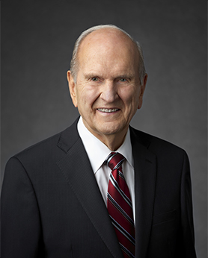
LESSON 25
“[You] will encounter people who pick which commandments they will keep and ignore others that they choose to break. I call this the cafeteria approach to obedience. This practice of picking and choosing will not work. It will lead to misery. To prepare to meet God, one keeps all of His commandments” (“Face the Future with Faith, ”Ensign or Liahona, May 2011,34).
How might the “cafeteria approach to obedience” Elder Nelson described be evidence that a person is slighting the Lord’s commandments?

Slide 12
LESSON 25
Doctrine and Covenants 19:36–41
The Lord counsels Martin Harris
concerning his ministry.

Slide 13
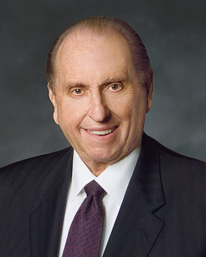
LESSON 25
“Born in poverty but nurtured in faith, Jose [Garcia] prepared for a mission call. I was present the day his recommendation was received. There appeared the statement: ‘Brother Garcia will serve at great sacrifice to his family, for he is the means of much of the family support. He has but one possession—a treasured stamp collection—which he is willing to sell, if necessary, to help finance his mission.’
“President [Spencer W.] Kimball listened attentively as this statement was read to him, and then he responded: ‘Have him sell his stamp collection. Such sacrifice will be to him a blessing’” (“Profiles of Faith, ”Ensign, Nov. 1978,56).
How might difficult decisions like Jose’s be easier if we have already experienced the peace that results from obedience to the Lord’s commandments?

Slide 14
LESSON 25
Doctrine and Covenants 19:36–41
36 Leave thy house and home, except when thou shalt desire to see thy family;
37 And speak freely to all; yea, preach, exhort, declare the truth, even with a loud voice, with a sound of rejoicing, crying—Hosanna, hosanna, blessed be the name of the Lord God!
38 Pray always, and I will pour out my Spirit upon you, and great shall be your blessing—yea, even more than if you should obtain treasures of earth and corruptibleness to the extent thereof.
39 Behold, canst thou read this without rejoicing and lifting up thy heart for gladness?
40 Or canst thou run about longer as a blind guide?
41 Or canst thou be humble and meek, and conduct thyself wisely before me? Yea, come unto me thy Savior. Amen.
If we do the will of the Lord, He will give us blessings that are of greater value than the treasures of the earth.

Slide 15
LESSON 25
How does this principle relate to other truths you have learned in this lesson?
“Then, with a twinkle in his eye and a smile on his face, this loving prophet said, ‘Each month at Church headquarters we receive thousands of letters from all parts of the world. See that we save these stamps and provide them to Jose at the conclusion of his mission. He will have, without cost, the finest stamp collection of any young man in Mexico’” (“Profiles of Faith,”56).

