Slide 1
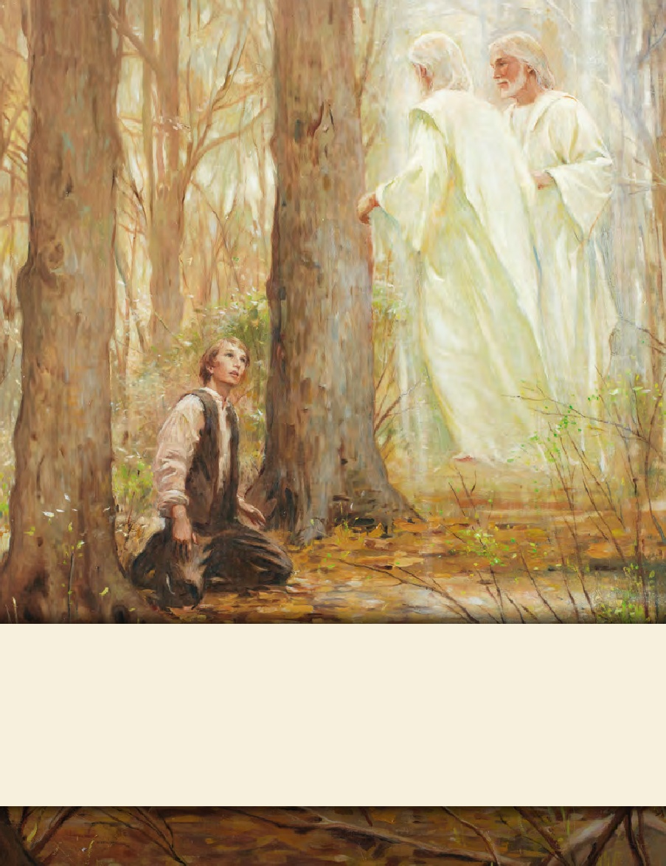
LESSON 15
SEMINARY
Doctrine and Covenants
and Church History

Slide 2
LESSON 24
Doctrine and Covenants 19:1–22

Slide 3
LESSON 24
Doctrine and Covenants 19:1–3.
“The Savior declares that
He accomplished the will of the Father”

Slide 4
LESSON 24
Paying tithing
Serving a mission
Repenting
Why might these things be hard for some people to do?

Slide 5
LESSON 24
Introduction
Doctrine and Covenants 19
Revelation given through Joseph Smith, at Manchester, New York, likely in the summer of 1829. In his history, the Prophet introduces it as “a commandment of God and not of man, to Martin Harris, given by him who is Eternal.”

Slide 6
LESSON 24
Doctrine and Covenants 19:1–3.
1 I am Alpha and Omega, Christ the Lord; yea, even I am he, the beginning and the end, the Redeemer of the world.
2 I, having accomplished and finished the will of him whose I am, even the Father, concerning me—having done this that I might subdue all things unto myself—
3 Retaining all power, even to the destroying of Satan and his works at the end of the world, and the last great day of judgment, which I shall pass upon the inhabitants thereof, judging every man according to his works and the deeds which he hath done.

Slide 7
LESSON 24
Jesus Christ fulfilled the will of His Father. Jesus Christ will judge us according to our works.
Jesus Christ fulfilled the will of His Father.
Jesus Christ will judge us according to our works.
How might knowing these truths about the Savior have helped Martin Harris feel peace concerning his decision to sell a large part of his farm?

Slide 8
LESSON 24
Doctrine and Covenants 19:4–12
“Jesus Christ explains eternal and endless punishment”

Slide 9
LESSON 24
“Jesus Christ will judge us according to our works.”
Doctrine and Covenants 19:4–12
4 And surely every man must repent or suffer, for I, God, am endless.
5 Wherefore, I revoke not the judgments which I shall pass, but woes shall go forth, weeping, wailing and gnashing of teeth, yea, to those who are found on my left hand.
6 Nevertheless, it is not written that there shall be no end to this torment, but it is written endless torment.
7 Again, it is written eternal damnation; wherefore it is more express than other scriptures, that it might work upon the hearts of the children of men, altogether for my name’s glory.
8 Wherefore, I will explain unto you this mystery, for it is meet unto you to know even as mine apostles.
9 I speak unto you that are chosen in this thing, even as one, that you may enter into my rest.
10 For, behold, the mystery of godliness, how great is it! For, behold, I am endless, and the punishment which is given from my hand is endless punishment, for Endless is my name. Wherefore—
11 Eternal punishment is God’s punishment.
12 Endless punishment is God’s punishment.
4 And surely every man must repent or suffer, for I, God, am endless.
5 Wherefore, I revoke not the judgments which I shall pass, but woes shall go forth, weeping, wailing and gnashing of teeth, yea, to those who are found on my left hand.
6 Nevertheless, it is not written that there shall be no end to this torment, but it is written endless torment.
7 Again, it is written eternal damnation; wherefore it is more express than other scriptures, that it might work upon the hearts of the children of men, altogether for my name’s glory.
8 Wherefore, I will explain unto you this mystery, for it is meet unto you to know even as mine apostles.
9 I speak unto you that are chosen in this thing, even as one, that you may enter into my rest.
10 For, behold, the mystery of godliness, how great is it! For, behold, I am endless, and the punishment which is given from my hand is endless punishment, for Endless is my name. Wherefore—
11 Eternal punishment is God’s punishment.
12 Endless punishment is God’s punishment.
All men must repent or suffer.

Slide 10
LESSON 24
What will be the experience of those who do not repent?
How can Doctrine and Covenants 19:5 motivate us to repent?
“All men must repent or suffer”: Endless or eternal punishment.
What do you think of when you hear or read the phrase “endless or eternal punishment”?

Slide 11
LESSON 24
Doctrine and Covenants 19:6–12
6 Nevertheless, it is not written that there shall be no end to this torment, but it is written endless torment.
7 Again, it is written eternal damnation; wherefore it is more express than other scriptures, that it might work upon the hearts of the children of men, altogether for my name’s glory.
8 Wherefore, I will explain unto you this mystery, for it is meet unto you to know even as mine apostles.
9 I speak unto you that are chosen in this thing, even as one, that you may enter into my rest.
10 For, behold, the mystery of godliness, how great is it! For, behold, I am endless, and the punishment which is given from my hand is endless punishment, for Endless is my name. Wherefore—
11 Eternal punishment is God’s punishment.
12 Endless punishment is God’s punishment.
What do you think of when you read or hear the phrase “God’s punishment”

Slide 12
LESSON 24
Doctrine and Covenants 19:13–22
“The Savior speaks of His suffering for sin”

Slide 13
LESSON 24
Doctrine and Covenants 19:13–17
13 Wherefore, I command you to repent, and keep the commandments which you have received by the hand of my servant Joseph Smith, Jun., in my name;
14 And it is by my almighty power that you have received them;
15 Therefore I command you to repent—repent, lest I smite you by the rod of my mouth, and by my wrath, and by my anger, and your sufferings be sore—how sore you know not, how exquisite you know not, yea, how hard to bear you know not.
16 For behold, I, God, have suffered these things for all, that they might not suffer if they would repent;
17 But if they would not repent they must suffer even as I;
What will happen to those who choose not to repent of their sins?
Those who choose not to repent will suffer the penalty for their sins.

Slide 14
LESSON 24
Doctrine and Covenants 19:16–19
16 For behold, I, God, have suffered these things for all, that they might not suffer if they would repent;
17 But if they would not repent they must suffer even as I;
18 Which suffering caused myself, even God, the greatest of all, to tremble because of pain, and to bleed at every pore, and to suffer both body and spirit—and would that I might not drink the bitter cup, and shrink—
19 Nevertheless, glory be to the Father, and I partook and finished my preparations unto the children of men.
What reason did the Savior give for why He suffered for our sins?
The Savior suffered for our sins so we could repent and not have to suffer as He did.

Slide 15
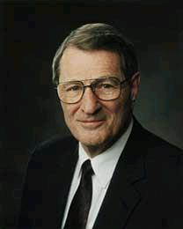
LESSON 24
What made it possible for our sins to be forgiven?
Jesus Christ’s suffering and His atoning blood satisfied the demands of justice. Therefore, mercy is extended to those who repent.
How does knowing the truths we’ve identified so far today affect your desire to repent?
“We will end up either choosing Christ’s manner of living or His manner of suffering! It is either ‘suffer even as I’ (D&C 19:16–17), or overcome ‘even as [He] … overcame (Revelation 3:21)” (“Overcome … Even As I Also Overcame,” Ensign, May 1987,72).

Slide 16
LESSON 24
Doctrine and Covenants 19:15,18–19
15 Therefore I command you to repent—repent, lest I smite you by the rod of my mouth, and by my wrath, and by my anger, and your sufferings be sore—how sore you know not, how exquisite you know not, yea, how hard to bear you know not.
18 Which suffering caused myself, even God, the greatest of all, to tremble because of pain, and to bleed at every pore, and to suffer both body and spirit—and would that I might not drink the bitter cup, and shrink—
19 Nevertheless, glory be to the Father, and I partook and finished my preparations unto the children of men.

Slide 17
LESSON 24
Jesus Christ fulfilled the will of His Father.
Jesus Christ will judge us according to our works.
D&C 19:15, 18–19
The Savior’s suffering was sore, exquisite, and hard to bear.
The Savior’s suffering caused Him to tremble because of pain and to bleed from every pore.
Jesus Christ suffered both physically and spiritually.
The Savior prayed that He might be spared from partaking of the bitter cup.
The Savior fulfilled the Father’s will and “finished [His] preparations unto the children of men” (D&C 19:19).
D&C 19:4–12.
All men must repent or suffer.
God’s punishment.
D&C 19:13–17.
Those who choose not to repent will suffer the penalty for their sins.
D&C 19:16–19.
Jesus Christ’s suffering and His atoning blood satisfied the demands of justice. Therefore, mercy is extended to those who repent.

Slide 18
LESSON 24
How do you feel about the Savior suffering the penalty for your sins?
How might knowing about the Savior’s suffering have helped Martin Harris as he considered things like the loss of the 116 manuscript pages or giving up part of his property to finance the printing of the Book of Mormon?
When has your knowledge of the Savior’s Atonement helped you face something difficult?

Slide 19
LESSON 24
Doctrine and Covenants 19:20
Wherefore, I command you again to repent, lest I humble you with my almighty power; and that you confess your sins, lest you suffer these punishments of which I have spoken, of which in the smallest, yea, even in the least degree you have tasted at the time I withdrew my Spirit.
Why do you think the withdrawal of the Spirit would lead to suffering?

Slide 20
LESSON 24
Doctrine and Covenants 19:13, 15, 20
13 Wherefore, I command you to repent, and keep the commandments which you have received by the hand of my servant Joseph Smith, Jun., in my name;
15 Therefore I command you to repent—repent, lest I smite you by the rod of my mouth, and by my wrath, and by my anger, and your sufferings be sore—how sore you know not, how exquisite you know not, yea, how hard to bear you know not.
20 Wherefore, I command you again to repent, lest I humble you with my almighty power; and that you confess your sins, lest you suffer these punishments of which I have spoken, of which in the smallest, yea, even in the least degree you have tasted at the time I withdrew my Spirit.
How is the Lord’s commandment to repent evidence of His love for us?

