Slide 1
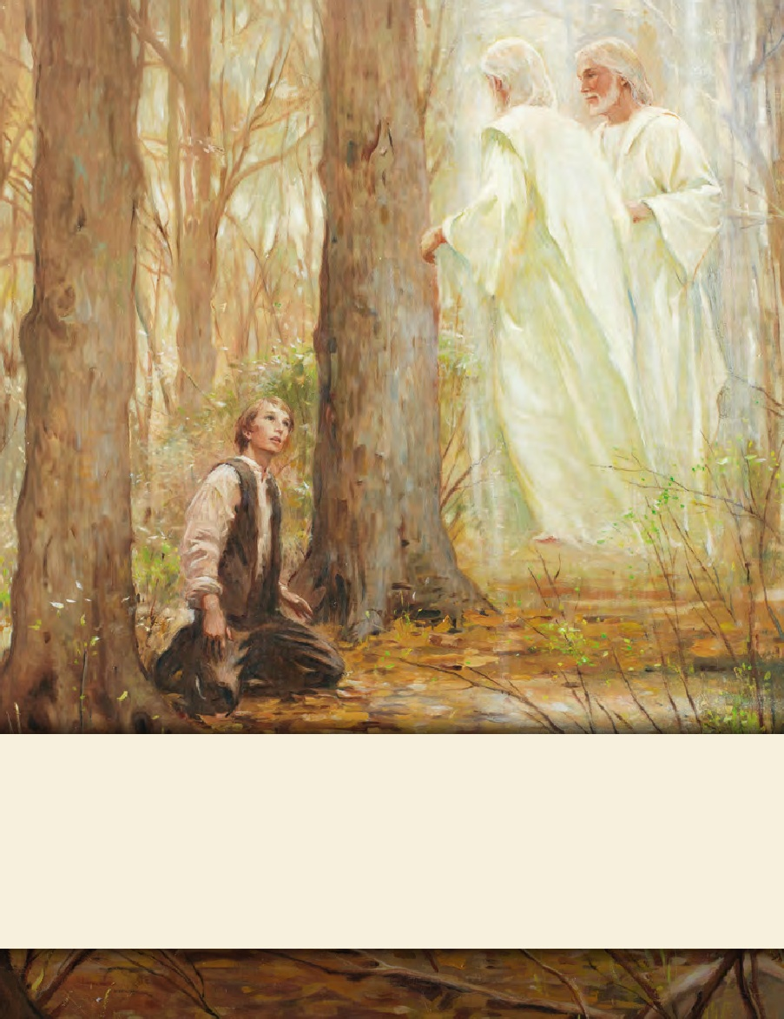
LESSON 15
SEMINARY
Doctrine and Covenants
and Church History

Slide 2
LESSON 23
Doctrine and Covenants 18:17–47

Slide 3
LESSON 23
Doctrine and Covenants 18:17-25.
“Jesus Christ teaches that His name
is the only name whereby we can be saved”

Slide 4
LESSON 23
What does your surname mean to you?
What privileges and responsibilities come with that name?
Privileges might include a place to live, family love, security, and being raised in the Church. Responsibilities might include helping to keep the home safe, treating family members with respect, doing household chores, and bringing honor to the family name.

Slide 5
LESSON 23
Doctrine and Covenants 18:17–25
17 Behold, you have my gospel before you, and my rock, and my salvation.
18 Ask the Father in my name in faith, believing that you shall receive, and you shall have the Holy Ghost, which manifesteth all things which are expedient unto the children of men.
19 And if you have not faith, hope, and charity, you can do nothing.
20 Contend against no church, save it be the church of the devil.
21 Take upon you the name of Christ, and speak the truth in soberness.
22 And as many as repent and are baptized in my name, which is Jesus Christ, and endure to the end, the same shall be saved.
23 Behold, Jesus Christ is the name which is given of the Father, and there is none other name given whereby man can be saved;
24 Wherefore, all men must take upon them the name which is given of the Father, for in that name shall they be called at the last day;
25 Wherefore, if they know not the name by which they are called, they cannot have place in the kingdom of my Father.

Slide 6
LESSON 23
PRIVILEGES
RESPONSABILITIES
Receive and be taught by the Holy Ghost.
Invite others to be baptized and endure to the end.
Receive salvation in the kingdom of the Father.
Have faith, hope, and charity.
Avoid contending with other churches.
Speak the truth in soberness.
Repent and endure to the end.

Slide 7
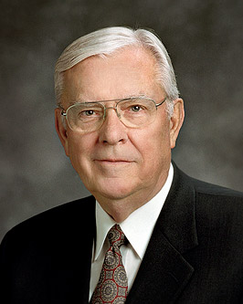
LESSON 23
According to Doctrine and Covenants 18:23, why is it important for us to take upon ourselves the name of Jesus Christ?
The name of Jesus Christ is the only name whereby we can be saved.
“We take the name of Christ upon us in the waters of baptism. We renew the effect of that baptism each week as we partake of the sacrament, signifying our willingness to take His name upon us and promising always to remember Him (see D&C 20:77, 79)… “We are asked to stand as a witness of Him. … This means that we must be willing to let others know whom we follow and to whose Church we belong: the Church of Jesus Christ. We certainly want to do this in the spirit of love and testimony. We want to follow the Savior by simply and clearly, yet humbly, declaring that we are members of His Church” (“The Importance of a Name, ”Ensign or Liahona, Nov. 2011,79–80).

Slide 8
LESSON 23
How did Elder Ballard suggest that we let others know we follow Jesus Christ?
Why do you think it is important for us to do these things as followers of Jesus Christ?
Doctrine and Covenants 18:20.
“Contend against no church, save it be the church of the devil”.

Slide 9
LESSON 23
Doctrine and Covenants 18:26–47
“The Lord reveals the calling and mission of the Twelve Apostles”

Slide 10
LESSON 23
Doctrine and Covenants 18:27–32.
27 Yea, even twelve; and the Twelve shall be my disciples, and they shall take upon them my name; and the Twelve are they who shall desire to take upon them my name with full purpose of heart.
28 And if they desire to take upon them my name with full purpose of heart, they are called to go into all the world to preach my gospel unto every creature.
29 And they are they who are ordained of me to baptize in my name, according to that which is written;
30 And you have that which is written before you; wherefore, you must perform it according to the words which are written.
31 And now I speak unto you, the Twelve—Behold, my grace is sufficient for you; you must walk uprightly before me and sin not.
32 And, behold, you are they who are ordained of me to ordain priests and teachers; to declare my gospel, according to the power of the Holy Ghost which is in you, and according to the callings and gifts of God unto men;

Slide 11
LESSON 23
1. What desires would these twelve disciples have?
2. What would these men be called to do? (Look for 3–5 separate ideas.)
The Lord’s Twelve Apostles are called to preach and administer the gospel to the entire world.
3. Which members of the current Quorum of the Twelve Apostles can you remember? (Write their names.)
What do you think it means to take upon ourselves the name of Jesus Christ with full purpose of heart?

Slide 12
LESSON 23
Doctrine and Covenants 18:37–39.
37 And now, behold, I give unto you, Oliver Cowdery, and also unto David Whitmer, that you shall search out the Twelve, who shall have the desires of which I have spoken;
38 And by their desires and their works you shall know them.
39 And when you have found them you shall show these things unto them.
What did the Lord command Oliver and David to do?
Search for men the Lord would call as the first members of the Quorum of the Twelve Apostles in the latter days.
How would they be able to know who should be called as Apostles?
The future Apostles would demonstrate the desires and works the Lord had spoken of.

Slide 13
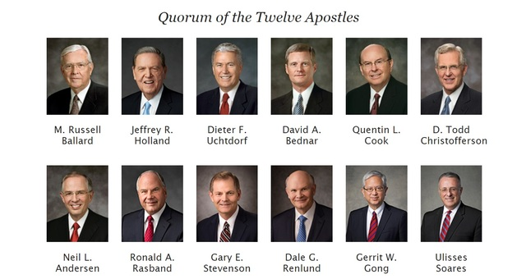
LESSON 23

Slide 14
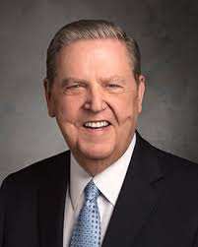
LESSON 23
“Obviously my greatest thrill and the most joyful of all realizations is that I have the opportunity, as Nephi phrased it, to ‘talk of Christ, … rejoice in Christ, … preach of Christ, [and] prophesy of Christ’ (2Ne. 25:26) wherever I may be and with whomever I may find myself until the last breath of my life is gone. Surely there could be no higher purpose or greater privilege than that of ‘special [witness] of the name of Christ in all the world’ (D&C 107:23).
“…Beyond my words and teachings and spoken witness, my life must be part of that testimony of Jesus. My very being should reflect the divinity of this work. I could not bear it if anything I might ever say or do would in any way diminish your faith in Christ, your love for this church, or the esteem in which you hold the holy apostleship.
“I do promise you—as I have promised the Lord and these my brethren—that I will strive to live worthy of this trust and serve to the full measure of my ability” (“Miracles of the Restoration,” Ensign, Nov. 1994,31).

Slide 15
LESSON 23
Doctrine and Covenants 18:27.
Yea, even twelve; and the Twelve shall be my disciples, and they shall take upon them my name; and the Twelve are they who shall desire to take upon them my name with full purpose of heart.
How does it help you to know that those who serve as Apostles have taken upon themselves the name of Jesus Christ with full purpose of heart? How can we follow their example?
Why are some voices easier to recognize than others?

Slide 16
LESSON 23
Doctrine and Covenants 18:34–36, 47.
34 These words are not of men nor of man, but of me; wherefore, you shall testify they are of me and not of man;
35 For it is my voice which speaketh them unto you; for they are given by my Spirit unto you, and by my power you can read them one to another; and save it were by my power you could not have them;
36 Wherefore, you can testify that you have heard my voice, and know my words.
47 Behold, I, Jesus Christ, your Lord and your God, and your Redeemer, by the power of my Spirit have spoken it. Amen.

Slide 17
LESSON 23
How can we hear the voice of the Lord?
We can hear the voice of Jesus Christ as we read the scriptures by the power of the Spirit.
In what ways does scripture study help us hear the voice of Jesus Christ?
Doctrine and Covenants 8:2-3.
2 Yea, behold, I will tell you in your mind and in your heart, by the Holy Ghost, which shall come upon you and which shall dwell in your heart.
3 Now, behold, this is the spirit of revelation; behold, this is the spirit by which Moses brought the children of Israel through the Red Sea on dry ground.
2 Yea, behold, I will tell you in your mind and in your heart, by the Holy Ghost, which shall come upon you and which shall dwell in your heart.
3 Now, behold, this is the spirit of revelation; behold, this is the spirit by which Moses brought the children of Israel through the Red Sea on dry ground.

Slide 18
LESSON 23
How might this truth influence the way you think about the scriptures?
How might it guide you as you choose the time and place in which you read the scriptures?
When have you felt the Lord inspire you as you have read or pondered the scriptures?

