Slide 1
LESSON 15
SEMINARY
Doctrine and Covenants
and Church History

Slide 2
LESSON 22
Doctrine and Covenants 18:1–16

Slide 3
LESSON 22
Doctrine and Covenants 18:1-5.
“The Lord teaches how to build up His Church”

Slide 4
LESSON 22
What concerns would you have about living in a house with a weak foundation?

Slide 5
LESSON 22
Doctrine and Covenants 18:1–4.
1 Now, behold, because of the thing which you, my servant Oliver Cowdery, have desired to know of me, I give unto you these words:
2 Behold, I have manifested unto you, by my Spirit in many instances, that the things which you have written are true; wherefore you know that they are true.
3 And if you know that they are true, behold, I give unto you a commandment, that you rely upon the things which are written;
4 For in them are all things written concerning the foundation of my church, my gospel, and my rock.
What did the Lord say was in the Book of Mormon? How could the teachings in the Book of Mormon help in the building up of the Church?

Slide 6
LESSON 22
Doctrine and Covenants 18:5.
Wherefore, if you shall build up my church, upon the foundation of my gospel and my rock, the gates of hell shall not prevail against you.
What is the true Church to be built upon?
The true Church is built upon Jesus Christ and His gospel.

Slide 7
LESSON 22
Doctrine and Covenants 18:6–16.
“The Lord calls Oliver Cowdery and David Whitmer to preach repentance”

Slide 8
LESSON 22
Doctrine and Covenants 18:6.
Doctrine and Covenants 18:9.
Behold, the world is ripening in iniquity; and it must needs be that the children of men are stirred up unto repentance, both the Gentiles and also the house of Israel.
And now, Oliver Cowdery, I speak unto you, and also unto David Whitmer, by the way of commandment; for, behold, I command all men everywhere to repent, and I speak unto you, even as unto Paul mine apostle, for you are called even with that same calling with which he was called.
What was the Lord’s response to the increasing iniquity in the world?
He called servants to preach repentance.

Slide 9
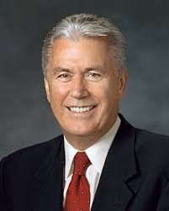
LESSON 22
Doctrine and Covenants 18:10.
Remember the worth of souls is great in the sight of God;
Remember the worth of souls is great in the sight of God;
Why do you think you are of such great worth to God?
“God sees you not only as a mortal being on a small planet who lives for a brief season—He sees you as His child. He sees you as the being you are capable and designed to become. He wants you to know that you matter to Him” (“You Matter to Him, ”Ensign or Liahona, Nov. 2011,22).

Slide 10
LESSON 22
Doctrine and Covenants 18:11-12
11 For, behold, the Lord your Redeemer suffered death in the flesh; wherefore he suffered the pain of all men, that all men might repent and come unto him.
12 And he hath risen again from the dead, that he might bring all men unto him, on conditions of repentance.
What price did the Savior pay for our souls?
How can we show gratitude for the sacrifice the Savior has made for us?
My worth is so great that Jesus Christ suffered and died so I can repent.

Slide 11
LESSON 22
How might this truth influence how you see yourself?
How might this truth influence the way you treat other people?
Doctrine and Covenants 18:13
And how great is his joy in the soul that repenteth!
Why do you think the Lord feels great joy when we repent?
If someone believes that the worth of souls is great in the sight of God, then what might their belief lead them to do?

Slide 12
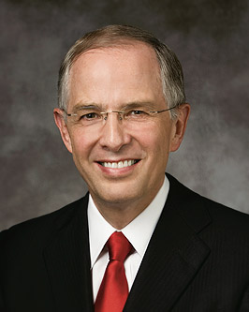
LESSON 22
Doctrine and Covenants 18:14.
Wherefore, you are called to cry repentance unto this people.
What do you think it means to “cry repentance”?
“Crying repentance simply means helping people return to God” (“Preparing for Your Spiritual Destiny” [CES fireside address, Jan. 10, 2010], 7, speeches.byu.edu).
What are some ways we can help others repent?

Slide 13
LESSON 22
Doctrine and Covenants 18:15–16.
15 And if it so be that you should labor all your days in crying repentance unto this people, and bring, save it be one soul unto me, how great shall be your joy with him in the kingdom of my Father!
16 And now, if your joy will be great with one soul that you have brought unto me into the kingdom of my Father, how great will be your joy if you should bring many souls unto me!
What blessings are given to those who help others come unto Jesus Christ?
If we help others to repent and come unto the Lord, we will feel joy with them in the kingdom of God.
Why do you think you will feel joy if you bring others to Jesus Christ?

