Slide 1
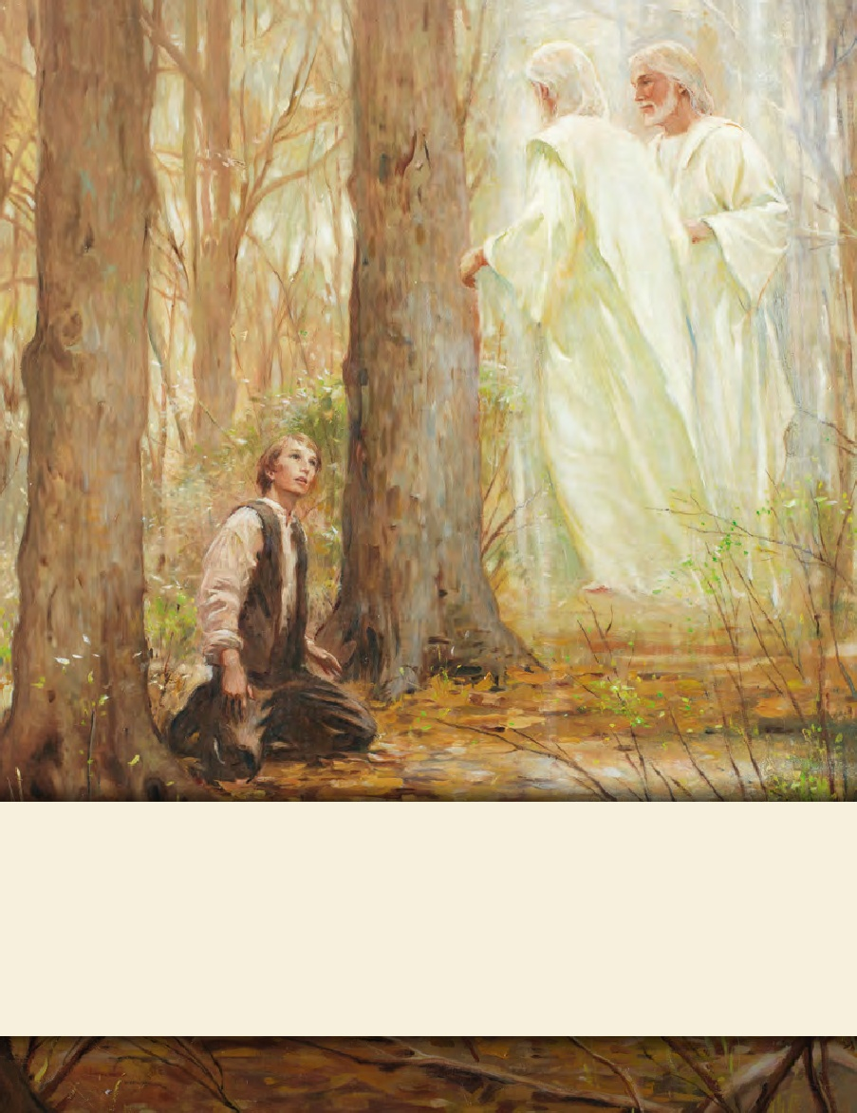
SEMINARY
Doctrine and Covenants
and Church History

Slide 2
LESSON 2
Introduction to the Doctrine and Covenants

Slide 3
LESSON 2
The Doctrine and Covenants contains “divine revelations and inspired declarations given for the establishment and regulation of the kingdom of God on the earth in the last day”

Slide 4
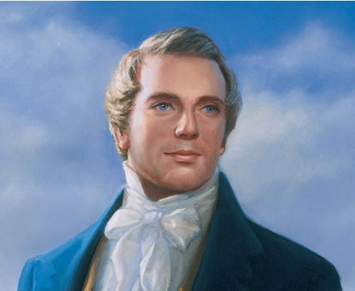
LESSON 2
The Doctrine and Covenants contains revelations received by the Prophet Joseph Smith and his successors.
What books do you think the entire world would benefit from reading? Why?
“[The Doctrine and Covenants is] the foundation of the Church in these last days, and a benefit to the world, showing that the keys of the mysteries of the kingdom of our Savior are again entrusted to man” (Teachings of Presidents of the Church: Joseph Smith[2007],194

Slide 5
LESSON 2
Title Page
Containing Revelations Given to Joseph Smith, the Prophet with Some Additions by His Successors in the Presidency of the Church.
Published by The Church of Jesus Christ of Latter-day Saints
Salt Lake City, Utah, USA
© 2013 by Intellectual Reserve, Inc. All rights reserved. Source: 2015/03/24
Introduction The Doctrine and Covenants
The Doctrine and Covenants is a collection of divine revelations and inspired declarations given for the establishment and regulation of the kingdom of God on the earth in the last days. Although most of the sections are directed to members of The Church of Jesus Christ of Latter-day Saints, the messages, warnings, and exhortations are for the benefit of all mankind and contain an invitation to all people everywhere to hear the voice of the Lord Jesus Christ, speaking to them for their temporal well-being and their everlasting salvation.

Slide 6
How would you define the words:
LESSON 2
Doctrine
Is a fundamental, eternal truth of the gospel of Jesus Christ.
Covenant
Is a sacred agreement between God and His children.
Revelation
Is communication from God to His children.

Slide 7
LESSON 2
The eighth paragraph of the introduction to the Doctrine and Covenants
In the revelations, the doctrines of the gospel are set forth with explanations about such fundamental matters as the nature of the Godhead, the origin of man, the reality of Satan, the purpose of mortality, the necessity for obedience, the need for repentance, the workings of the Holy Spirit, the ordinances and performances that pertain to salvation, the destiny of the earth, the future conditions of man after the Resurrection and the Judgment, the eternity of the marriage relationship, and the eternal nature of the family. Likewise, the gradual unfolding of the administrative structure of the Church is shown with the calling of bishops, the First Presidency, the Council of the Twelve, and the Seventy and the establishment of other presiding offices and quorums. Finally, the testimony that is given of Jesus Christ—His divinity, His majesty, His perfection, His love, and His redeeming power—makes this book of great value to the human family and “worth to the Church the riches of the whole Earth”

Slide 8
LESSON 2
Which doctrines are you most interested in learning more about? How do you think you would benefit from greater knowledge and understanding of those truths?
What makes the Doctrine and Covenants “of great value”? Why is a testimony of the Savior so valuable?
How might your study of the Doctrine and Covenants increase your testimony of Jesus Christ?
“By studying the revelations in the Doctrine and Covenants,
we can strengthen our testimonies of Jesus Christ”.

Slide 9
LESSON 2
The first paragraph of the introduction the Doctrine and Covenants
The Doctrine and Covenants is a collection of divine revelations and inspired declarations given for the establishment and regulation of the kingdom of God on the earth in the last days. Although most of the sections are directed to members of The Church of Jesus Christ of Latter-day Saints, the messages, warnings, and exhortations are for the benefit of all mankind and contain an invitation to all people everywhere to hear the voice of the Lord Jesus Christ, speaking to them for their temporal well-being and their everlasting salvation.
“As we study the Doctrine and Covenants, we can hear the voice of the Savior”.

Slide 10
LESSON 2
Doctrine and Covenants 18:34-36
34 These words are not of men nor of man, but of me; wherefore, you shall testify they are of me and not of man;
35 For it is my voice which speaketh them unto you; for they are given by my Spirit unto you, and by my power you can read them one to another; and save it were by my power you could not have them;
36 Wherefore, you can testify that you have heard my voice, and know my words.

Slide 11
LESSON 2
What can we testify of if we study the Doctrine and Covenants?
What words are used to describe the Savior’s voice?
What benefits can come to your life from being able to hear and recognize the voice of the Lord?

Slide 12
LESSON 2
The sixth paragraph of the introduction the Doctrine and Covenants
These sacred revelations were received in answer to prayer, in times of need, and came out of real-life situations involving real people. The Prophet and his associates sought for divine guidance, and these revelations certify that they received it. In the revelations, one sees the restoration and unfolding of the gospel of Jesus Christ and the ushering in of the dispensation of the fulness of times. The westward movement of the Church from New York and Pennsylvania to Ohio, to Missouri, to Illinois, and finally to the Great Basin of western America and the mighty struggles of the Saints in attempting to build Zion on the earth in modern times are also shown forth in these revelations.

Slide 13
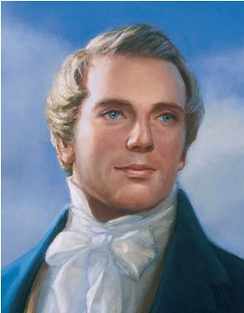
LESSON 2
What phrases in this paragraph describe the circumstances in which these revelations were received?

Slide 14
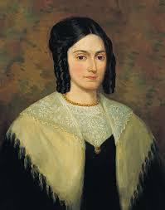
LESSON 2
How can these additional witnesses help you when you are in challenging circumstances?

Slide 15
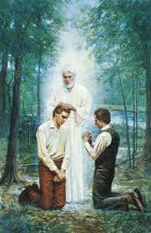
LESSON 2
Based on what you have read in sixth paragraph of the introduction, what must we do to receive divine guidance in our times of need?

Slide 16
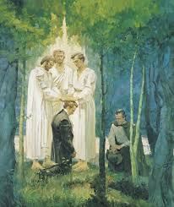
LESSON 2
When have you faced a situation in which you needed the Lord’s help or guidance and you received it?

Slide 17
LESSON 2
If we, then the Lord will _________________.
pray for help in our times of need
give us guidance

Slide 18
LESSON 2
“Testimony of the Twelve Apostles to the Truth of the Book of Doctrine and Covenants”
We, therefore, feel willing to bear testimony to all the world of mankind, to every creature upon the face of the earth, that the Lord has borne record to our souls, through the Holy Ghost shed forth upon us, that these commandments were given by inspiration of God, and are profitable for all men and are verily true.
We give this testimony unto the world, the Lord being our helper; and it is through the grace of God the Father, and His Son, Jesus Christ, that we are permitted to have this privilege of bearing this testimony unto the world, in the which we rejoice exceedingly, praying the Lord always that the children of men may be profited thereby.

Slide 19
LESSON 2
The names of the Twelve were:
Thomas B. Marsh
David W. Patten
Brigham Young
Heber C. Kimball
Orson Hyde
William E. McLellin
Parley P. Pratt
Luke S. Johnson
William Smith
Orson Pratt
John F. Boynton
Lyman E. Johnson
Which phrases from the Twelve Apostles’ testimony of the Doctrine and Covenants stand out to you? Why?

