Slide 1
LESSON 15
SEMINARY
Doctrine and Covenants
and Church History

Slide 2
LESSON 17
Doctrine and Covenants 9:1-6, 11
“The Lord explains why Oliver Cowdery struggled to translate”

Slide 3
LESSON 17
How would seeking guidance from the Lord help you make this decision?
Doctrine and Covenants 9:1–4
1 Behold, I say unto you, my son, that because you did not translate according to that which you desired of me, and did commence again to write for my servant, Joseph Smith, Jun., even so I would that ye should continue until you have finished this record, which I have entrusted unto him.
2 And then, behold, other records have I, that I will give unto you power that you may assist to translate.
3 Be patient, my son, for it is wisdom in me, and it is not expedient that you should translate at this present time.
4 Behold, the work which you are called to do is to write for my servant Joseph.
What work did the Lord ask Oliver to do?

Slide 4
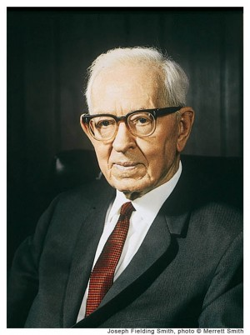
LESSON 17
Doctrine and Covenants 9:5–6, 11
5 And, behold, it is because that you did not continue as you commenced, when you began to translate, that I have taken away this privilege from you.
6 Do not murmur, my son, for it is wisdom in me that I have dealt with you after this manner.
11 Behold, it was expedient when you commenced; but you feared, and the time is past, and it is not expedient now;
“Oliver’s failure came because he did not continue as he commenced, and the task being a difficult one, his faith deserted him” (Church History and Modern Revelation[1953],1:51).

Slide 5
LESSON 17
According to President Smith, why was Oliver unable to continue as he had started?
His faith faltered.
What are some ways that fear, or a lack of faith, could prevent us from receiving or acting on revelation from the Lord?
What can Oliver’s experience teach us about how to receive revelation from the Lord?
To receive revelation, we must act in faith.

Slide 6
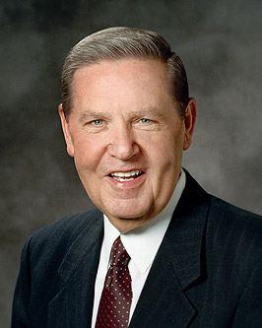
LESSON 17
“In the process of revelation and making important decisions, fear plays a destructive, sometimes paralyzing role. To Oliver Cowdery, who missed the opportunity of a lifetime because he didn’t seize it in the lifetime of the opportunity, the Lord said, ‘You did not continue as you commenced.’ Does that sound familiar to those who have been illuminated and then knuckled under to second thoughts and returning doubts?…
“…After you have gotten the message, after you have paid the price to feel His love and hear the word of the Lord, go forward. Don’t fear, don’t vacillate, don’t quibble, don’t whine. … Dismiss your fears and wade in with both feet” (“Cast Not Away Therefore Your Confidence,” Ensign, Mar. 2000,10).
When have you received an answer from the Lord and acted on it without hesitation?

Slide 7
LESSON 17
Doctrine and Covenants 9:7–10.
“The Lord reveals principles governing revelation”

Slide 8
LESSON 17
Doctrine and Covenants 9:7–8
7 Behold, you have not understood; you have supposed that I would give it unto you, when you took no thought save it was to ask me.
8 But, behold, I say unto you, that you must study it out in your mind; then you must ask me if it be right, and if it is right I will cause that your bosom shall burn within you; therefore, you shall feel that it is right.
According to Doctrine and Covenants 9:7, what did Oliver suppose was the only thing he would need to do to receive revelation while he translated?
What did the Lord teach Oliver he should do before asking for guidance?

Slide 9
LESSON 17
What do you think it means to “study it out in your mind”?
To consider decisions and options, weighing alternatives carefully.
How have you done this when you have needed to make decisions?
According to Doctrine and Covenants 9:8, what do we need to do after we have studied out the matter we are considering?
Decide which choice we believe is right and then take our decision to Heavenly Father in prayer.
What lesson can we learn from Doctrine and Covenants 9:8 about what the Lord expects of us as we seek His direction and guidance?
Receiving and recognizing revelation require effort on our part.

Slide 10
LESSON 17
1. A young man receives an offer for a good job, but it requires him to work on Sunday. He is trying to decide whether to accept the job.
2. A young woman has been thinking about the friends she is associating with and the negative influence they have on her. She wants to stop hanging out with them, but she does not know the most tactful way to withdraw from them.
3. A young woman is considering what she should do after she completes high school. She knows she wants to continue her education but is unsure of which educational institution she should attend.
When have you felt that effort on your part has helped you receive revelation from the Lord?

Slide 11
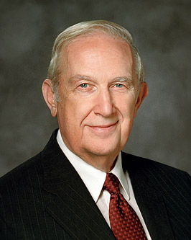
LESSON 17
What can we learn from verse 8 about how the Lord answers our questions?
Revelation can come through our feelings as we ask the Lord for guidance.
“The feeling of peace is the most common confirming witness that I personally experience. When I have been very concerned about an important matter, struggling to resolve it without success, I continued those efforts in faith. Later, an all-pervading peace has come, settling my concerns, as He has promised” (“Using the Supernal Gift of Prayer, ”Ensign or Liahona, May 2007,10)

Slide 12
LESSON 17
When have you felt the Lord confirm a decision that you have made? How did that confirmation feel to you?
Doctrine and Covenants 9:9.
But if it be not right you shall have no such feelings, but you shall have a stupor of thought that shall cause you to forget the thing which is wrong; therefore, you cannot write that which is sacred save it be given you from me.
“That [stupor of thought], for me, is an unsettling, discomforting feeling” (“Using the Supernal Gift of Prayer,”10).

Slide 13
LESSON 17
Doctrine and Covenants 9:12–14
“The Lord encourages Oliver to continue in the work he has been called to do”

Slide 14
LESSON 17
Doctrine and Covenants 9:12–14
12 For, do you not behold that I have given unto my servant Joseph sufficient strength, whereby it is made up? And neither of you have I condemned.
13 Do this thing which I have commanded you, and you shall prosper. Be faithful, and yield to no temptation.
14 Stand fast in the work wherewith I have called you, and a hair of your head shall not be lost, and you shall be lifted up at the last day. Amen.

