Slide 1
LESSON 15
SEMINARY
Doctrine and Covenants
and Church History

Slide 2
LESSON 16
Doctrine and Covenants 8

Slide 3
LESSON 16
Doctrine and Covenants 8:1–5
“The Lord promises Oliver Cowdery the gift of revelation”

Slide 4
LESSON 16
What can we do to make our prayers more meaningful?
How can we know when God is speaking to us?
Why do you think it is important to understand the answers to these questions?

Slide 5
LESSON 16
Doctrine and Covenants 8:1
Oliver Cowdery, verily, verily, I say unto you, that assuredly as the Lord liveth, who is your God and your Redeemer, even so surely shall you receive a knowledge of whatsoever things you shall ask in faith, with an honest heart, believing that you shall receive a knowledge concerning the engravings of old records, which are ancient, which contain those parts of my scripture of which has been spoken by the manifestation of my Spirit.
What instruction did the Lord give to Oliver about how to pray?
What do you think it means to “ask in faith, with an honest heart”?

Slide 6
LESSON 16
If we pray_____________________________, we can receive____________________
with faith and an honest heart
knowledge from God.
Why do you think our faith and sincerity affect our ability to receive knowledge from God?
2 Yea, behold, I will tell you in your mind and in your heart, by the Holy Ghost, which shall come upon you and which shall dwell in your heart.
3 Now, behold, this is the spirit of revelation; behold, this is the spirit by which Moses brought the children of Israel through the Red Sea on dry ground.
Doctrine and Covenants 8:2-3

Slide 7
LESSON 16
How did God inspire Moses to part the Red Sea?
By the spirit of revelation.
What truth do we learn from these verses about how the Lord may speak to us?
The Lord speaks to our minds and hearts by the power of the Holy Ghost.

Slide 8
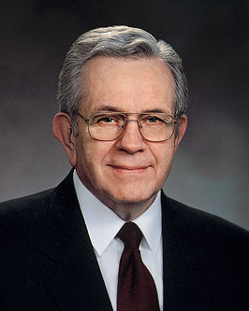
LESSON 16
In what ways does the Lord speak to our minds? In what ways does He speak to our hearts?
“You can learn now, in your youth, to be led by the Holy Ghost. “As an Apostle I listen now to the same inspiration, coming from the same source, in the same way, that I listened to as a boy. The signal is much clearer now” (“Prayers and Answers,” Ensign, Nov. 1979,21).

Slide 9
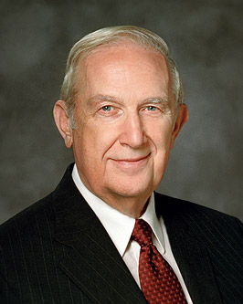
LESSON 16
“An impression to the mind is very specific. “Detailed words can be heard or felt and written as though the instruction were being dictated. “A communication to the heart is a more general impression. The Lord often begins by giving impressions. Where there is a recognition of their importance and they are obeyed, one gains more capacity to receive more detailed instruction to the mind. An impression to the heart, if followed, is fortified by a more specific instruction to the mind” (“Helping Others to Be Spiritually Led” [address to CES religious educators, Aug. 11, 1998], 3–4,LDS.org).

Slide 10
LESSON 16
Why is it important to understand and recognize how the Lord communicates with us individually?
Doctrine and Covenants 8:4.
Therefore this is thy gift; apply unto it, and blessed art thou, for it shall deliver you out of the hands of your enemies, when, if it were not so, they would slay you and bring your soul to destruction.
What do you think it means to “apply unto” the spirit of revelation?
To seek the guidance of the Holy Ghost.

Slide 11
LESSON 16
we can be delivered from evil and harm.
If we apply unto the spirit of revelation,___________________________.
Doctrine and Covenants 8:4-5
4 Therefore this is thy gift; apply unto it, and blessed art thou, for it shall deliver you out of the hands of your enemies, when, if it were not so, they would slay you and bring your soul to destruction.
5 Oh, remember these words, and keep my commandments. Remember, this is your gift.
How has the Lord used the power of revelation to protect you or someone you know from evil or harm?

Slide 12
LESSON 16
Doctrine and Covenants 8:6–9
Oliver Cowdery has the “gift of Aaron”

Slide 13
LESSON 16
Doctrine and Covenants 8:7–8
7 Behold, there is no other power, save the power of God, that can cause this gift of Aaron to be with you.
8 Therefore, doubt not, for it is the gift of God; and you shall hold it in your hands, and do marvelous works; and no power shall be able to take it away out of your hands, for it is the work of God.

Slide 14
LESSON 16
Doctrine and Covenants 8:10–12.
“The Lord promises Oliver Cowdery the gift to translate if he exercises faith”.

Slide 15
LESSON 16
“If we pray with faith and an honest heart, we can receive knowledge from God.”
Doctrine and Covenants 8:10–12
10 Remember that without faith you can do nothing; therefore ask in faith. Trifle not with these things; do not ask for that which you ought not.
11 Ask that you may know the mysteries of God, and that you may translate and receive knowledge from all those ancient records which have been hid up, that are sacred; and according to your faith shall it be done unto you.
12 Behold, it is I that have spoken it; and I am the same that spake unto you from the beginning. Amen
If you were in Oliver’s situation, how do you think this counsel would help you?

