Slide 1
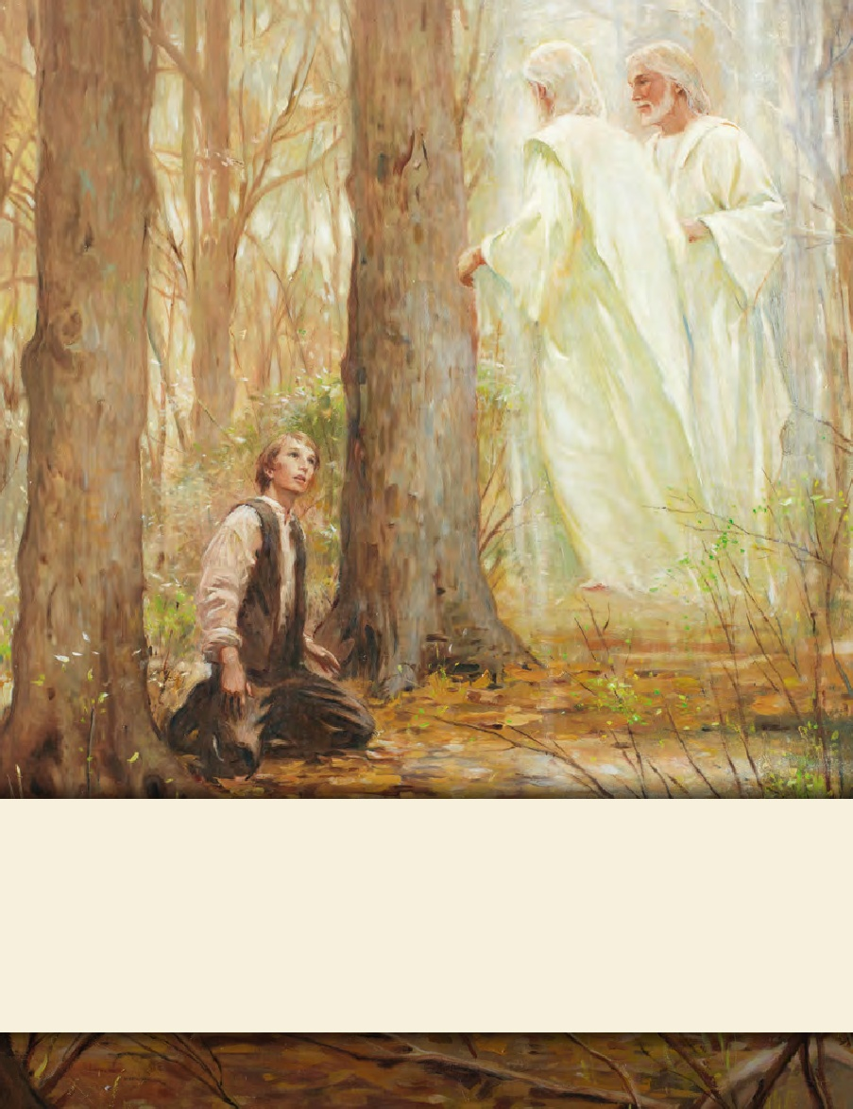
SEMINARY
Doctrine and Covenants
and Church History

Slide 2
LESSON 12
Doctrine and Covenants 10

Slide 3
LESSON 12
Doctrine and Covenants 10:1–4
“The Lord restores Joseph’s gift to translate”

Slide 4
LESSON 12
Doctrine and Covenants 10:3–4
3 Nevertheless, it is now restored unto you again; therefore see that you are faithful and continue on unto the finishing of the remainder of the work of translation as you have begun.
4 Do not run faster or labor more than you have strength and means provided to enable you to translate; but be diligent unto the end.
Why do you think Joseph Smith needed to be counseled not to labor or to translate more than he had strength?
How can the counsel in Doctrine and Covenants 10:4 guide us as we serve the Lord?

Slide 5
LESSON 12
Doctrine and Covenants10:5–37
“The Lord warns of Satan’s plans to destroy Joseph Smith and the work of God”

Slide 6
LESSON 12
How could a device like this represent Satan’s intentions toward us?
Doctrine and Covenants10:5
Pray always, that you may come off conqueror; yea, that you may conquer Satan, and that you may escape the hands of the servants of Satan that do uphold his work.
What can we learn from this verse?
As we pray always, we will have power to overcome Satan and those who serve him.

Slide 7
LESSON 12
How can prayer help us to “conquer Satan, and … escape [those who] uphold his work”?
Doctrine and Covenants 10:8–19
8 And because you have delivered the writings into his hands, behold, wicked men have taken them from you.
9 Therefore, you have delivered them up, yea, that which was sacred, unto wickedness.
10 And, behold, Satan hath put it into their hearts to alter the words which you have caused to be written, or which you have translated, which have gone out of your hands.
11 And behold, I say unto you, that because they have altered the words, they read contrary from that which you translated and caused to be written;
12 And, on this wise, the devil has sought to lay a cunning plan, that he may destroy this work;
13 For he hath put into their hearts to do this, that by lying they may say they have caught you in the words which you have pretended to translate.
14 Verily, I say unto you, that I will not suffer that Satan shall accomplish his evil design in this thing.
15 For behold, he has put it into their hearts to get thee to tempt the Lord thy God, in asking to translate it over again.
16 And then, behold, they say and think in their hearts—We will see if God has given him power to translate; if so, he will also give him power again;
17 And if God giveth him power again, or if he translates again, or, in other words, if he bringeth forth the same words, behold, we have the same with us, and we have altered them;
18 Therefore they will not agree, and we will say that he has lied in his words, and that he has no gift, and that he has no power;
19 Therefore we will destroy him, and also the work; and we will do this that we may not be ashamed in the end, and that we may get glory of the world.

Slide 8
LESSON 12
What was the plan of the wicked individuals who had the manuscript?
To discredit the Prophet and the work of the Lord by altering the words of the manuscript. If Joseph had translated the same material again, they would have said that he was unable to do it the same way twice and therefore had no gift.

Slide 9
LESSON 12
Doctrine and Covenants 10:20–29
20 Verily, verily, I say unto you, that Satan has great hold upon their hearts; he stirreth them up to iniquity against that which is good;
21 And their hearts are corrupt, and full of wickedness and abominations; and they love darkness rather than light, because their deeds are evil; therefore they will not ask of me.
22 Satan stirreth them up, that he may lead their souls to destruction.
23 And thus he has laid a cunning plan, thinking to destroy the work of God; but I will require this at their hands, and it shall turn to their shame and condemnation in the day of judgment.
24 Yea, he stirreth up their hearts to anger against this work.
25 Yea, he saith unto them: Deceive and lie in wait to catch, that ye may destroy; behold, this is no harm. And thus he flattereth them, and telleth them that it is no sin to lie that they may catch a man in a lie, that they may destroy him.
26 And thus he flattereth them, and leadeth them along until he draggeth their souls down to hell; and thus he causeth them to catch themselves in their own snare.
27 And thus he goeth up and down, to and fro in the earth, seeking to destroy the souls of men.
28 Verily, verily, I say unto you, wo be unto him that liethto deceive because he supposeth that another lieth to deceive, for such are not exempt from the justice of God.
29 Now, behold, they have altered these words, because Satan saith unto them: He hath deceived you—and thus he flattereth them away to do iniquity, to get thee to tempt the Lord thy God.

Slide 10
LESSON 12
What do we learn from these verses about Satan’s purposes?
Satan desires to destroy the work of the Lord and our souls.
Doctrine and Covenants 10:22-23,27
22 Satan stirreth them up, that he may lead their souls to destruction.
23 And thus he has laid a cunning plan, thinking to destroy the work of God; but I will require this at their hands, and it shall turn to their shame and condemnation in the day of judgment.
27 And thus he goeth up and down, to and fro in the earth, seeking to destroy the souls of men.
How does Satan seek to destroy the work of the Lord and our souls?

Slide 11
LESSON 12
What evidence have you seen that Satan uses deception, anger, flattery, and lying to destroy the work of the Lord and our souls?
How can being aware of Satan’s intentions and methods help us avoid and escape his traps?

Slide 12
LESSON 12
Doctrine and Covenants 10:38–45
“The Lord commands Joseph Smith to translate the small plates of Nephi”

Slide 13
LESSON 12
Doctrine and Covenants 10:38–42
38 And now, verily I say unto you, that an account of those things that you have written, which have gone out of your hands, is engraven upon the plates of Nephi;
39 Yea, and you remember it was said in those writings that a more particular account was given of these things upon the plates of Nephi.
40 And now, because the account which is engraven upon the plates of Nephi is more particular concerning the things which, in my wisdom, I would bring to the knowledge of the people in this account—
41 Therefore, you shall translate the engravings which are on the plates of Nephi, down even till you come to the reign of king Benjamin, or until you come to that which you have translated, which you have retained;
42 And behold, you shall publish it as the record of Nephi; and thus I will confound those who have altered my words.
What did the Lord command Joseph to translate? Why?

Slide 14
Words of Mormon 1:3–7
3 And now, I speak somewhat concerning that which I have written; for after I had made an abridgment from the plates of Nephi, down to the reign of this king Benjamin, of whom Amaleki spake, I searched among the records which had been delivered into my hands, and I found these plates, which contained this small account of the prophets, from Jacob down to the reign of this king Benjamin, and also many of the words of Nephi.
4 And the things which are upon these plates pleasing me, because of the prophecies of the coming of Christ; and my fathers knowing that many of them have been fulfilled; yea, and I also know that as many things as have been prophesied concerning us down to this day have been fulfilled, and as many as go beyond this day must surely come to pass—
5 Wherefore, I chose these things, to finish my record upon them, which remainder of my record I shall take from the plates of Nephi; and I cannot write the hundredth part of the things of my people.
6 But behold, I shall take these plates, which contain these prophesyings and revelations, and put them with the remainder of my record, for they are choice unto me; and I know they will be choice unto my brethren.
7 And I do this for a wise purpose; for thus it whispereth me, according to the workings of the Spirit of the Lord which is in me. And now, I do not know all things; but the Lord knoweth all things which are to come; wherefore, he worketh in me to do according to his will.

Slide 15
LESSON 12
Doctrine and Covenants 10:43
I will not suffer that they shall destroy my work; yea, I will show unto them that my wisdom is greater than the cunning of the devil.
The wisdom of God is greater than the cunning of the devil.

Slide 16
LESSON 12
How does the Lord’s plan to replace the lost manuscript illustrate this truth?
Doctrine and Covenants 10:44-45
44 Behold, they have only got a part, or an abridgment of the account of Nephi.
45 Behold, there are many things engraven upon the plates of Nephi which do throw greater views upon my gospel; therefore, it is wisdom in me that you should translate this first part of the engravings of Nephi, and send forth in this work.
Why are the small plates of Nephi of greater worth than what was lost with the 116 manuscript pages?
How does knowing that God prepared a way to compensate for the 116 lost manuscript pages help you more fully trust Him?

Slide 17
LESSON 12
Doctrine and Covenants 10:46–70
“The Lord explains the purpose of the Book of Mormon and its role in establishing His Church”.

Slide 18
LESSON 12
Doctrine and Covenants 10:62-63
62 Yea, and I will also bring to light my gospel which was ministered unto them, and, behold, they shall not deny that which you have received, but they shall build it up, and shall bring to light the true points of my doctrine, yea, and the only doctrine which is in me.
63 And this I do that I may establish my gospel, that there may not be so much contention; yea, Satan doth stir up the hearts of the people to contention concerning the points of my doctrine; and in these things they do err, for they do wrest the scriptures and do not understand them.
62 Yea, and I will also bring to light my gospel which was ministered unto them, and, behold, they shall not deny that which you have received, but they shall build it up, and shall bring to light the true points of my doctrine, yea, and the only doctrine which is in me.
63 And this I do that I may establish my gospel, that there may not be so much contention; yea, Satan doth stir up the hearts of the people to contention concerning the points of my doctrine; and in these things they do err, for they do wrest the scriptures and do not understand them.
What will the Book of Mormon bring to light?
The true points of Jesus Christ’s doctrine.

Slide 19
LESSON 12
Doctrine and Covenants 10:67,69-70
67 Behold, this is my doctrine—whosoever repenteth and cometh unto me, the same is my church.
69 And now, behold, whosoever is of my church, and endureth of my church to the end, him will I establish upon my rock, and the gates of hell shall not prevail against them.
70 And now, remember the words of him who is the life and light of the world, your Redeemer, your Lord and your God. Amen.

