Slide 1
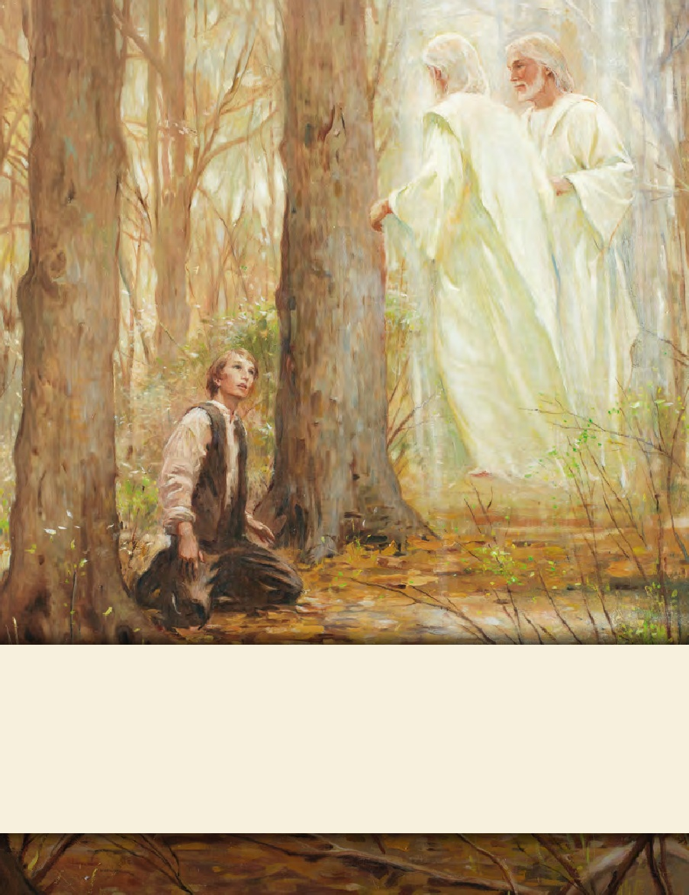
SEMINARY
Doctrine and Covenants
and Church History

Slide 2
LESSON 11
Doctrine and Covenants 3:1–3
“Joseph Smith learns that the work of God cannot be frustrated”

Slide 3
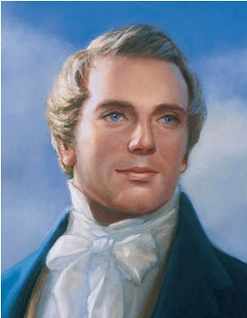
LESSON 11
Why is it sometimes difficult to resist our friends when they try to influence us to do something wrong?
“[Martin] desired of me that I would inquire of the Lord, through the Urim and Thummim, if he might not [take the manuscript home and show it]. I did inquire, and the answer was that he must not. However, he was not satisfied with this answer, and desired that I should inquire again. I did so, and the answer was as before. Still he could not be contented, but insisted that I should inquire once more” (in History of the Church,1:21).

Slide 4
LESSON 11
Why do you think Joseph Smith persisted in asking God the same question even after receiving a clear answer?
Consider these difficult circumstances for the Prophet Joseph Smith. How do you think you would feel in this situation?

Slide 5
LESSON 11
Doctrine and Covenants 3:1–3
1 The works, and the designs, and the purposes of God cannot be frustrated, neither can they come to naught.
2 For God doth not walk in crooked paths, neither doth he turn to the right hand nor to the left, neither doth he vary from that which he hath said, therefore his paths are straight, and his course is one eternal round.
3 Remember, remember that it is not the work of God that is frustrated, but the work of men;
How would you summarize the Lord’s message to Joseph Smith in these verses?
The purposes of God cannot be frustrated

Slide 6
LESSON 11
Doctrine and Covenants 3:4–15
“The Lord rebukes Joseph Smith and exhorts him to repent”

Slide 7
LESSON 11
Doctrine and Covenants 3:4-6
4 For although a man may have many revelations, and have power to do many mighty works, yet if he boasts in his own strength, and sets at naught the counsels of God, and follows after the dictates of his own will and carnal desires, he must fall and incur the vengeance of a just God upon him.
5 Behold, you have been entrusted with these things, but how strict were your commandments; and remember also the promises which were made to you, if you did not transgress them.
6 And behold, how oft you have transgressed the commandments and the laws of God, and have gone on in the persuasions of men.
In what way had Joseph “gone on in the persuasions of men”?

Slide 8
LESSON 11
Doctrine and Covenants 3:12-15
12 And when thou deliveredst up that which God had given thee sight and power to translate, thou deliveredst up that which was sacred into the hands of a wicked man,
13 Who has set at naught the counsels of God, and has broken the most sacred promises which were made before God, and has depended upon his own judgment and boasted in his own wisdom.
14 And this is the reason that thou hast lost thy privileges for a season—
15 For thou hast suffered the counsel of thy director to be trampled upon from the beginning.
For, behold, you should not have feared man more than God. Although men set at naught the counsels of God, and despise his words
Doctrine and Covenants 3:7
We should fear God more than man.

Slide 9
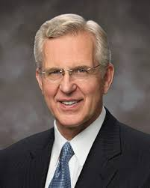
LESSON 11
What do you think it means to fear God more than man?
“There are many places in the scriptures that counsel mankind to fear God. In our day we generally interpret the word fear as “respect” or “reverence” or “love”; that is, the fear of God means the love of God or respect for Him and His law. That may often be a correct reading, but I wonder if sometimes fear doesn’t really mean fear, as when the prophets speak of fearing to offend God by breaking His commandments.…
“…We should so love and reverence Him that we fear doing anything
wrong in His sight, whatever may be the opinions of or pressure from others” (“A Sense of the Sacred” [CES fireside for young adults, Nov. 7, 2004], 6–7,LDS.org; see alsospeeches.byu.edu)
According to Elder Christofferson, what does it mean to fear God?
How can fearing God, as Elder Christofferson explained, help us make right decisions even when we feel peer pressure?

Slide 10
LESSON 11
Doctrine and Covenants 3:8
Yet you should have been faithful; and he would have extended his arm and supported you against all the fiery darts of the adversary; and he would have been with you in every time of trouble.
“if we are faithful to the Lord’s commandments, He will support us during times of trouble”.
How can this truth help you when you are tempted by a friend to do something you know is not right?

Slide 11
LESSON 11
9 Behold, thou art Joseph, and thou wast chosen to do the work of the Lord, but because of transgression, if thou art not aware thou wilt fall.
10 But remember, God is merciful; therefore, repent of that which thou hast done which is contrary to the commandment which I gave you, and thou art still chosen, and art again called to the work;
Doctrine and Covenants 3:9-10
What promise did the Lord give to Joseph Smith? How does this promise apply to us?
if we repent of our sins, we will receive the Lord’s mercy

Slide 12
LESSON 11
Keeping in mind what the Lord said to Joseph in Doctrine and Covenants 3:4–6, how would you have felt after hearing this promise from the Lord if you were in Joseph’s place?
Doctrine and Covenants 3:9, 11
9 Behold, thou art Joseph, and thou wast chosen to do the work of the Lord, but because of transgression, if thou art not aware thou wilt fall.
11 Except thou do this, thou shalt be delivered up and become as other men, and have no more gift.
Why are these warnings important to remember as we repent of our sins and seek the Lord’s mercy?

Slide 13
LESSON 11
Doctrine and Covenants 3:16–20
“The Lord explains His purposes for
the Book of Mormon”

Slide 14
LESSON 11
Doctrine and Covenants 3:16–20
16 Nevertheless, my work shall go forth, for inasmuch as the knowledge of a Savior has come unto the world, through the testimony of the Jews, even so shall the knowledge of a Savior come unto my people—
17 And to the Nephites, and the Jacobites, and the Josephites, and the Zoramites, through the testimony of their fathers—
18 And this testimony shall come to the knowledge of the Lamanites, and the Lemuelites, and the Ishmaelites, who dwindled in unbelief because of the iniquity of their fathers, whom the Lord has suffered to destroy their brethren the Nephites, because of their iniquities and their abominations.
19 And for this very purpose are these plates preserved, which contain these records—that the promises of the Lord might be fulfilled, which he made to his people;
20 And that the Lamanites might come to the knowledge of their fathers, and that they might know the promises of the Lord, and that they may believe the gospel and rely upon the merits of Jesus Christ, and be glorified through faith in his name, and that through their repentance they might be saved. Amen.
Why was the work that Joseph Smith and Martin Harris were doing so important to the Lord and His people?

