Slide 1
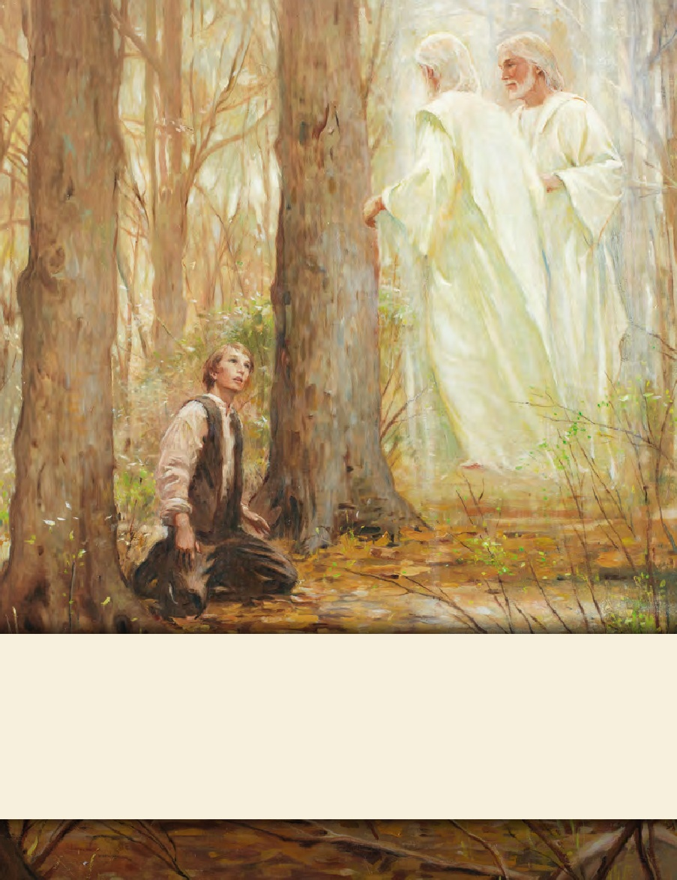
SEMINARY
Doctrine and Covenants
and Church History

Slide 2
LESSON 10
Joseph Smith—History 1:55–58
“Joseph Smith works for Josiah Stoal and marries Emma Hale”

Slide 3
LESSON 10
Joseph Smith—History 1:55–58
55 As my father’s worldly circumstances were very limited, we were under the necessity of laboring with our hands, hiring out by day’s work and otherwise, as we could get opportunity. Sometimes we were at home, and sometimes abroad, and by continuous labor were enabled to get a comfortable maintenance.
56 In the year 1823 my father’s family met with a great affliction by the death of my eldest brother, Alvin. In the month of October, 1825, I hired with an old gentleman by the name of Josiah Stoal, who lived in Chenango county, State of New York. He had heard something of a silver mine having been opened by the Spaniards in Harmony, Susquehanna county, State of Pennsylvania; and had, previous to my hiring to him, been digging, in order, if possible, to discover the mine. After I went to live with him, he took me, with the rest of his hands, to dig for the silver mine, at which I continued to work for nearly a month, without success in our undertaking, and finally I prevailed with the old gentleman to cease digging after it. Hence arose the very prevalent story of my having been a money-digger.
57 During the time that I was thus employed, I was put to board with a Mr. Isaac Hale, of that place; it was there I first saw my wife (his daughter), Emma Hale. On the 18th of January, 1827, we were married, while I was yet employed in the service of Mr. Stoal.
58 Owing to my continuing to assert that I had seen a vision, persecution still followed me, and my wife’s father’s family were very much opposed to our being married. I was, therefore, under the necessity of taking her elsewhere; so we went and were married at the house of Squire Tarbill, in South Bainbridge, Chenango county, New York. Immediately after my marriage, I left Mr. Stoal’s, and went to my father’s, and farmed with him that season.
What significant events occurred during this time period in Joseph Smith’s life?
Joseph’s brother Alvin died.
Joseph went to work for Josiah Stoal.
Joseph married Emma Hale

Slide 4
LESSON 10
Joseph Smith—History 1:59–62
“Joseph receives the plates and begins translating them”

Slide 5
LESSON 10
Have you ever seen someone who has neglected or failed to take care of something of value? Why do some people do this?
Joseph Smith—History 1:59
59 At length the time arrived for obtaining the plates, the Urim and Thummim, and the breastplate. On the twenty-second day of September, one thousand eight hundred and twenty-seven, having gone as usual at the end of another year to the place where they were deposited, the same heavenly messenger delivered them up to me with this charge: that I should be responsible for them; that if I should let them go carelessly, or through any neglect of mine, I should be cut off; but that if I would use all my endeavors to preserve them, until he, the messenger, should call for them, they should be protected.
would use all my endeavors to preserve them, until he, the messenger, should call for them, they should be protected.

Slide 6
LESSON 10
What items did Moroni entrust to Joseph Smith?
The gold plates, the Urim and Thummim, and the breastplate.
What charge did Moroni give to Joseph Smith concerning the plates?

Slide 7
LESSON 10
As we take responsibility for and preserve that which the Lord has given us, He will____________________________
extend His protection and help.
What did the Lord promise Joseph if he would be responsible in his care of the plates?
What are some examples of sacred trusts the Lord has given us?
Treating our bodies with reverence, baptismal and temple covenants, priesthood authority and duties, Church callings, our responsibility to nourish our minds and spirits, our family responsibilities and relationships, and our testimonies.

Slide 8
LESSON 10
Joseph Smith—History 1:60
60 I soon found out the reason why I had received such strict charges to keep them safe, and why it was that the messenger had said that when I had done what was required at my hand, he would call for them. For no sooner was it known that I had them, than the most strenuous exertions were used to get them from me. Every stratagem that could be invented was resorted to for that purpose. The persecution became more bitter and severe than before, and multitudes were on the alert continually to get them from me if possible. But by the wisdom of God, they remained safe in my hands, until I had accomplished by them what was required at my hand. When, according to arrangements, the messenger called for them, I delivered them up to him; and he has them in his charge until this day, being the second day of May, one thousand eight hundred and thirty-eight.
“But by the wisdom of God, they remained safe in my hands, until I had accomplished by them what was required at my hand.”

Slide 9
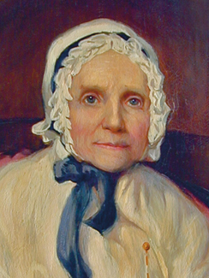
LESSON 10
“Joseph, on coming to them, took them from their secret place, and, wrapping them in his linen frock, placed them under his arm and started for home. “After proceeding a short distance, he thought it would be more safe to leave the road and go through the woods. Traveling some distance after he left the road, he came to a large windfall, and as he was jumping over a log, a man sprang up from behind it and gave him a heavy blow with a gun. Joseph turned around and knocked him down, then ran at the top of his speed. About half a mile farther he was attacked again in the same manner as
before; he knocked this man down in like manner as the former and ran on again; and before he reached home he was assaulted the third time. In striking the last one, he dislocated his thumb, which, however, he did not notice until he came within sight of the house, when he threw himself down in the corner of the fence in order to recover his breath. As soon as he was able, he arose and came to the house. He was still altogether speechless from fright and the fatigue of running” (in Lucy Mack Smith, History of Joseph Smith by His Mother, ed. Preston Nibley [1958],108).
When have you (or someone you know) received the Lord’s protection and help as you diligently sought to be true to a sacred trust from the Lord?

Slide 10
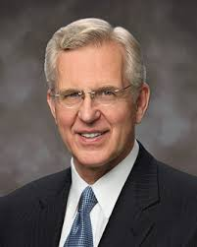
LESSON 10
“Be wise with what the Lord gives you. It is a trust.…
“Rather than drifting into carelessness, may your life be one of increasing exactness in obedience. I hope you will think and feel and dress and act in ways that show reverence and respect for sacred things, sacred places, sacred occasions” (“A Sense of the Sacred” [Church Educational System fireside for young adults, Nov. 7, 2004], 9, 10; speeches.byu.edu).
Joseph Smith—History 1:61-62
61 The excitement, however, still continued, and rumor with her thousand tongues was all the time employed in circulating falsehoods about my father’s family, and about myself. If I were to relate a thousandth part of them, it would fill up volumes. The persecution, however, became so intolerable that I was under the necessity of leaving Manchester, and going with my wife to Susquehanna county, in the State of Pennsylvania. While preparing to start—being very poor, and the persecution so heavy upon us that there was no probability that we would ever be otherwise—in the midst of our afflictions we found a friend in a gentleman by the name of Martin Harris, who came to us and gave me fifty dollars to assist us on our journey. Mr. Harris was a resident of Palmyra township, Wayne county, in the State of New York, and a farmer of respectability.
62 By this timely aid was I enabled to reach the place of my destination in Pennsylvania; and immediately after my arrival there I commenced copying the characters off the plates. I copied a considerable number of them, and by means of the Urim and Thummim I translated some of them, which I did between the time I arrived at the house of my wife’s father, in the month of December, and the February following.
How did the Lord bless the Prophet and his wife at this time?

Slide 11
LESSON 10
Joseph Smith—History 1:63–65
“Martin Harris shows characters from the plates to scholars in New York”

Slide 12
LESSON 10

Slide 13
LESSON 10
Joseph Smith—History 1:63–65
63 Sometime in this month of February, the aforementioned Mr. Martin Harris came to our place, got the characters which I had drawn off the plates, and started with them to the city of New York. For what took place relative to him and the characters, I refer to his own account of the circumstances, as he related them to me after his return, which was as follows:
64 “I went to the city of New York, and presented the characters which had been translated, with the translation thereof, to Professor Charles Anthon, a gentleman celebrated for his literary attainments. Professor Anthon stated that the translation was correct, more so than any he had before seen translated from the Egyptian. I then showed him those which were not yet translated, and he said that they were Egyptian, Chaldaic, Assyriac, and Arabic; and he said they were true characters. He gave me a certificate, certifying to the people of Palmyra that they were true characters, and that the translation of such of them as had been translated was also correct. I took the certificate and put it into my pocket, and was just leaving the house, when Mr. Anthon called me back, and asked me how the young man found out that there were gold plates in the place where he found them. I answered that an angel of God had revealed it unto him.
65 “He then said to me, ‘Let me see that certificate.’ I accordingly took it out of my pocket and gave it to him, when he took it and tore it to pieces, saying that there was no such thing now as ministering of angels, and that if I would bring the plates to him he would translate them. I informed him that part of the plates were sealed, and that I was forbidden to bring them. He replied, ‘I cannot read a sealed book.’ I left him and went to Dr. Mitchell, who sanctioned what Professor Anthon had said respecting both the characters and the translation.”
Isaiah 29:10–12
10 For the Lord hath poured out upon you the spirit of deep sleep, and hath closed your eyes: the prophets and your rulers, the seers hath he covered.
11 And the vision of all is become unto you as the words of a book that is sealed, which men deliver to one that is learned, saying, Read this, I pray thee: and he saith, I cannot; for it is sealed:
12 And the book is delivered to him that is not learned, saying, Read this, I pray thee: and he saith, I am not learned.

Slide 14
LESSON 10
What truth do these passages teach us about the Lord’s foreknowledge and the prophecies of His servants?
The prophecies of the Lord’s servants will come to pass.
How does the fulfillment of divine promises or prophetic statements strengthen your faith?

