Slide 1
SEMINARY
Doctrine and Covenants
and Church History

Slide 2
LESSON 1
The Plan of Salvation

Slide 3
Heavenly Father’s Plan of Happiness
Read the following: Moses 1:39
The purpose of Heavenly Father’s plan is to provide a way for us to receive immortality and eternal life.

Slide 4
What is the difference between immortality and eternal life?
LESSON 1
Immortality:
Eternal life:
Is living forever in a resurrected state; through the Atonement of Jesus Christ, everyone will receive this gift.
Is living in God’s presence forever with our families; this gift is also available through the Atonement of Jesus Christ, but only to those who obey the laws and ordinances of the gospel.

Slide 5
What are some of the blessings given to those who receive eternal life?
LESSON 1

Slide 6
The Plan of Salvation
LESSON 1
Pre- Earth Life
The Presence of God

Slide 7
There we learned about Heavenly Father’s plan for our happiness and how following that plan would help us fulfill His purposes for us.
LESSON 1
Let´s see:
D&C 138:55-56
Abraham 3:22-28

Slide 8
LESSON 1
Questions:
In the pre-earth life, what did Heavenly Father present to us to help us receive immortality and eternal life?
He had a perfected body and character. We did not.
How were we different from our Heavenly Father in the pre-earth life?
The plan of salvation.

Slide 9
The Plan of Salvation
LESSON 1
Pre- Earth Life
The presence of God
Why did we need to leave God’s presence in order to become more like Him?
Mortality

Slide 10
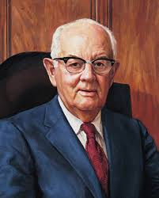
LESSON 1
The president Spencer W. Kimball: “God has given us a plan. He has sent us all to earth to obtain bodies and to gain experience and growth”

Slide 11
LESSON 1
What role do the challenges of temptation, sickness, sorrow, pain, discouragement, disability, and other mortal difficulties play in our efforts to receive eternal life?
D&C 20:19-20
What are some obstacles we face in mortality that can prevent us from receiving eternal life?
Moses 6:57
Remember: Sin prevents us from becoming like Heavenly Father and returning to live with Him

Slide 12
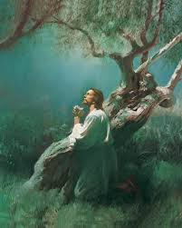
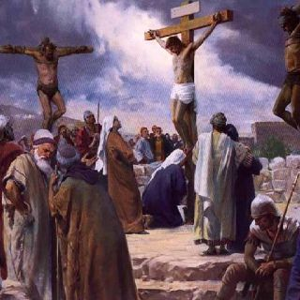
LESSON 1

Slide 13
The Plan of Salvation
LESSON 1
Pre- Earth Life
The presence of God
Mortality
Sin

Slide 14
According to these verses, why does sin prevent us from becoming like Heavenly Father and receiving eternal life?
LESSON 1
No unclean thing can dwell in the presence of God.
Read: D&C 76:40–42
What makes it possible for us to overcome sin?
Jesus Christ suffered and was crucified for the sins of all people.

Slide 15
D&C 18:22–23 D&C 25:13,15
LESSON 1
What must we do to come unto Jesus Christ and receive the blessings of His atoning sacrifice?
Faith in Jesus Chris
Repenting
Being baptized
Receiving the Holy Ghost
Enduring in faith
Keeping covenants
Obeying the commandments
How has God helped you through the Holy Ghost in your daily efforts to live the gospel?

Slide 16
The Plan of Salvation
LESSON 1
Pre- Earth Life
The presence of God
Mortality
Sin
Physical Death

Slide 17
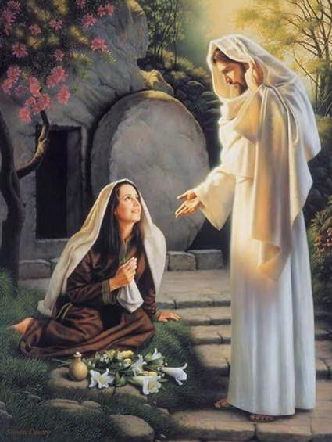
D&C 93:33-34 D&C 130:22
LESSON 1
According to these verses, what has Jesus Christ done to ensure that we can overcome physical death?
Alma 11:42–44

Slide 18
The Plan of Salvation
LESSON 1
Pre- Earth Life
The presence of God
Eternal life
The Atonement of Jesus Christ
Mortality
Repentance
Obedience
Holy Ghost
Covenants
Endurance
Baptism
Faith
Sin
Physical Death

