Slide 1
Virtue
Virtue originates in your innermost thoughts and desires. It is a pattern of thought and behavior based on high moral standards. Since the Holy Ghost does not dwell in unclean tabernacles, virtue is prerequisite to receiving the Spirit’s guidance. What you choose to think and do when you are alone and you believe no one is watching is a strong measure of your virtue.

Slide 2
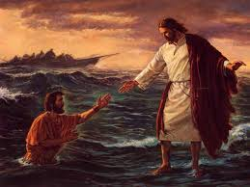
Virtuous people are clean and pure spiritually. They focus on righteous, uplifting thoughts and put unworthy thoughts that lead to inappropriate actions out of their minds. They obey God’s commandments and follow the counsel of Church leaders. They pray for the strength to resist temptation and do what is right. They quickly repent of any sins or wrongdoings. They live worthy of a temple recommend.

Slide 3
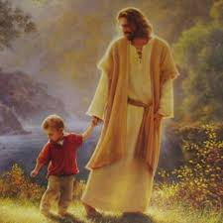
Your mind is like a stage in a theater; in the theater of your mind, however, only one actor can be on stage at a time. If the stage is left bare, thoughts of darkness and sin often enter the stage to tempt. But these thoughts have no power if the stage of your mind is occupied by wholesome thoughts, such as a memorized hymn or verse of scripture that you can call upon in a moment of temptation. By controlling the stage of your mind, you can successfully resist persistent urges to yield to temptation and indulge in sin. You can become pure and virtuous.

