Slide 1
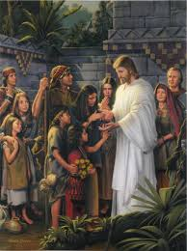
Hope
Hope is an abiding trust that the Lord will fulfill His promises to you. It is manifest in confidence, optimism, enthusiasm, and patient perseverance. It is believing and expecting that something will occur.

Slide 2
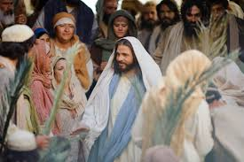
When you have hope, you work through trials and difficulties with the confidence and assurance that all things will work together for your good. Hope helps you conquer discouragement. The scriptures often describe hope in Jesus Christ as the assurance that you will inherit eternal life in the celestial kingdom.

Slide 4
President James E. Faust taught:
“Being blessed with hope, let us, as disciples, reach out to all who, for whatever reason, have ‘moved away from the hope of the gospel’(Col. 1:23). Let us reach to lift hands which hang hopelessly down.”
–Elder Neal A. Maxwell
“Brightness of Hope,” Ensign, Nov. 1994, 36
“Hope is the anchor of our souls. …
“Hope is trust in God’s promises, faith that if we act now, the desired blessings will be fulfilled in the future. …

Slide 5
“The unfailing source of our hope is that we are sons and daughters of God and that His Son, the Lord Jesus Christ, saved us from death” (“Hope, an Anchor of the Soul,” Ensign, Nov. 1999, 59–60).

