Slide 1
Diligence
Diligence is steady, consistent, earnest, and energetic effort in doing the Lord’s work. The Lord expects you to work diligently—persistently and with great effort and care.

Slide 2
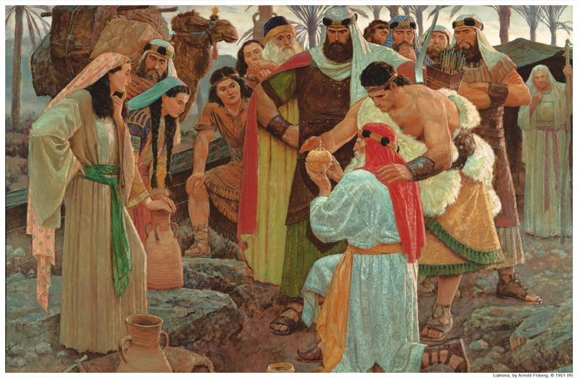
A diligent missionary works effectively and efficiently. Diligence in missionary work is an expression of your love for the Lord and His work. When you are diligent, you find joy and satisfaction in your work.

Slide 3
Do many good things of your own free will (see D&C 58:27). Don’t wait for your leaders to tell you what to do. Continue until you have done all you can, even when you are tired. Focus on the most important things and avoid wasting time. Pray for guidance and strength. Plan regularly and effectively. Avoid anything that distracts your thoughts or actions.

Slide 4
“I have often said one of the greatest secrets of missionary work is work! If a missionary works, he will get the Spirit; if he gets the Spirit, he will teach by the Spirit; and if he teaches by the Spirit, he will touch the hearts of the people and he will be happy. There will be no homesickness, no worrying about families, for all time and talents and interests are centered on the work of the ministry. Work, work, work—there is no satisfactory substitute, especially in missionary work.”
–President Ezra Taft Benson
The Teachings of Ezra Taft Benson (1988), 200

