Slide 1
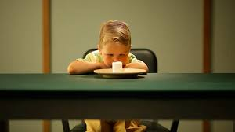
Patience
Patience is the capacity to endure delay, trouble, opposition, or suffering without becoming angry, frustrated, or anxious.

Slide 2
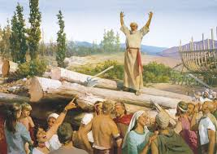
It is the ability to do God’s will and accept His timing. When you are patient, you hold up under pressure and are able to face adversity calmly and hopefully. Patience is related to hope and faith—you must wait for the Lord’s promised blessings to be fulfilled.

Slide 3
You need patience in your everyday experiences and relationships, especially with your companion. You must be patient with all people, yourself included, as you work to overcome faults and weaknesses.

Slide 4
“Life is full of difficulties, some minor and others of a more serious nature. There seems to be an unending supply of challenges for one and all. Our problem is that we often expect instantaneous solutions to such challenges, forgetting that frequently the heavenly virtue of patience is required.”
–President Thomas S. Monson
“Patience—a Heavenly Virtue,” Ensign, Nov. 1995, 59

