Slide 1
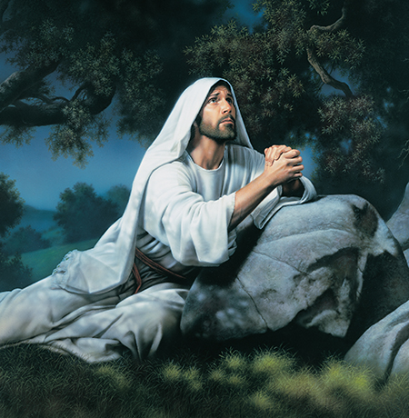
Obedience
As a missionary, you are expected to keep the commandments willingly, to obey mission rules, and to follow the counsel of your leaders.

Slide 2
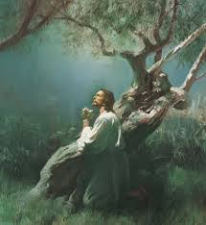
Obedience is the first law of heaven. It is an act of faith. You may sometimes be required to do things you do not completely understand. As you obey, you increase in faith, knowledge, wisdom, testimony, protection, and freedom. Strive to be obedient to the Lord, the living prophet, and your mission president.

Slide 4
“The discipline contained in daily obedience and clean living and wholesome lives builds an armor around you of protection and safety from the temptations that beset you as you proceed through mortality.”
–Elder L. Tom Perry
“Called to Serve,” Ensign, May 1991, 39

