Slide 1
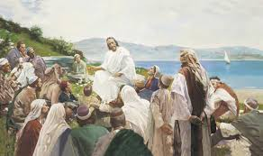
Knowledge
The Lord commanded, “Seek learning, even by study and also by faith” (D&C 88:118). He also warned, “It is impossible for a man to be saved in ignorance” (D&C 131:6). Seek knowledge, especially spiritual knowledge.

Slide 2
Study the scriptures every day, and also study the words of the living prophets. Through study and prayer, seek help for your specific questions, challenges, and opportunities. Give special attention to scripture passages you can use as you teach and as you answer questions about the restored gospel.

Slide 3
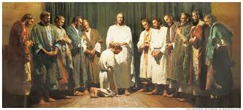
Think about how you can apply gospel principles in your life. As you study diligently, prayerfully, and with pure intent, the Holy Ghost will enlighten your mind, teach you, and help you understand the meaning of the scriptures and the teachings of living prophets.

Slide 4
You can also gain knowledge by watching and listening to others, especially Church leaders. Like Nephi, you can say: “My soul delighteth in the scriptures, and my heart pondereth them. … Behold, my soul delighteth in the things of the Lord; and my heart pondereth continually upon the things which I have seen and heard” (2 Nephi 4:15–16).

