Slide 1
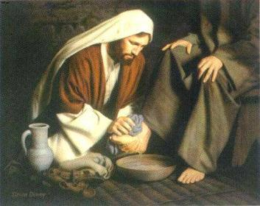
Humility
Humility is willingness to submit to the will of the Lord and to give the Lord the honor for what is accomplished. It includes gratitude for His blessings and acknowledgment of your constant need for His divine help.

Slide 2
Humility is not a sign of weakness; it is a sign of spiritual strength. When you humbly trust Him and acknowledge His power and mercy, you can have the assurance that His commandments are for your good.

Slide 3
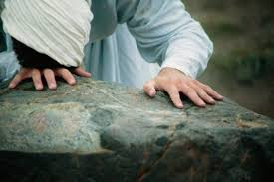
You are confident that you can do whatever the Lord requires of you if you rely on Him. You are also willing to trust His chosen servants and follow their counsel. Humility will help you as you strive to be obedient, to work hard, and serve selflessly.

Slide 4
The opposite of humility is pride, which is condemned in the scriptures. To be prideful means to put greater trust in oneself than in God or in His servants. It also means to put the things of the world above the things of God. Prideful people take honor to themselves rather than giving God the glory. Pride is competitive; those who are prideful seek to have more and presume they are better than other people. Pride usually results in feelings of anger and hatred, and it is a great stumbling block.

