Slide 1
Charity and Love
A man once asked Jesus, “Which is the great commandment in the law?” Jesus replied: “Thou shalt love the Lord thy God with all thy heart, and with all thy soul, and with all thy mind.

Slide 2
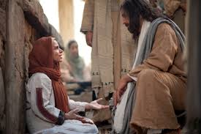
This is the first and great commandment. And the second is like unto it, Thou shalt love thy neighbour as thyself” (Matthew 22:36–39).

Slide 3
Charity is “the pure love of Christ” (Moroni 7:47). It includes God’s eternal love for all His children. We are to seek to develop that kind of love. When you are filled with charity, you obey God’s commandments and do all you can to serve others and help them receive the restored gospel.

Slide 4
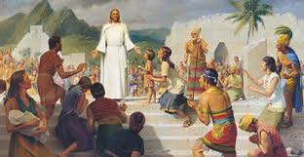
Charity is a gift from God. The prophet Mormon said that we should “pray unto the Father with all the energy of heart, that [we] may be filled with this love” (Moroni 7:48). As you follow this counsel and strive to do righteous works, your love for all people will increase, especially those among whom you labor.

Slide 5
You will come to feel a sincere concern for the eternal welfare and happiness of other people. You will see them as children of God with the potential of becoming like our Heavenly Father, and you will labor in their behalf. You will avoid negative feelings such as anger, envy, lust, or covetousness. You will avoid judging others, criticizing them, or saying negative things about them. You will try to understand them and their points of view. You will be patient with them and try to help them when they are struggling or discouraged. Charity, like faith, leads to action. You will develop charity as you look for opportunities to serve others and give of yourself.

