Slide 1
Chapter 4: The Pioneer Heritage of Faith and Sacrifice
“Whether you have pioneer ancestry or came into the Church only yesterday, you are a part of this whole grand picture of which those men and women dreamed. … They laid the foundation. Ours is the duty to build on it.”

Slide 2
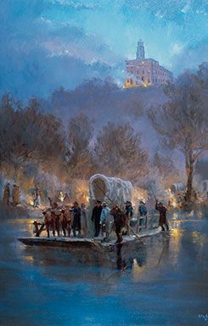
From the Life of Gordon B. Hinckley
“The power that moved our gospel forebears was the power of faith in God.”

Slide 3
With vision, labor, and confidence in the power of God working through them, the early Latter-day Saint pioneers brought their faith to reality.
It was by faith that a small band of early converts [in the eastern United States] moved from New York to Ohio and from Ohio to Missouri and from Missouri to Illinois in their search for peace and freedom to worship God according to the dictates of conscience.
Behind us is a glorious history. It is bespangled with heroism, tenacity to principle, and unflagging fidelity. It is the product of faith. Before us is a great future. It begins today. We cannot pause. We cannot slow down. We cannot slacken our pace or shorten our stride.
Why was faith essential for the pioneers who wanted to gather in the Salt Lake Valley?

Slide 4
Early Latter-day Saint pioneers looked to the future with a grand dream of Zion.
It is proper that we pause to pay reverent respect to those who laid the foundation of this great work. … Their grand objective was Zion [see D&C 97:21; Moses 7:18]. They sang about it. They dreamed of it. It was their great hope. Their epic journey must stand forever as an incomparable undertaking. The movement of tens of thousands to [the] West was fraught with every imaginable hazard, including death, whose grim reality was familiar to every wagon train and every handcart company.
President Hinckley taught that the early pioneers looked to the future, with Zion as their “grand objective,” “great hope,” and “dream” . Why do you think this was such a powerful motivating force for the early pioneers? What similar hopes motivate us today?

Slide 5
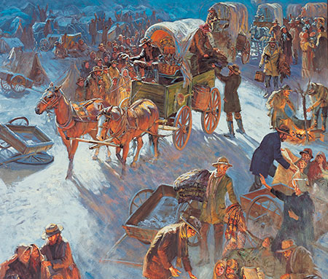
The rescue of the Willie and Martin handcart pioneers speaks of the very essence of the gospel of Jesus Christ.
“When the rescuers reached the beleaguered Saints, they were like angels from heaven.”

Slide 6
Each of us is a pioneer.
It is good to look to the past to gain appreciation for the present and perspective for the future. It is good to look upon the virtues of those who have gone before, to gain strength for whatever lies ahead. It is good to reflect upon the work of those who labored so hard and gained so little in this world, but out of whose dreams and early plans, so well nurtured, has come a great harvest of which we are the beneficiaries. Their tremendous example can become a compelling motivation for us all, for each of us is a pioneer in his own life, often in his own family, and many of us pioneer daily in trying to establish a gospel foothold in distant parts of the world.
How does looking to the past help you “gain appreciation for the present and perspective for the future”?

Slide 7
We honor the sacrifices and heritage of the pioneers by following their example and building on their foundation.
We stand today as the recipients of [the pioneers’] great effort. I hope we are thankful. I hope we carry in our hearts a deep sense of gratitude for all that they have done for us.
Why is it good for us to honor the early pioneers?

