Slide 1
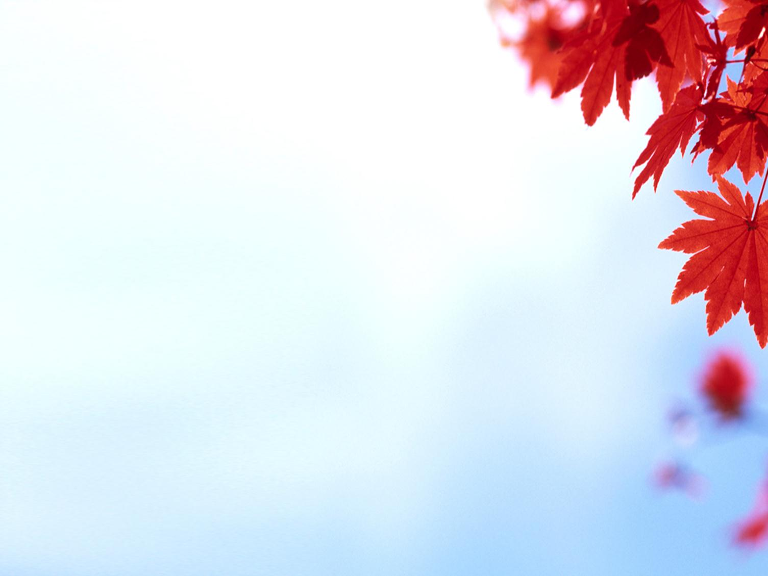
Chapter 3: Cultivating an Attitude of Happiness and a Spirit of Optimism
Be believing.
Be happy.
Don’t get discouraged.
Things will work out.

Slide 2
From the Life of Gordon B. Hinckley
President Gordon B. Hinckley’s mother, Ada Bitner Hinckley, often said that “a happy attitude and smiling countenance could boost one over almost any misfortune and that every individual was responsible for his own happiness.”¹ His father, Bryant S. Hinckley, also had an “inherently positive outlook.”² President Hinckley recalled, “When I was a young man and was prone to speak critically, my father would say: ‘Cynics do not contribute, skeptics do not create, doubters do not achieve.’”³ Influenced by his parents’ counsel and example, young Gordon Hinckley learned to approach life with optimism and faith.

Slide 3
Even when many people are negative and pessimistic, we can cultivate a spirit of happiness and optimism.
There is a terrible ailment of pessimism in the land. It’s almost endemic. We’re constantly fed a steady and sour diet of character assassination, faultfinding, evil speaking of one another. …
I come … with a plea that we stop seeking out the storms and enjoy more fully the sunlight. I’m suggesting that we accentuate the positive. I’m asking that we look a little deeper for the good, that we still our voices of insult and sarcasm, that we more generously compliment virtue and effort.
Why do we need this counsel today?
How can we cultivate an attitude of happiness?

Slide 4
Rather than dwell on our problems, we can let a spirit of thanksgiving guide and bless us.
How magnificently we are blessed! How thankful we ought to be! … Cultivate a spirit of thanksgiving for the blessing of life and for the marvelous gifts and privileges each of us enjoy. The Lord has said that the meek shall inherit the earth. (See Matt. 5:5.) I cannot escape the interpretation that meekness implies a spirit of gratitude as opposed to an attitude of self-sufficiency, an acknowledgment of a greater power beyond oneself, a recognition of God, and an acceptance of his commandments. This is the beginning of wisdom. Walk with gratitude before him who is the giver of life and every good gift
How are you blessed when you have a spirit of thanksgiving?

Slide 5
The gospel of Jesus Christ gives us a reason for gladness.
D&C 25:13
Never forget who you are. … You are in very deed a child of God. … He is your Eternal Father. He loves you. … He wants His sons and daughters to be happy. Sin never was happiness. Transgression never was happiness. Disobedience never was happiness. The way of happiness is found in the plan of our Father in Heaven and in obedience to the commandments of His Beloved Son, the Lord Jesus Christ.
How does the “good news” of the gospel influence the way you approach that journey?

Slide 6
The gospel is a message of triumph to be embraced with enthusiasm, affection, and optimism.
I stand here today as an optimist concerning the work of the Lord. I cannot believe that God has established his work in the earth to have it fail. I cannot believe that it is getting weaker. I know that it is getting stronger. … I have a simple and solemn faith that right will triumph and that truth will prevail.
When the Lord took Moses unto Himself, He then said to Joshua, “Be strong and of a good courage; be not afraid, neither be thou dismayed: for the Lord thy God is with thee whithersoever thou goest” (Josh. 1:9). This is His work. Never forget it. Embrace it with enthusiasm and affection.
What experiences have increased your optimism about the Lord’s work?

Slide 7
With knowledge that we are all children of God, we can stand a little taller, rise a little higher, and be a little better.
There is a sad tendency in our world today for persons to cut one another down. Did you ever realize that it does not take very much in the way of brainpower to make remarks that may wound another? Try the opposite of that. Try handing out compliments. …
These great words of confidence are a beacon to each of us. In him we may indeed have trust. For he and his promises will never fail.

