Slide 1
Chapter 2: An Ensign to the Nations, a Light to the World
“This is a season to be strong. It is a time to move forward without hesitation, knowing well the meaning, the breadth, and the importance of our mission.”

Slide 2
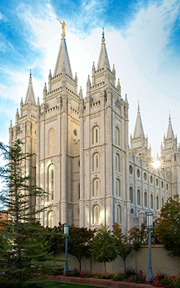
From the Life of Gordon B. Hinckley
“I believe and testify that it is the mission of this Church to stand as an ensign to the nations and a light to the world. We have had placed upon us a great, all-encompassing mandate from which we cannot shrink nor turn aside. We accept that mandate and are determined to fulfill it, and with the help of God we shall do it.”
“It is the mission of this Church to stand as an ensign to the nations and a light to the world.”

Slide 3
Like the stone in Daniel’s vision, the Church is rolling forth to fill the whole earth.
This Church began with the humble prayer of the boy Joseph Smith in the grove of his father’s farm. From that remarkable experience, which we call the First Vision, has grown this work. … It is the very personification of Daniel’s vision of a stone cut out of the mountain without hands rolling forth to fill the whole earth
Daniel 2:44–45
And this is only the beginning. This work will continue to grow and prosper and move across the earth.
what are your feelings as you consider the growth of the Church from 1830 to the present day?

Slide 4
Early Church leaders had a prophetic view of the destiny of the Lord’s work.
I marvel at the foresight of that little group. It was both audacious and bold. It was almost unbelievable. Here they were, almost a thousand miles [1,600 kilometers] from the nearest settlement to the east and almost eight hundred miles [1,300 kilometers] from the Pacific Coast. They were in an untried climate. The soil was different from that of the black loam of Illinois and Iowa, where they had most recently lived. They had never raised a crop here. They had never experienced a winter. They had not built a structure of any kind. These prophets, dressed in old, travel-worn clothes, standing in boots they had worn for more than a thousand miles from Nauvoo to this valley, spoke of a millennial vision. They spoke out of a prophetic view of the marvelous destiny of this cause. They came down from the peak that day and went to work to bring reality to their dream.
How have we benefited from the prophetic vision of early Church leaders?

Slide 5
We must never lose sight of the divine destiny of God’s work and the part we play in it.
Sometimes in our day, as we walk our narrow paths and fill our little niches of responsibility, we lose sight of the grand picture. When I was a small boy, draft horses were common. An important part of the harness was the bridle. On the bridle were blinders, one on each side. They were so placed that the horse could see only straight ahead and not to either side. They were designed to keep him from becoming frightened or distracted and to keep his attention on the road at his feet.
In what ways can our small efforts contribute to the growth of God’s kingdom?

Slide 6
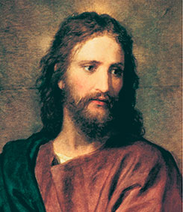
We can become as an ensign to the nations from which the people of the earth may gather strength.
My brethren and sisters, the time has come for us to stand a little taller, to lift our eyes and stretch our minds to a greater comprehension and understanding of the grand millennial mission of this The Church of Jesus Christ of Latter-day Saints. This is a season to be strong.
“If we are to hold up this Church as an ensign to the nations and a light to the world, we must take on more of the luster of the life of Christ.”

