Slide 1
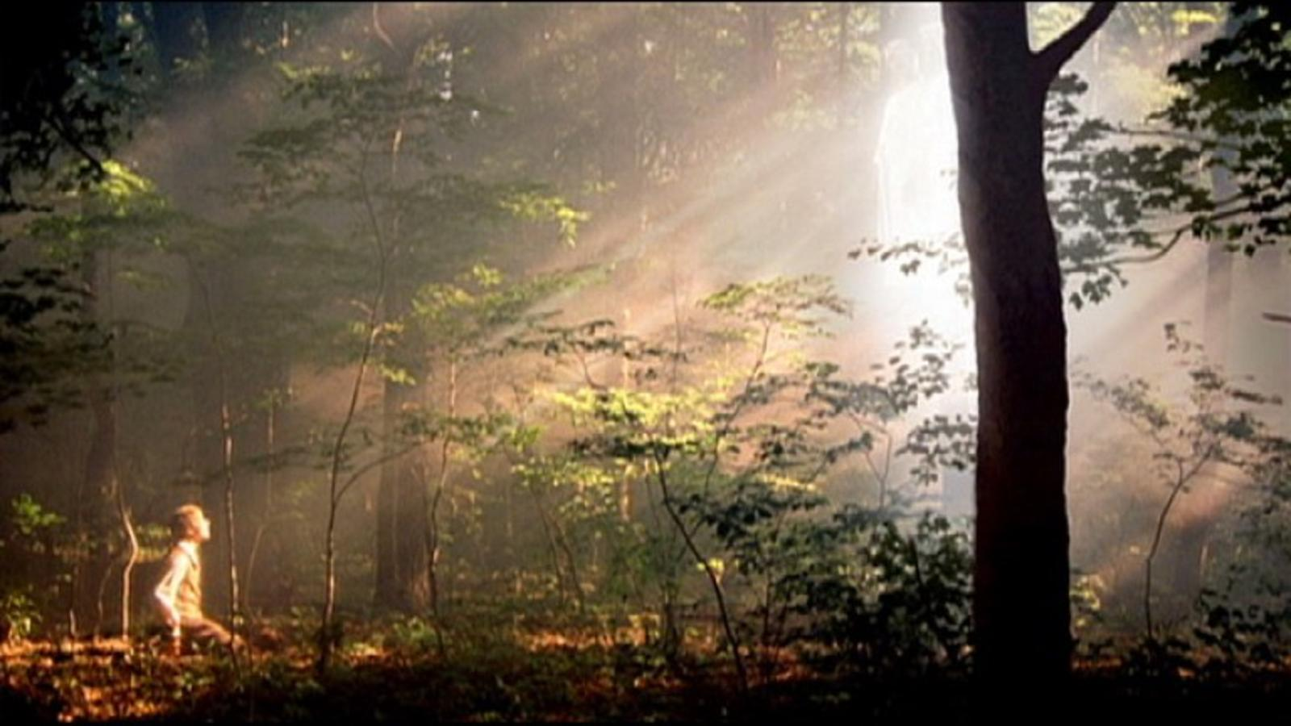
Chapter 1: The Restoration of the Gospel—The Dawning of a Brighter Day
“This glorious gospel was ushered in with the appearance of the Father and the Son to the boy Joseph.”

Slide 2
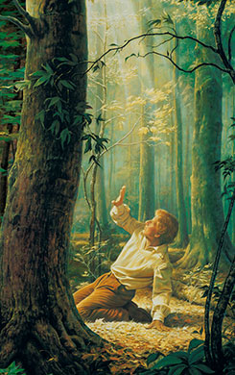
From the Life of Gordon B. Hinckley
Throughout his life, President Gordon B. Hinckley fostered a deep respect for the people and places involved in the restoration of the gospel. He felt special gratitude for Joseph Smith and his role in the Restoration, and he spoke of “an ever-growing compulsion to bear testimony of the divinity of the Lord and of the mission of the Prophet Joseph Smith.”
The First Vision began “the final chapter in the long chronicle of God’s dealing with men and women upon the earth.”

Slide 3
Following the Savior’s death, the Church He had established drifted into apostasy.
[Jesus Christ] was and is the great central figure of human history, the zenith of the times and seasons of all men.
Before His death, He had ordained His Apostles. They carried on for a period. His Church was set in place.³
Following the Savior’s death, the Church He had established drifted into apostasy.
Isaiah 24:5
The first thousand years passed, and the second millennium dawned. Its earlier centuries were a continuation of the former. It was a time fraught with fear and suffering
Why did the people of the world need the Church and gospel of Jesus Christ to be restored?

Slide 4
The Renaissance and Reformation helped prepare the way for the restoration of the gospel.
Somehow, in that long season of darkness, a candle was lighted. The age of Renaissance brought with it a flowering of learning, art, and science. There came a movement of bold and courageous men and women who looked heavenward in acknowledgment of God and His divine Son. We speak of it as the Reformation.
Daniel 2:35, 44
What are some ways the Lord prepared the way for the restoration of the gospel?

Slide 5
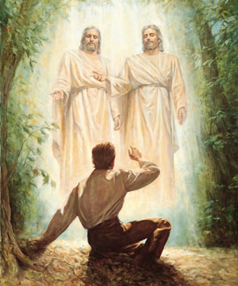
The Restoration was ushered in with the appearance of the Father and the Son to Joseph Smith.
After many generations had walked the earth—so many of them in conflict, hatred, darkness, and evil—there arrived the great, new day of the Restoration. This glorious gospel was ushered in with the appearance of the Father and the Son to the boy Joseph.

Slide 6
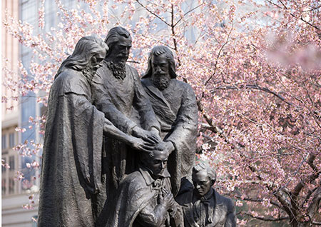
Priesthood authority and keys were restored.
The authority and keys of the Melchizedek Priesthood were restored to the earth as part of the Restoration.
In restoring the Aaronic Priesthood, the resurrected John the Baptist laid his hands on the heads of Joseph Smith and Oliver Cowdery.
D&C 13:1
Why was it necessary that the priesthood be restored by heavenly messengers?

Slide 7
Through Joseph Smith, the Lord revealed truths that distinguish us from other churches.
The Godhead
The Book of Mormon as a companion witness with the Bible
Priesthood authority and Church organization
The family
The innocence of little children
Salvation for the dead
The nature, purpose, and potential of God’s children
Modern revelation

