Slide 1
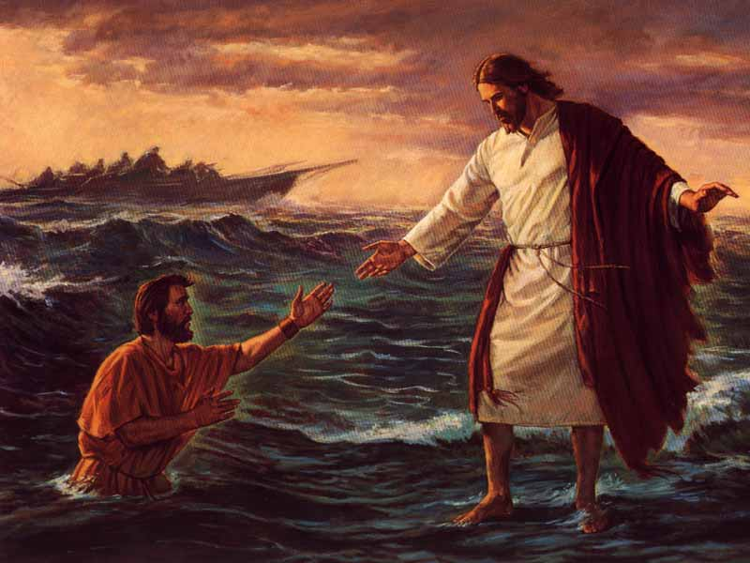
Chapter 18: Faith in Jesus Christ.

Slide 2
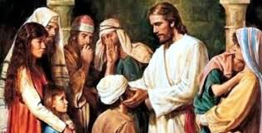
What Is Faith?
Faith in the Lord Jesus Christ is the first principle of the gospel. It is a spiritual gift, and it is necessary to our salvation. King Benjamin declared, “Salvation cometh to none … except it be through repentance and faith on the Lord Jesus Christ” (Mosiah 3:12).

Slide 3
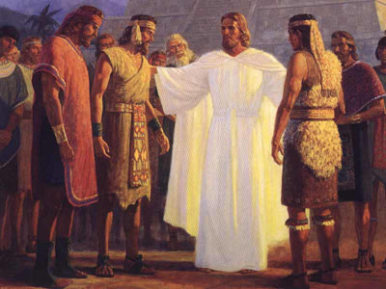
Why Should We Have Faith in Jesus Christ?
To have faith in Jesus Christ means to have such trust in Him that we obey whatever He commands. As we place our faith in Jesus Christ, becoming His obedient disciples, Heavenly Father will forgive our sins and prepare us to return to Him.

Slide 4
How Can We Increase Our Faith in Jesus Christ?
Knowing of the many blessings that come through exercising faith in Jesus Christ, we should seek to increase our faith in Him. The Savior said, “If ye have faith as a grain of mustard seed, … nothing shall be impossible unto you” (Matthew 17:20).

Slide 5
What Are Some Blessings That Follow Faith?
Through the gift of faith, miracles are wrought, angels appear, other gifts of the Spirit are given, prayers are answered, and men become the sons of God (seeMoroni 7:25–26, 36–37).
“When faith comes it brings … apostles, prophets, evangelists, pastors, teachers, gifts, wisdom, knowledge, miracles, healings, tongues, interpretation of tongues, etc.

