Slide 1
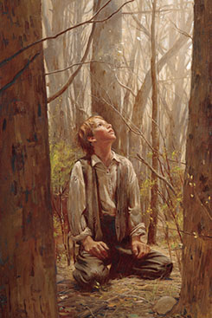
Chapter 17: The Church of Jesus Christ Today.

Slide 2
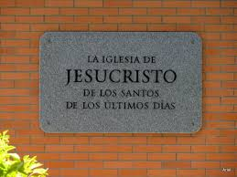
The Church of Jesus Christ Was Taken from the Earth.
When Jesus lived on the earth, He established His Church, the only true Church. He organized His Church so the truths of the gospel could be taught to all people and the ordinances of the gospel could be administered correctly with authority. Through this organization, Christ could bring the blessings of salvation to mankind.

Slide 3
The Lord Promised to Restore His True Church.
The Savior promised to restore His Church in the latter days. He said, “I will proceed to do a marvellous work among this people, even a marvellous work and a wonder” (Isaiah 29:14).

Slide 4
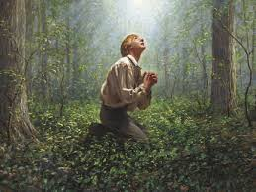
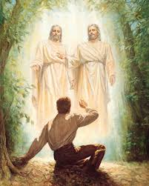
New Revelation from God.
In the spring of 1820, one of the most important events in the history of the world occurred. The time had come for the marvelous work and wonder of which the Lord had spoken. As a young boy, Joseph Smith wanted to know which of all the churches was the true Church of Jesus Christ.

Slide 5
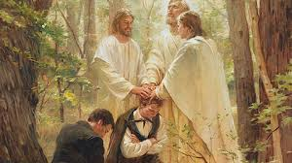
Authority from God Was Restored.
In restoring the gospel, God again gave the priesthood to men. John the Baptist came in 1829 to confer the Aaronic Priesthood on Joseph Smith and Oliver Cowdery (see D&C 13; 27:8).

Slide 6
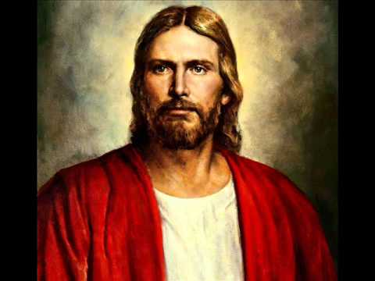
Christ’s Church Was Organized Again.
On April 6, 1830, the Savior again directed the organizing of His Church on the earth (see D&C 20:1). His Church is called The Church of Jesus Christ of Latter-day Saints (see D&C 115:4). Christ is the head of His Church today, just as He was in ancient times.

Slide 7
Important Truths Were Restored.
The Church today teaches the same principles and performs the same ordinances as were performed in the days of Jesus. The first principles and ordinances of the gospel are faith in the Lord Jesus Christ, repentance, baptism by immersion, and the laying on of hands for the gift of the Holy Ghost.

Slide 8
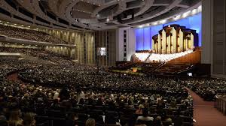
The Church of Jesus Christ Will Never Be Destroyed.
Since its restoration in 1830, The Church of Jesus Christ of Latter-day Saints has grown rapidly in membership. There are members in nearly every country in the world. The Church will continue to grow. As Christ said, “This Gospel of the Kingdom shall be preached in all the world, for a witness unto all nations” (Joseph Smith—Matthew 1:31).

