Slide 1
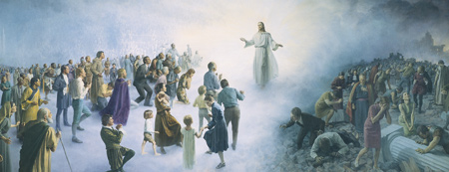
Chapter 46: The Final Judgment

Slide 2
Judgments of God
What are some different judgments that come before the Final Judgment? How do all these judgments relate to one another?
We need to understand how judgment takes place so we can be better prepared for this important event.
The scriptures teach that all of us will be judged according to our works: “And I saw the dead, small and great, stand before God; and the books were opened: and another book was opened, which is the book of life: and the dead were judged out of those things which were written in the books, according to their works”

Slide 3
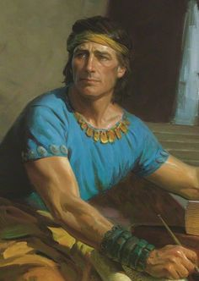
Our Words, Works, and Thoughts Are Used to Judge Us
Imagine being judged for all your thoughts, words, and actions.
The prophet Alma testified, “Our words will condemn us, yea, all our works will condemn us; … and our thoughts will also condemn us”

Slide 4
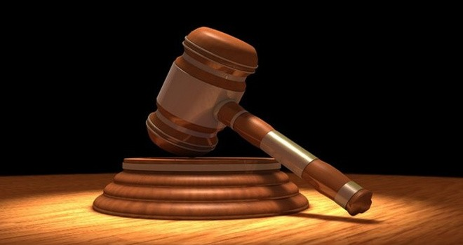
We Will Be Judged by Records
From what records will we be judged? Who will judge us?
The Prophet Joseph Smith said that the dead will be judged out of records kept on earth. We will also be judged out of the “book of life,” which is kept in heaven (see D&C 128:6–8).
“Every one of you … must stand before ‘the judgment-seat of the Holy One of Israel … and then must … be judged according to the holy judgment of God.

Slide 5
Stored in our body and mind is a complete history of everything we have done. President John Taylor taught this truth: “[The individual] tells the story himself, and bears witness against himself. … That record that is written by the man himself in the tablets of his own mind, that record that cannot lie will in that day be unfolded before God and angels, and those who shall sit as judges”
The Apostle John taught that “the Father judgeth no man, but hath committed all judgment unto the Son” (John 5:22). The Son, in turn, will call upon others to assist in the Judgment.

Slide 6
Inheriting a Place in a Kingdom of Glory
How will our faithfulness during our life on earth influence our life in the eternities?
At the Final Judgment we will inherit a place in the kingdom for which we are prepared. The scriptures teach of three kingdoms of glory—the celestial kingdom, the terrestrial kingdom, and the telestial kingdom.
The following are the kinds of lives we can choose to live and the kingdoms our choices will obtain for us.

Slide 7
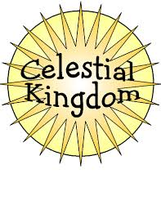
Celestial
“They are they who received the testimony of Jesus, and believed on his name and were baptized, … that by keeping the commandments they might be washed and cleansed from all their sins, and receive the Holy Spirit.” These are they who overcome the world by their faith.

Slide 8
Terrestrial
These are they who rejected the gospel on earth but afterward received it in the spirit world. These are the honorable people on the earth who were blinded to the gospel of Jesus Christ by the craftiness of men. These are also they who received the gospel and a testimony of Jesus but then were not valiant. They will be visited by Jesus Christ but not by our Heavenly Father.

Slide 9
Telestial
These people did not receive the gospel or the testimony of Jesus either on earth or in the spirit world. They will suffer for their own sins in hell until after the Millennium, when they will be resurrected. “These are they who are liars, and sorcerers, and adulterers, and whoremongers, and whosoever loves and makes a lie.” These people are as numerous as the stars in heaven and the sand on the seashore. They will be visited by the Holy Ghost but not by the Father or the Son.

Slide 10
Outer Darkness
These are they who had testimonies of Jesus through the Holy Ghost and knew the power of the Lord but allowed Satan to overcome them. They denied the truth and defied the power of the Lord. There is no forgiveness for them, for they denied the Holy Spirit after having received it.

Slide 11
We Should Prepare Now for Judgment
What must we do to be ready for the Final Judgment?
In reality, every day is a day of judgment. We speak, think, and act according to celestial, terrestrial, or telestial law. Our faith in Jesus Christ, as shown by our daily actions, determines which kingdom we will inherit.
We have the restored gospel of Jesus Christ in its fulness. The gospel is the law of the celestial kingdom. All the priesthood ordinances necessary for our progression have been revealed.

