Slide 1
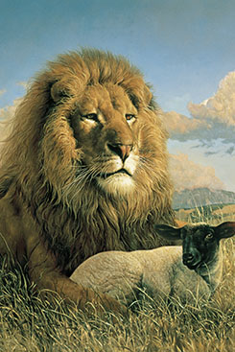
Chapter 45: The Millennium

Slide 2
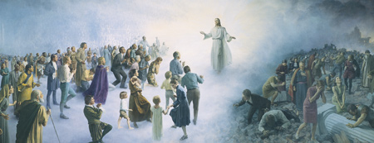
People on the Earth during the Millennium
Who will be on the earth during the Millennium?
A thousand years of peace, love, and joy will begin on the earth at the Second Coming of Jesus Christ. This thousand-year period is called the Millennium. The scriptures and the prophets help us understand what it will be like to live on the earth during the Millennium.

Slide 3
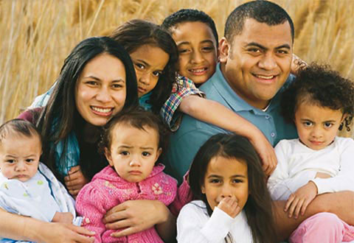
During the Millennium, mortals will still live on earth, and they will continue to have children as we do now Joseph Smith said that immortal beings will frequently visit the earth. These resurrected beings will help with the government and other work.

Slide 4
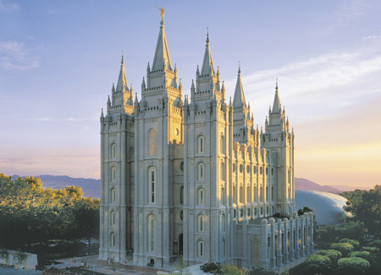
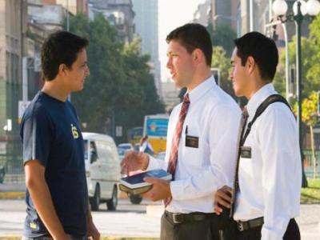
The Work of the Church during the Millennium
What are the two great works that will be done during the Millennium?
There will be two great works for members of the Church during the Millennium: temple work and missionary work.

Slide 5
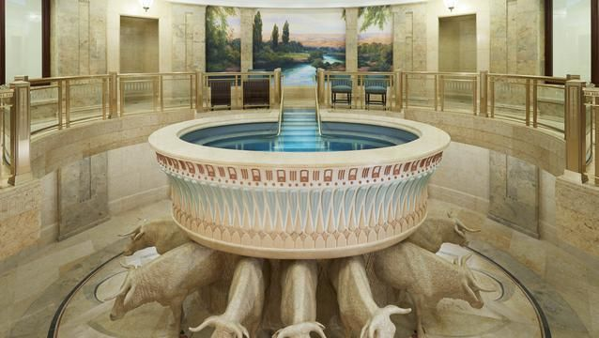
Temple work involves the ordinances that are necessary for exaltation. These include baptism, the laying on of hands for the gift of the Holy Ghost, and the temple ordinances—the endowment, temple marriage, and the sealing together of family units.
Many people have died without receiving these ordinances. People on the earth must perform these ordinances for them. This work is now being done in the temples of the Lord.

Slide 6
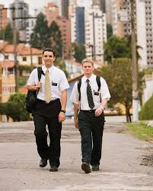
The other great work during the Millennium will be missionary work. The gospel will be taught with great power to all people. Eventually there will be no need to teach others the first principles of the gospel because “they shall all know me, from the least of them unto the greatest of them, saith the Lord”

Slide 7
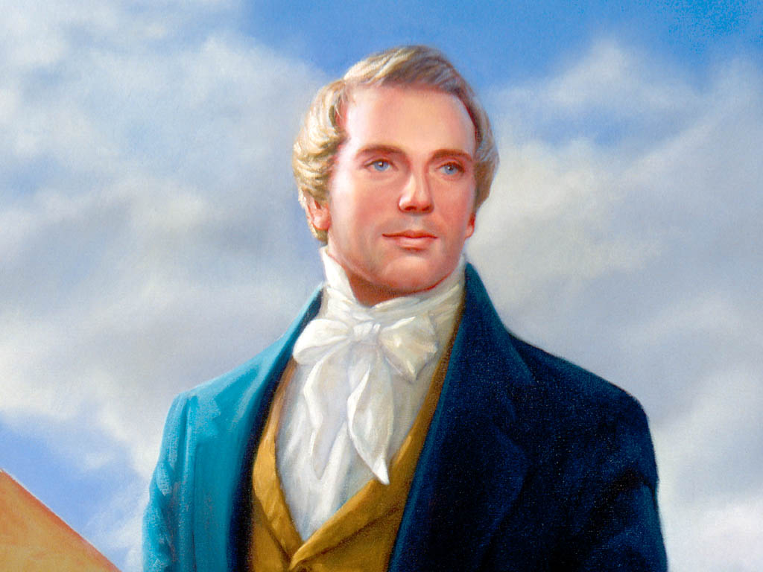
Conditions during the Millennium
In what ways will life during the Millennium be different from life on the earth now?
The Prophet Joseph Smith taught that during the Millennium, “the earth will be renewed and receive its paradisiacal glory”

Slide 8
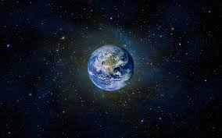
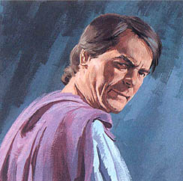
Satan Bound
During the Millennium, Satan will be bound. This means he will not have power to tempt those who are living at that time
Peace on the Earth
During the Millennium, there will be no war. People will live in peace and harmony together. Things that have been used for war will be turned to useful purposes.

Slide 9
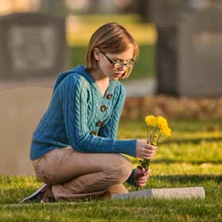
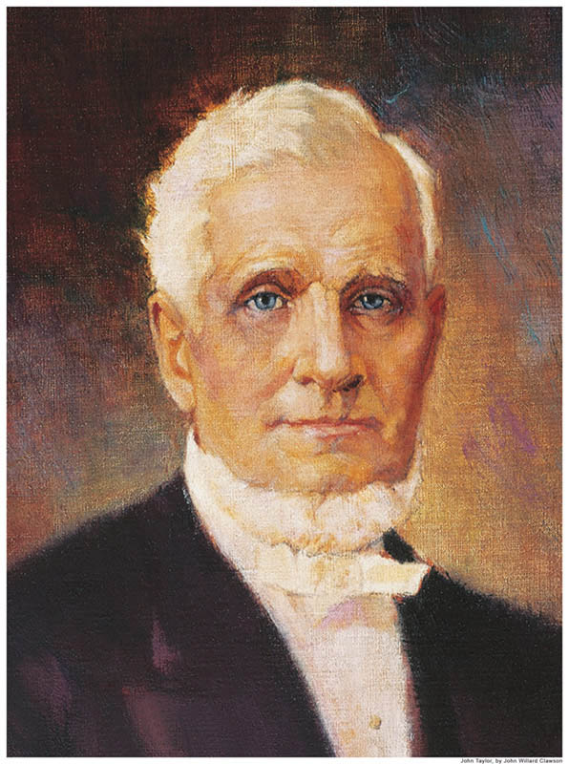
Righteous Government
President John Taylor taught: “The Lord will be king over all the earth, and all mankind literally under his sovereignty, and every nation under the heavens will have to acknowledge his authority, and bow to his scepter.
No Death
During the Millennium, there will be no death as we know it. When people have lived to an old age, they will not die and be buried.

Slide 10
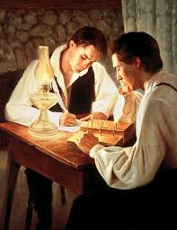
All Things Revealed
Some truths have not been revealed to us. All things will be revealed during the Millennium.
Other Millennial Activities
In many ways, life will be much as it is now, except that everything will be done in righteousness. People will eat and drink and will wear clothing.

Slide 11
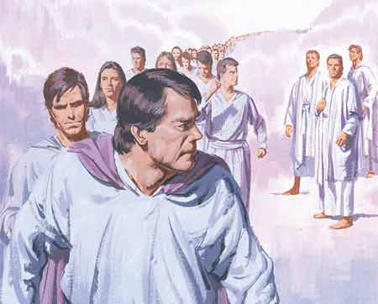
One Final Struggle after the Millennium
What will be the final destiny of the earth?
At the end of the 1,000 years, Satan will be set free for a short time. Some people will turn away from Heavenly Father. Satan will gather his armies, and Michael (Adam) will gather the hosts of heaven. In this great struggle, Satan and his followers will be cast out forever.

