Slide 1
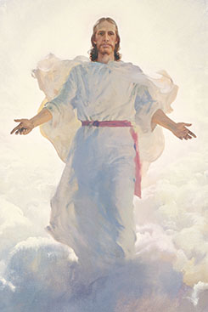
Chapter 44: The Second Coming of Jesus Christ

Slide 2
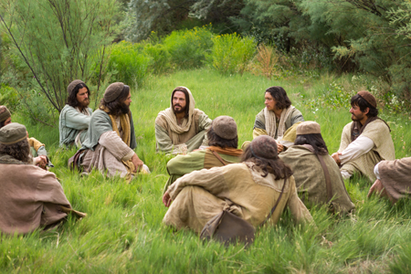
Looking forward to the Savior’s Second Coming
Forty days after His Resurrection, Jesus and His Apostles were gathered together on the Mount of Olives. The time had come for Jesus to leave the earth. He had completed all the work that He had to do at that time. He was to return to our Heavenly Father until the time of His Second Coming.

Slide 3
What Will Jesus Do When He Comes Again?
1. He will cleanse the earth. When Jesus comes again, He will come in power and great glory. At that time the wicked will be destroyed.
2. He will judge His people. When Jesus comes again, He will judge the nations and will divide the righteous from the wicked
3. He will usher in the Millennium. The Millennium is the thousand-year period when Jesus will reign on the earth. The righteous will be caught up to meet Jesus at His coming

Slide 4
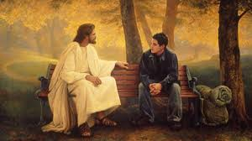
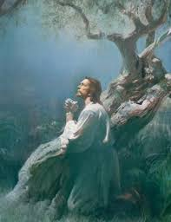

Slide 5
4. He will complete the First Resurrection. Those who have obtained the privilege of coming forth in the resurrection of the just will rise from their graves. They will be caught up to meet the Savior as He comes down from heaven.
5. He will take His rightful place as King of heaven and earth. When Jesus comes, He will establish His government on the earth. The Church will become part of that kingdom. He will rule all the people of the earth in peace for 1,000 years.
When Jesus Christ first came to the earth, He did not come in glory. He was born in a lowly stable and laid in a manger of hay. He did not come with great armies as the Jews had expected of their Savior.

Slide 6
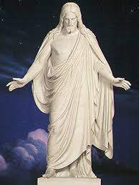

Slide 7
How Will We Know When the Savior’s Coming Is Near?
No one knows the exact time that the Savior will come again. “Of that day and hour knoweth no man, no, not the angels of heaven, but my Father only”
The Lord used a parable to give us an idea of the time of His coming.
The Lord has also given us some signs to let us know when His coming is near. After revealing the signs, He cautioned

Slide 8
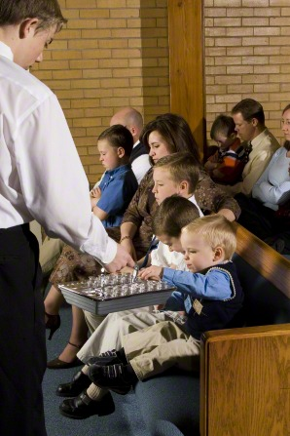
How Can We Be Ready When the Savior Comes?
The best way we can prepare for the Savior’s coming is to accept the teachings of the gospel and make them part of our lives. We should live each day the best we can, just as Jesus taught when He was on the earth. We can look to the prophet for guidance and follow his counsel. We can live worthy to have the Holy Ghost guide us.

