Slide 1
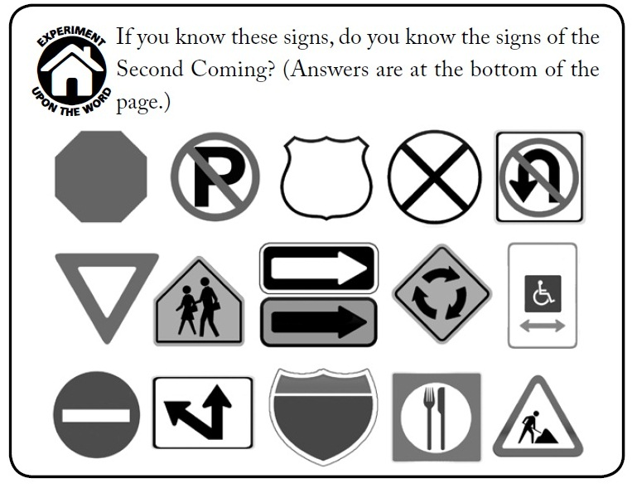
Chapter 43: Signs of the Second Coming

Slide 2
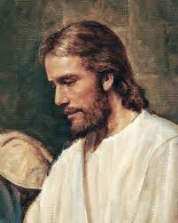
Jesus Christ Will Return to the Earth
What are some of the signs of the Second Coming?
The Savior told Joseph Smith, “I will reveal myself from heaven with power and great glory … and dwell in righteousness with men on earth a thousand years, and the wicked shall not stand” (D&C 29:11; see also chapters 44 and 45 in this book). Jesus has told us that certain signs and events will warn us when the time of His Second Coming is near.

Slide 3
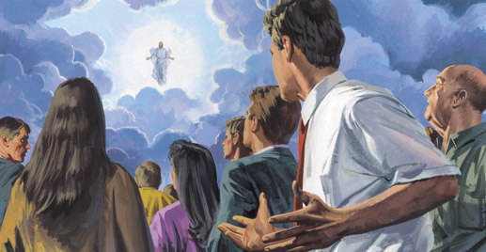
For thousands of years, followers of Jesus Christ have looked forward to the Second Coming as a time of peace and joy. But before the Savior comes, the people of the earth will experience great trials and calamities. Our Heavenly Father wants us to be prepared for these troubles. He also expects us to be spiritually ready when the Savior comes in His glory.

Slide 4
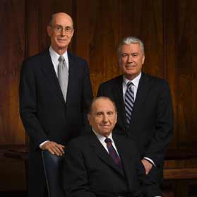
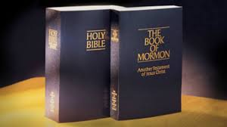
Throughout the ages God has revealed these signs to His prophets. He has said that all faithful followers of Christ will know what the signs are and will be watching for them (see D&C 45:39). If we are obedient and faithful, we will study the scriptures and know of the signs.

Slide 5
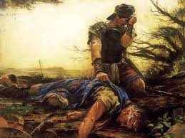
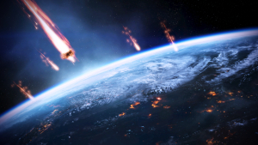
Wickedness, War, and Turmoil
Many of the signs are terrifying and dreadful. The prophets have warned that the earth will experience great turmoil, wickedness, war, and suffering. The prophet Daniel said that the time before the Second Coming would be a time of trouble such as the earth has never known

Slide 6
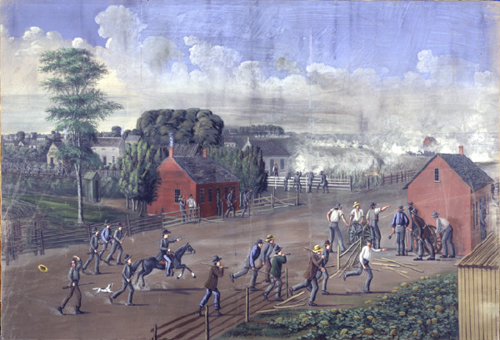
Many of these signs are being fulfilled. Wickedness is everywhere. Nations are constantly at war. Earthquakes and other calamities are occurring. Many people now suffer from devastating storms, drought, hunger, and diseases. We can be certain that these calamities will become more severe before the Lord comes.
However, not all the events preceding the Second Coming are dreadful. Many of them bring joy to the world.

Slide 7
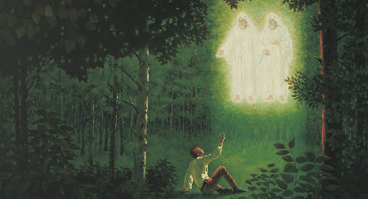
The Restoration of the Gospel
The Lord said, “Light shall break forth among them that sit in darkness, and it shall be the fulness of my gospel” (D&C 45:28). Prophets of old foretold the Restoration of the gospel. The Apostle John saw that the gospel would be restored by an angel (see Revelation 14:6–7). In fulfillment of this prophecy, the angel Moroni and other heavenly visitors brought the gospel of Jesus Christ to Joseph Smith.

Slide 8
The Coming Forth of the Book of Mormon
The Lord told the Nephites of another sign: the Book of Mormon would come to their descendants (see 3 Nephi 21). In Old Testament times the prophets Isaiah and Ezekiel foresaw the coming of the Book of Mormon (see Isaiah 29:4–18; Ezekiel 37:16–20). These prophecies are now being fulfilled. The Book of Mormon has been brought forth and is being taken to all the world.

Slide 9
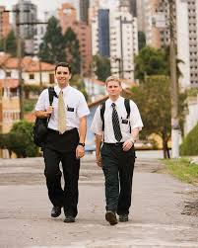
The Gospel Preached to All the World
Another sign of the last days is that the “gospel of the kingdom shall be preached in all the world for a witness unto all nations” (Matthew 24:14; see also Joseph Smith—Matthew 1:31). All people will hear the fulness of the gospel in their own language (see D&C 90:11). Ever since the Restoration of the Church, missionaries have preached the gospel.

Slide 10
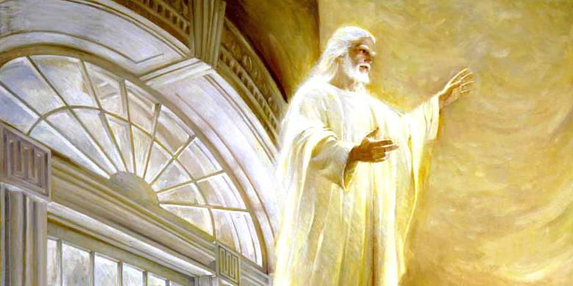
The Coming of Elijah
The prophet Malachi prophesied that before the Savior’s Second Coming, the prophet Elijah would be sent to the earth. Elijah would restore the sealing powers so families could be sealed together. He would also inspire people to be concerned about their ancestors and descendants.

Slide 11
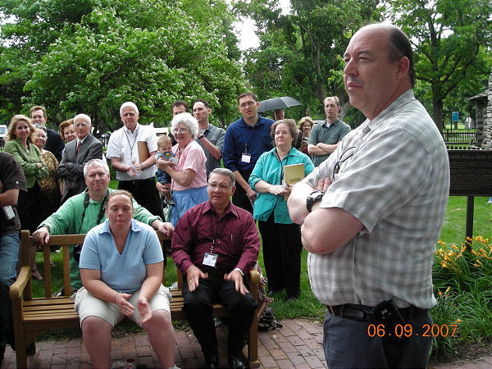
Lehi’s Descendants Will Become a Great People
The Lord said that when His coming was near, the Lamanites would become a righteous and respected people. He said, “Before the great day of the Lord shall come, … the Lamanites shall blossom as the rose” (D&C 49:24). Great numbers of Lehi’s descendants are now receiving the blessings of the gospel.

Slide 12
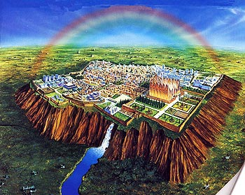
Building of the New Jerusalem
Near the time of the coming of Jesus Christ, the faithful Saints will build a righteous city, a city of God, called the New Jerusalem. Jesus Christ Himself will rule there. The Lord said the city will be built in the state of Missouri in the United States (see D&C 84:2–3).

Slide 13
Knowing the Signs of the Times Can Help Us
The Lord gives these signs to help us. We can put our lives in order and prepare ourselves and our families for those things yet to come.
We have been warned of calamities and told to prepare for them, but we can also look forward to the coming of the Savior and be glad. The Lord said, “Be not troubled, for, when all these things [the signs] shall come to pass, ye may know that the promises which have been made unto you shall be fulfilled”

Slide 14
