Slide 1
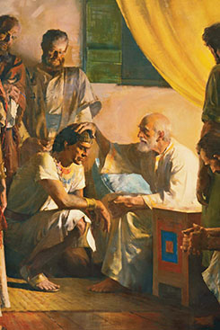
Chapter 42: The Gathering of the House of Israel

Slide 2
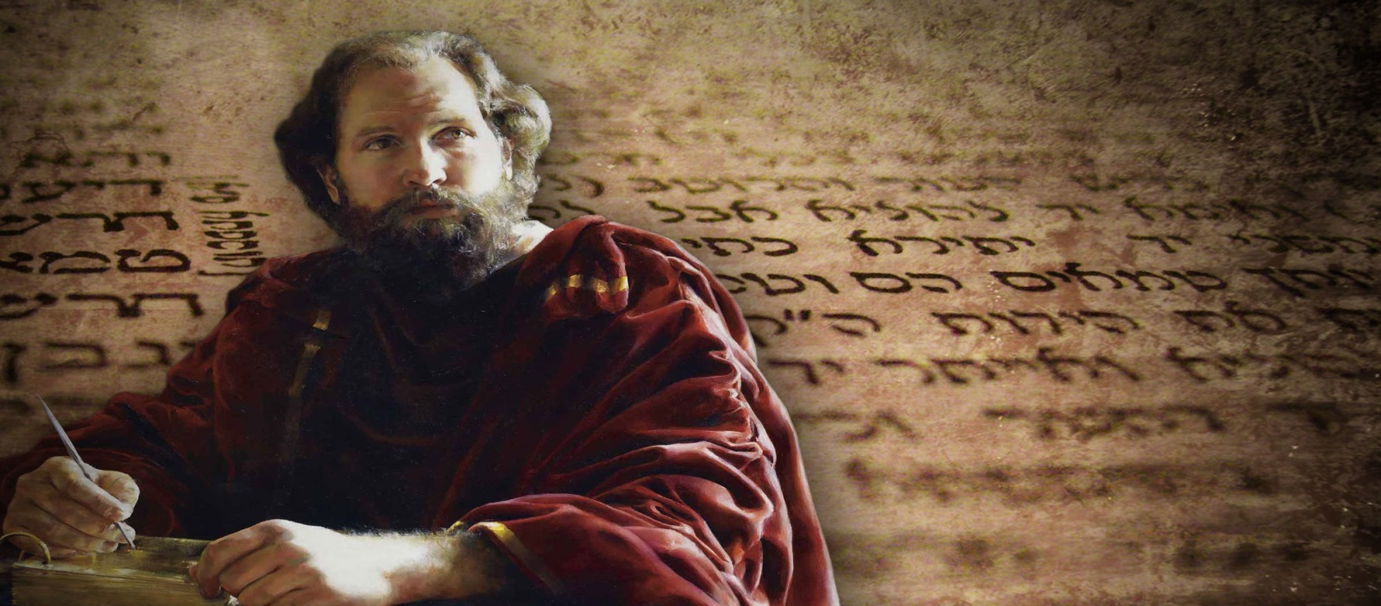
The House of Israel Are God’s Covenant People
What responsibilities do God’s covenant people have to the nations of the world?
Jacob was a great prophet who lived hundreds of years before the time of Christ. Because Jacob was faithful, the Lord gave him the special name of Israel, which means “one who prevails with God” or “let God prevail”

Slide 3
The House of Israel Was Scattered
Again and again prophets of the Lord warned the house of Israel what would happen if they were wicked. Moses prophesied, “And the Lord shall scatter thee among all people, from the one end of the earth even unto the other” (Deuteronomy 28:64).
Despite this warning, the Israelites consistently broke the commandments of God. They fought among themselves and split into two kingdoms: the Northern Kingdom, called the kingdom of Israel, and the Southern Kingdom, called the kingdom of Judah.

Slide 4
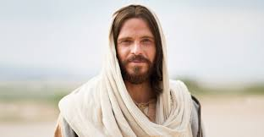
The House of Israel Must Be Gathered
Why does the Lord want His people to be gathered?
How will the house of Israel be gathered?
The Lord promised that His covenant people would someday be gathered: “I will gather the remnant of my flock out of all countries whither I have driven them”

Slide 5
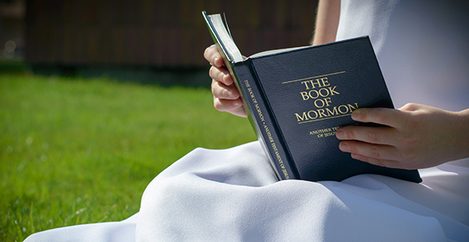
God gathers His children through missionary work. As people come to a knowledge of Jesus Christ, receiving the ordinances of salvation and keeping the associated covenants, they become “the children of the covenant” (3 Nephi 20:26). He has important reasons for gathering His children. He gathers them so they can learn the teachings of the gospel and prepare themselves to meet the Savior when He comes again.

Slide 6
The power and authority to direct the work of gathering the house of Israel was given to Joseph Smith by the prophet Moses, who appeared in 1836 in the Kirtland Temple (see D&C 110:11).
The Israelites are to be gathered spiritually first and then physically. They are gathered spiritually as they join The Church of Jesus Christ of Latter-day Saints and make and keep sacred covenants. This spiritual gathering began during the time of the Prophet Joseph Smith and continues today all over the world.

Slide 7
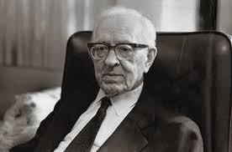
President Joseph Fielding Smith said: “There are many nations represented in the … Church. … They have come because the Spirit of the Lord rested upon them

Slide 8
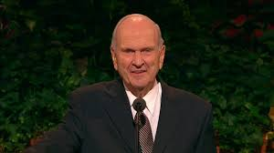
When the Church was first established, the Saints were instructed to gather in Ohio, then Missouri, and then the Salt Lake Valley. Today, however, modern prophets have taught that Church members are to build up the kingdom of God in their own lands. Elder Russell M. Nelson said: “The choice to come unto Christ is not a matter of physical location; it is a matter of individual commitment. People can be ‘brought to the knowledge of the Lord’ [3 Nephi 20:13] without leaving their homelands.

Slide 9
“But, The Lord liveth, that brought up the children of Israel from the land of the north, and from all the lands whither he had driven them: and I will bring them again into their land that I gave unto their fathers” (Jeremiah 16:14–15).
In what ways have you been gathered spiritually as one of the Lord’s covenant people?

Slide 10
