Slide 1
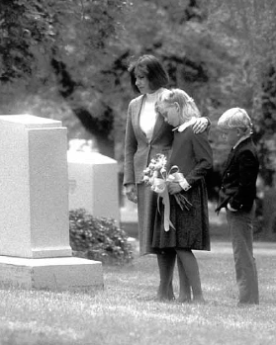
Chapter 41: The Postmortal Spirit World

Slide 2
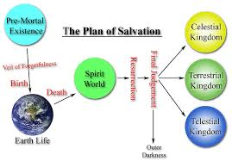
Life after Death
What happens to us after we die?
Heavenly Father prepared a plan for our salvation. As part of this plan, He sent us from His presence to live on earth and receive mortal bodies of flesh and blood. Eventually our mortal bodies will die, and our spirits will go to the spirit world. The spirit world is a place of waiting, working, learning, and, for the righteous, resting from care and sorrow.

Slide 3
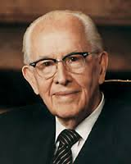
Where Is the Postmortal Spirit World?
Latter-day prophets have said that the spirits of those who have died are not far from us. President Ezra Taft Benson said: “Sometimes the veil between this life and the life beyond becomes very thin. Our loved ones who have passed on are not far from us” (in Conference Report, Apr. 1971, 18; or Ensign, June 1971, 33).

Slide 4
What Is the Nature of Our Spirits?
Spirit beings have the same bodily form as mortals except that the spirit body is in perfect form (see Ether 3:16). Spirits carry with them from earth their attitudes of devotion or antagonism toward things of righteousness (see Alma 34:34). They have the same appetites and desires that they had when they lived on earth. All spirits are in adult form. They were adults before their mortal existence, and they are in adult form after death, even if they die as infants or children

Slide 5
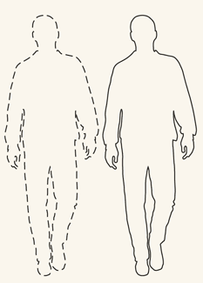

Slide 6
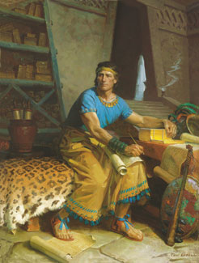
What Are the Conditions in the Postmortal Spirit World?
The prophet Alma in the Book of Mormon taught about two divisions or states in the spirit world:

Slide 7
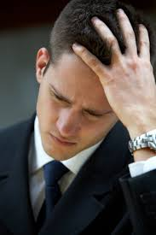
“And then shall it come to pass, that the spirits of the wicked, yea, who are evil—for behold, they have no part nor portion of the Spirit of the Lord; for behold, they chose evil works rather than good
“The spirits of those who are righteous are received into a state of happiness, which is called paradise, a state of rest, a state of peace, where they shall rest from all their troubles and from all care, and sorrow.

Slide 8
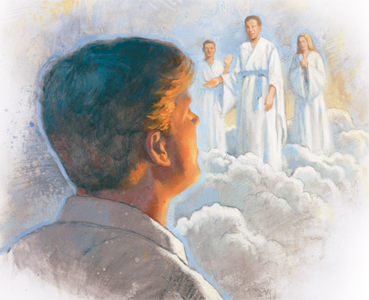
The spirits are classified according to the purity of their lives and their obedience to the will of the Lord while on earth. The righteous and the wicked are separated (see 1 Nephi 15:28–30), but the spirits may progress as they learn gospel principles and live in accordance with them. The spirits in paradise can teach the spirits in prison (see D&C 138).

Slide 9
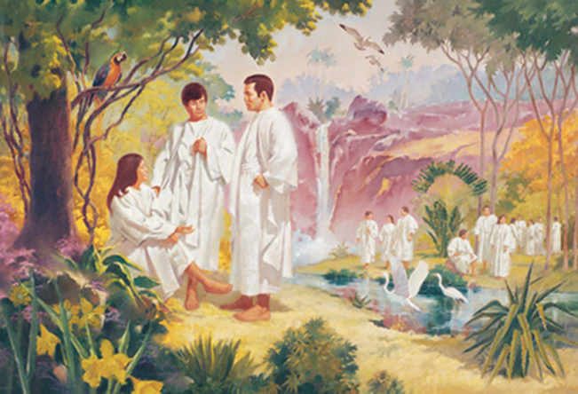
Paradise
According to the prophet Alma, the righteous spirits rest from earthly care and sorrow. Nevertheless, they are occupied in doing the work of the Lord. President Joseph F. Smith saw in a vision that immediately after Jesus Christ was crucified, He visited the righteous in the spirit world.

Slide 10
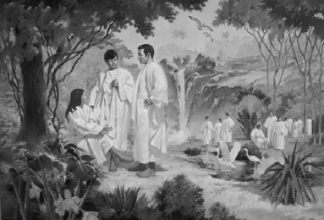
Spirit Prison
The Apostle Peter referred to the Postmortal spirit world as a prison, which it is for some (see 1 Peter 3:18–20). In the spirit prison are the spirits of those who have not yet received the gospel of Jesus Christ. These spirits have agency and may be enticed by both good and evil. If they accept the gospel and the ordinances performed for them in the temples, they may leave the spirit prison and dwell in paradise.

Slide 11
How are conditions in the spirit world similar to conditions in this life?

